Slide 1
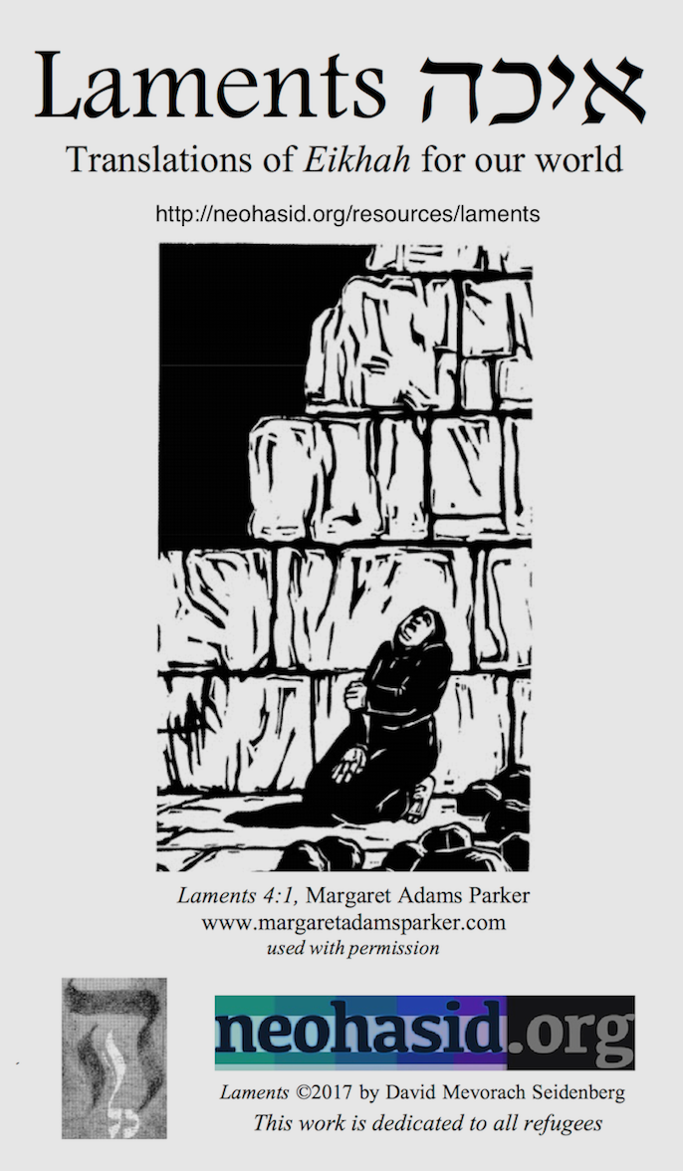
Tisha B’Av is not primarily about the Temple – Chaza”l, the rabbis, figured out how to live without the Temple long ago. Rather, Tisha B’Av is about homelessness, fleeing from war into famine, being thrown into a hostile world without shelter or protection – things all too present in our world. It’s an opportunity empathize, to confront the ways we abuse our power, as individuals, as a society, as a people, and as a species, turning other people, and other species, into refugees.
Last year, Tisha B’Av was especially weighty. So many continue to suffer the loss of community, wealth, and mental well-being. As the world struggles to face the plagues of racism and the pandemic, both plagues make each other worse. There is hope in the U.S., with a government that isn’t putting refugees in detention camps and that acknowledges systemic racism. At the same time, Jews we face growing anti-Semitism, along with pressure from some on the left to say that anti-Semitism isn’t so important. And climate cataclysm comes ever closer. We remain in difficult times.
New this year from neohasid: Use the Omer Counter app to count the seven weeks and Sefirot between Tisha B’Av and Rosh Hashanah. Go to: neohasid.org/omer/apps/. See slides at the end for more reflections on Tisha B’Av. Add your own slides to include contemporary readings.

Slide 2
Note: please display previous slide as people prepare to read Eikhah-Laments.
On Gender: As a somewhat literal translation of a book that is highly gendered, Laments uses “He” and “His” as pronouns for God. But Torah and common sense command us not to make an exclusively male or female image of God. If you are using Laments liturgically, please feel encouraged to change these pronouns, for example by saying God/God’s or the One, or She/Her. For brief essays on the theology of Eikhah, refugees, the Earth, and more, see the end slides.
This translation of Laments, the book of mourning poems read on Tish’a B’Av, is inspired by the principles of the Buber-Rosenzweig Bible. It strives to be “concordant”, translating related Hebrew words with related English words and following the order and syntax of the Hebrew where possible. It also focuses on the more physical, earthy meaning of words, in hopes of drawing the modern reader into more ancient ways of seeing and feeling. Sometimes alternate translations are given, indicated by a slash. When reading aloud, simply pick one of the translations. For YHVH, you can read Adonai or Hashem or “the Eternal”.
Read sections from Rabbi Seidenberg’s groundbreaking book, Kabbalah and Ecology: God’s Image in the More-Than- Human World (Cambridge U., 2015) at kabbalahandecology.com. Find more Tisha B’Av resources, songs, and teachings online at: theshalomcenter.org/node/1733 and neohasid.org/zman/tisha_bav/.

Slide 3
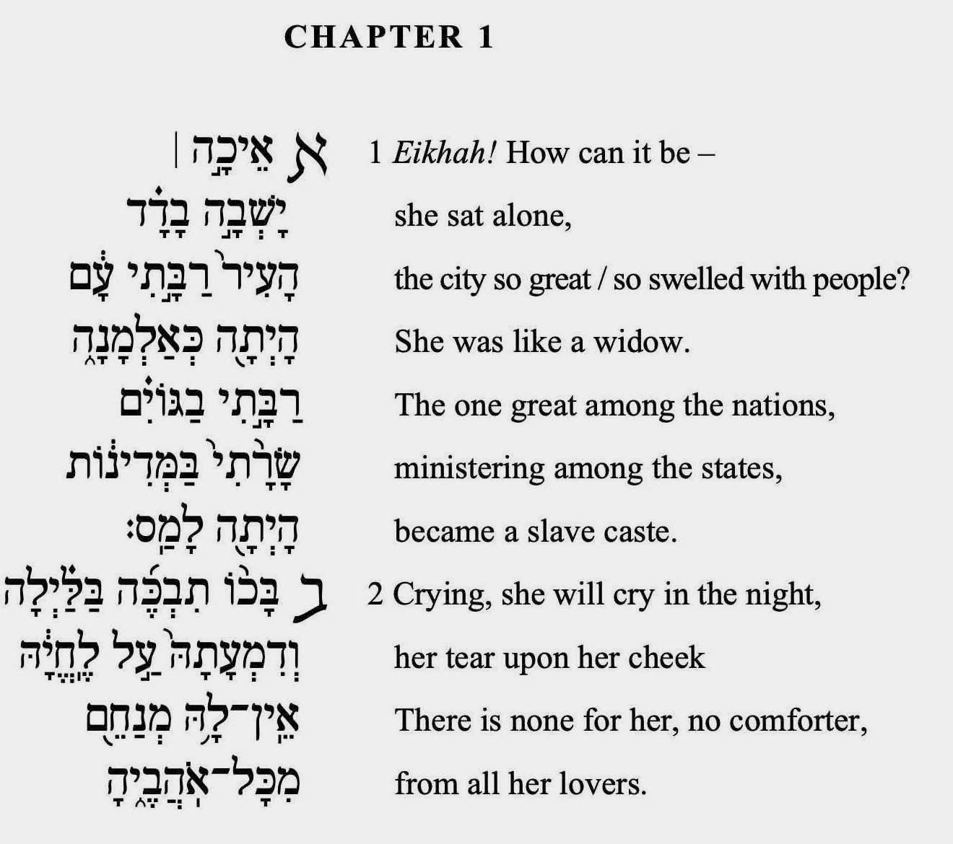
Note: Occasional page numbers correspond to the print version

Slide 4
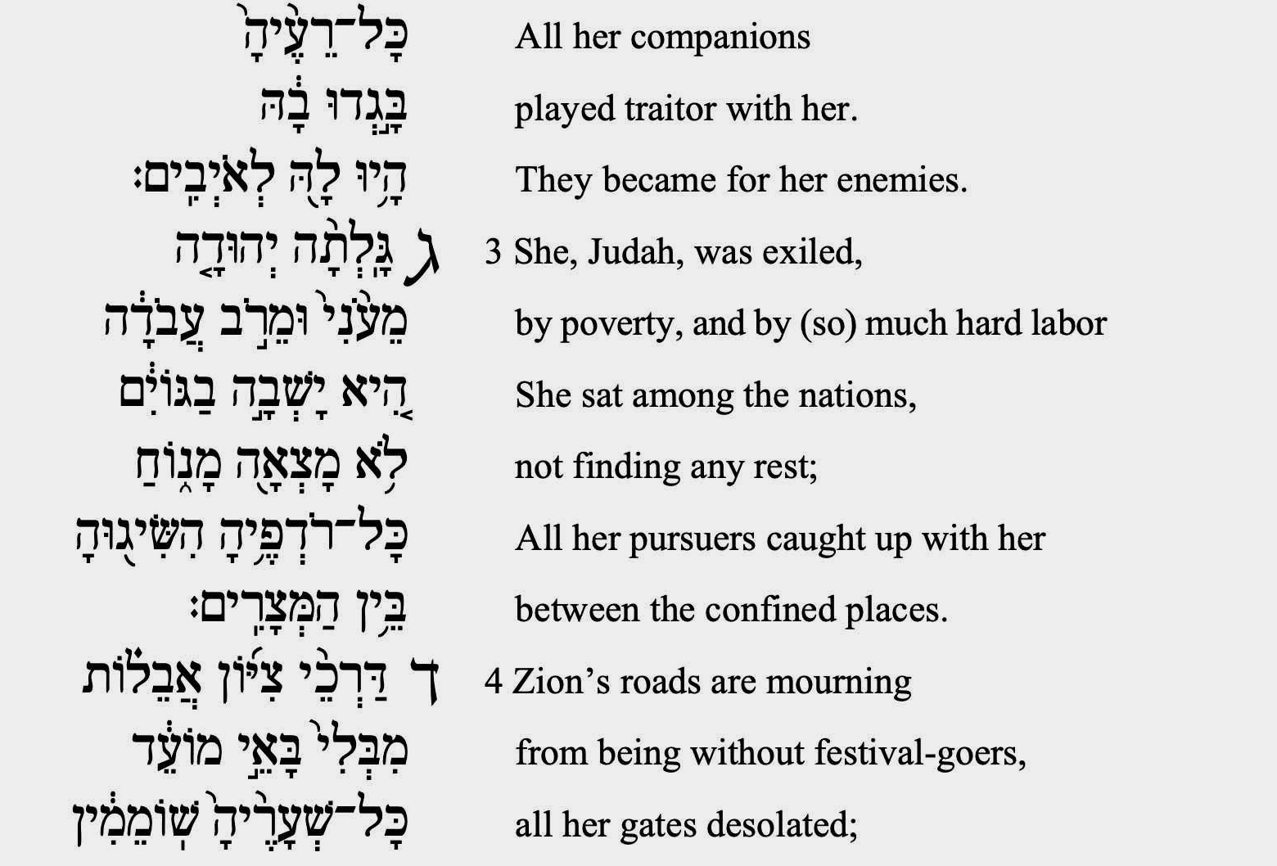

Slide 7
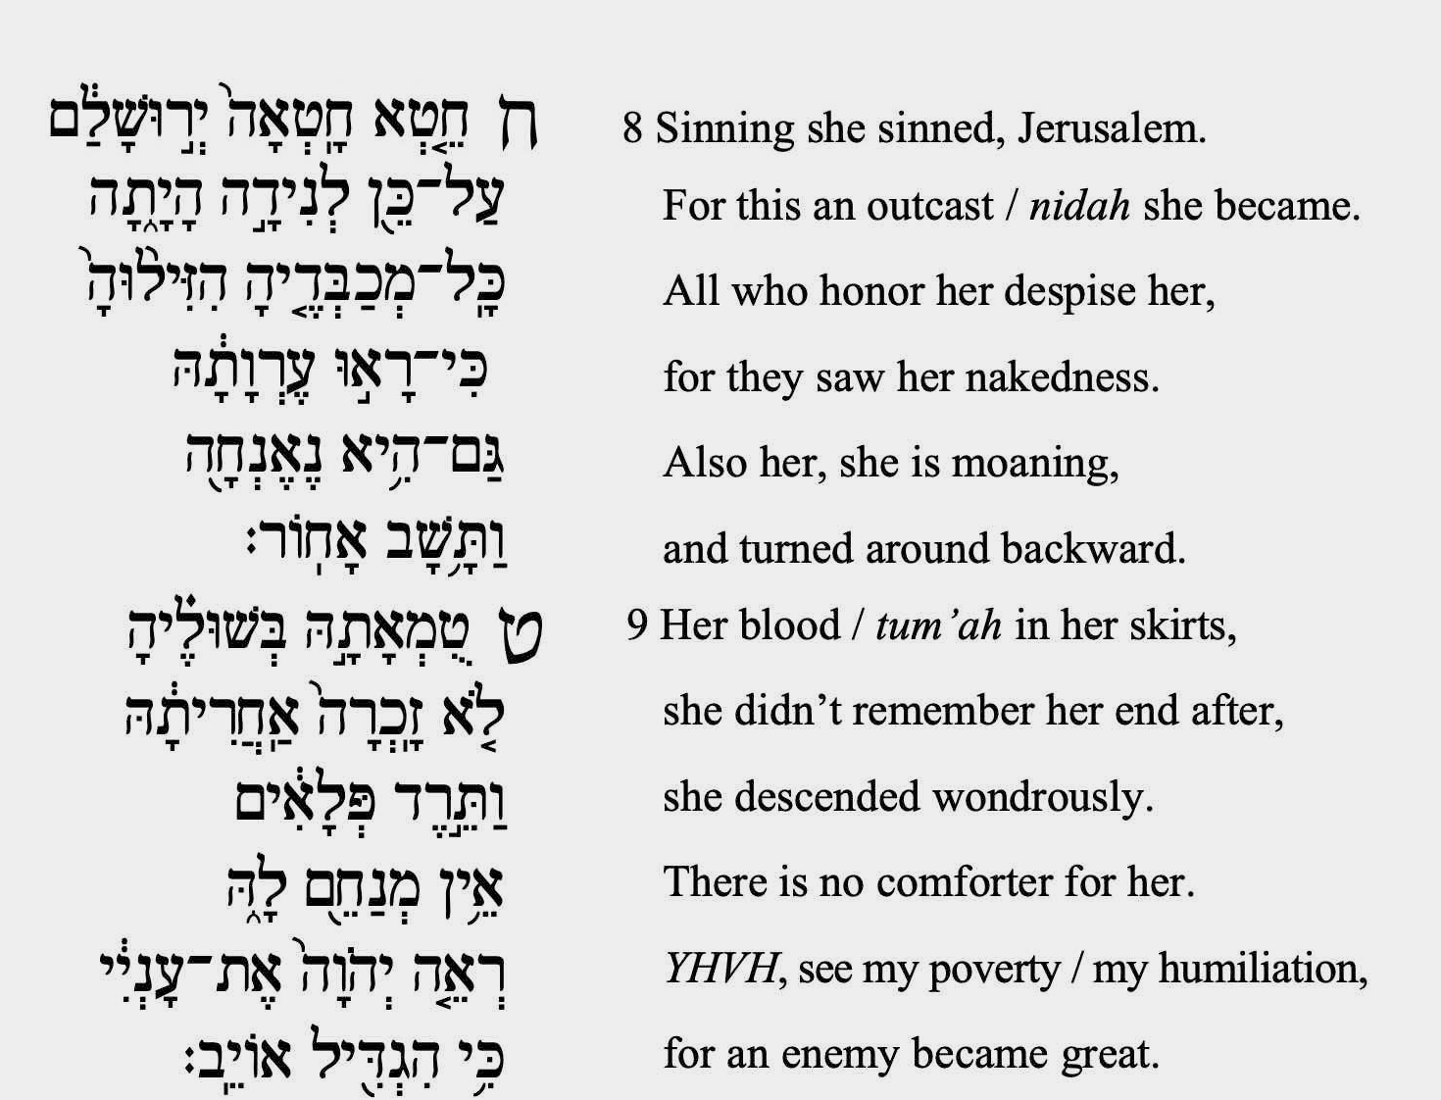

Slide 8
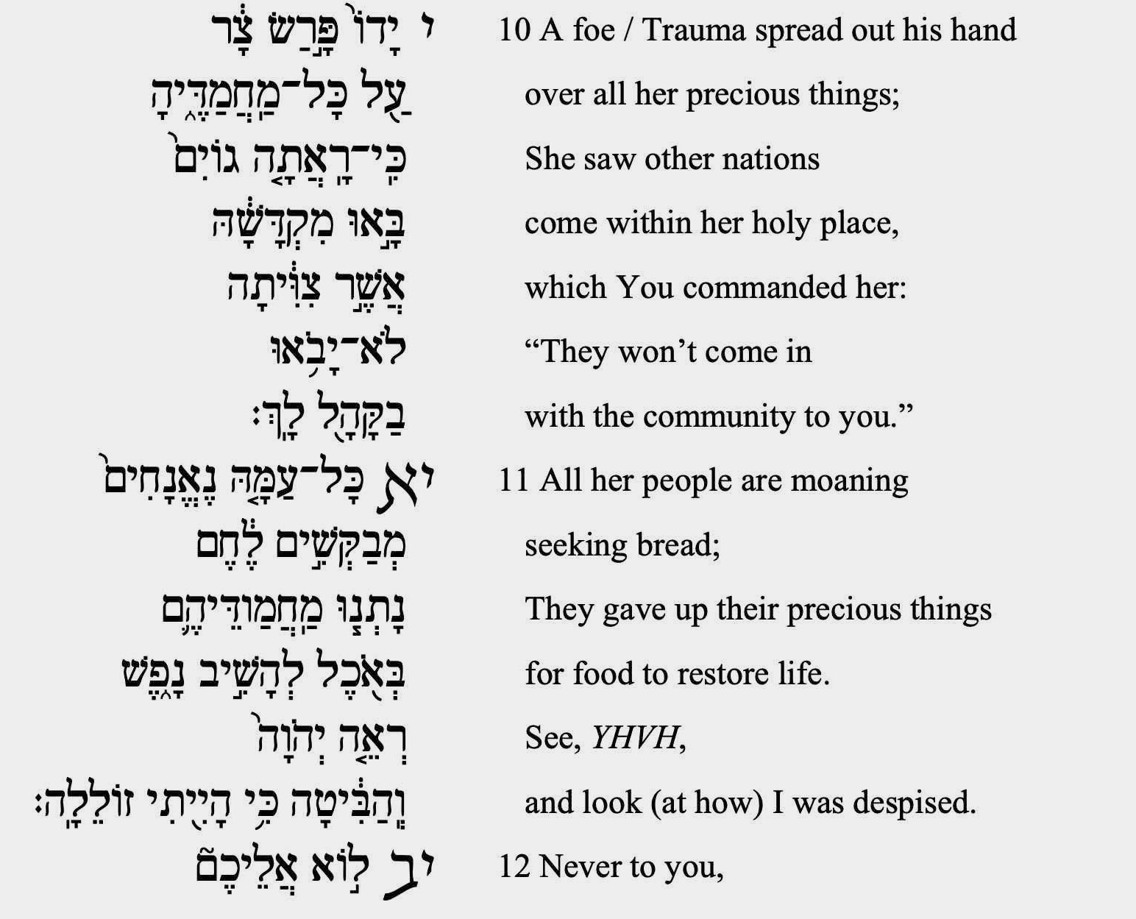

Slide 9
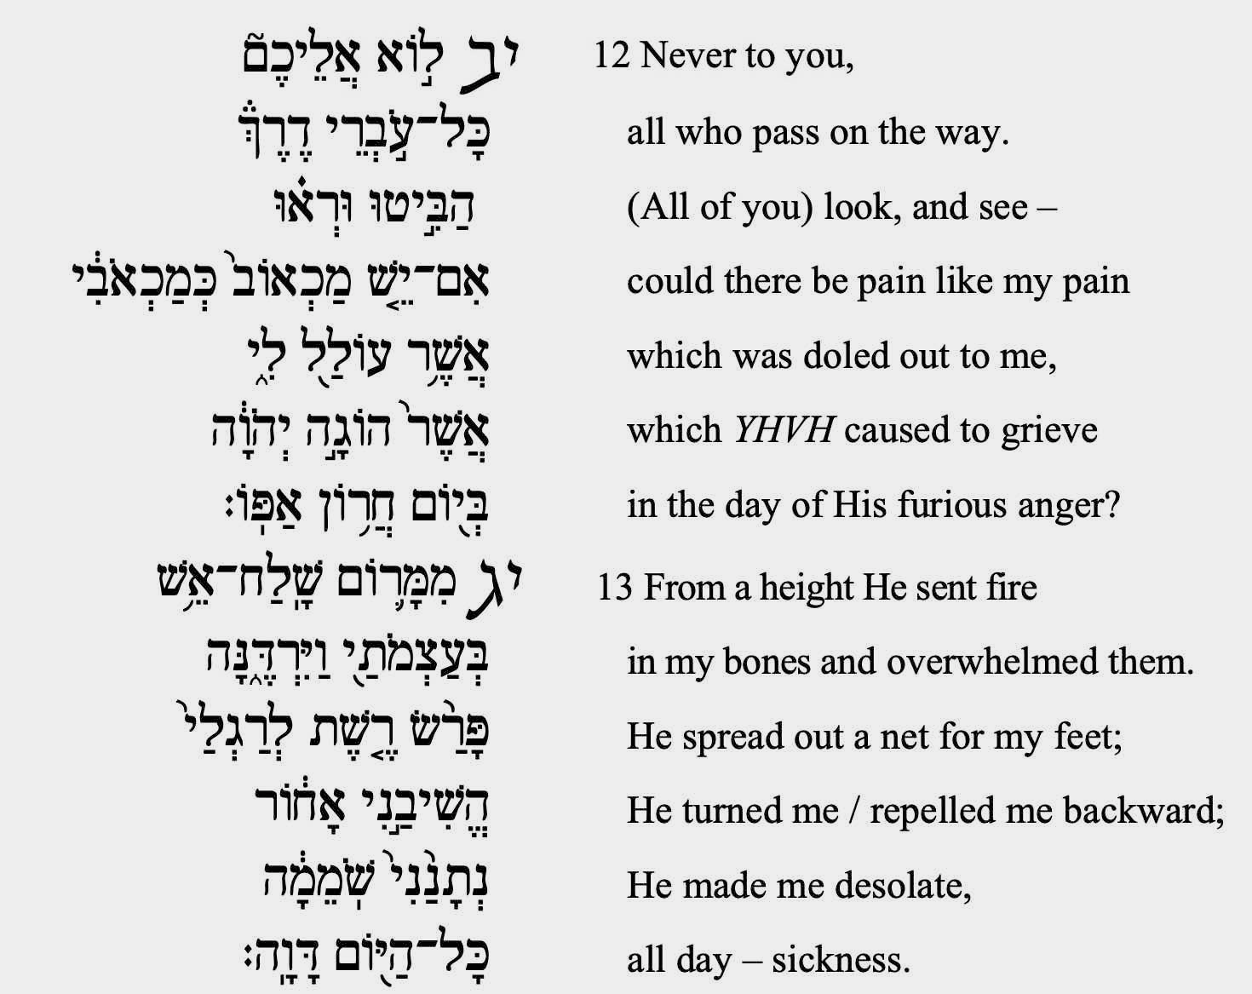

Slide 10
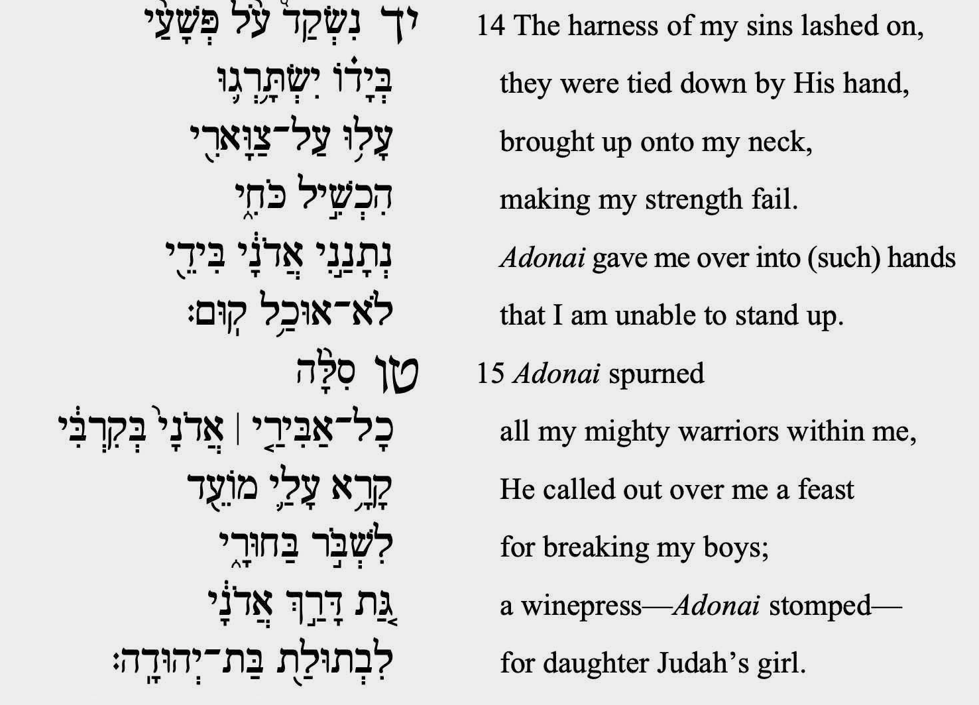

Slide 11
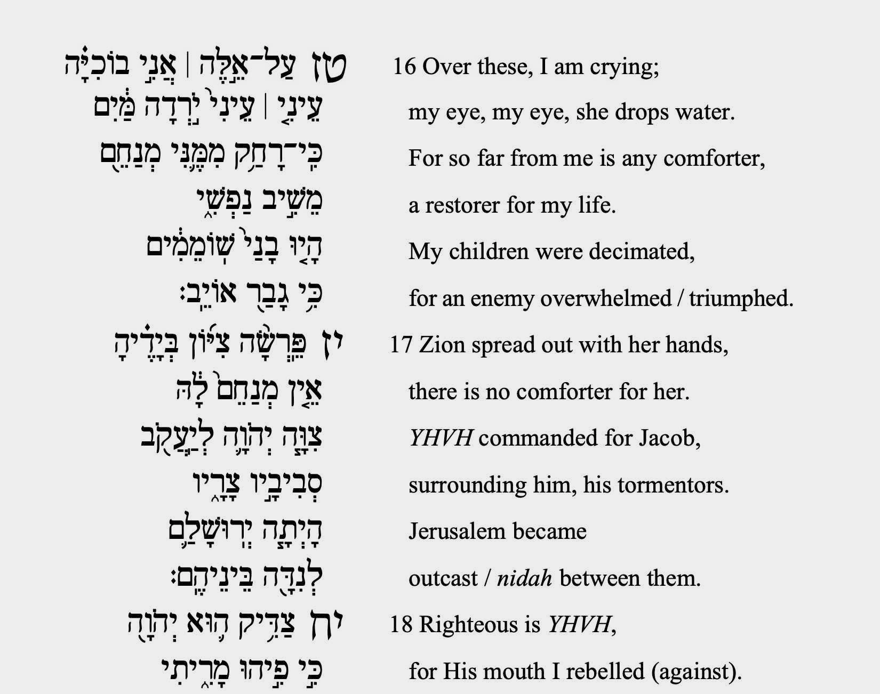

Slide 12
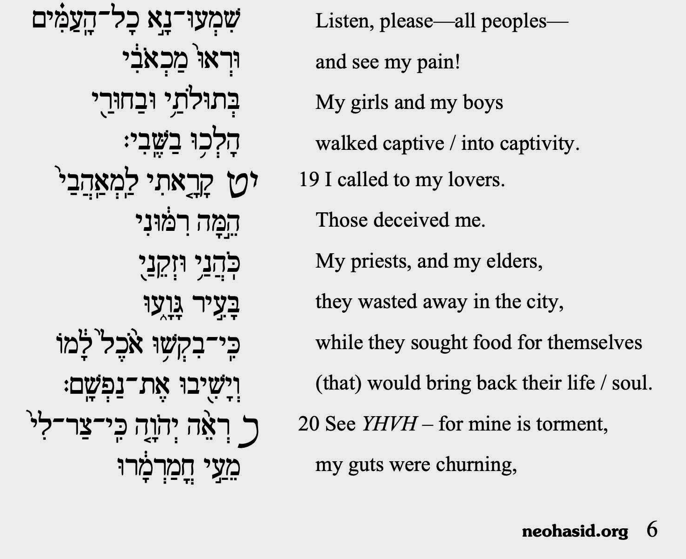

Slide 13
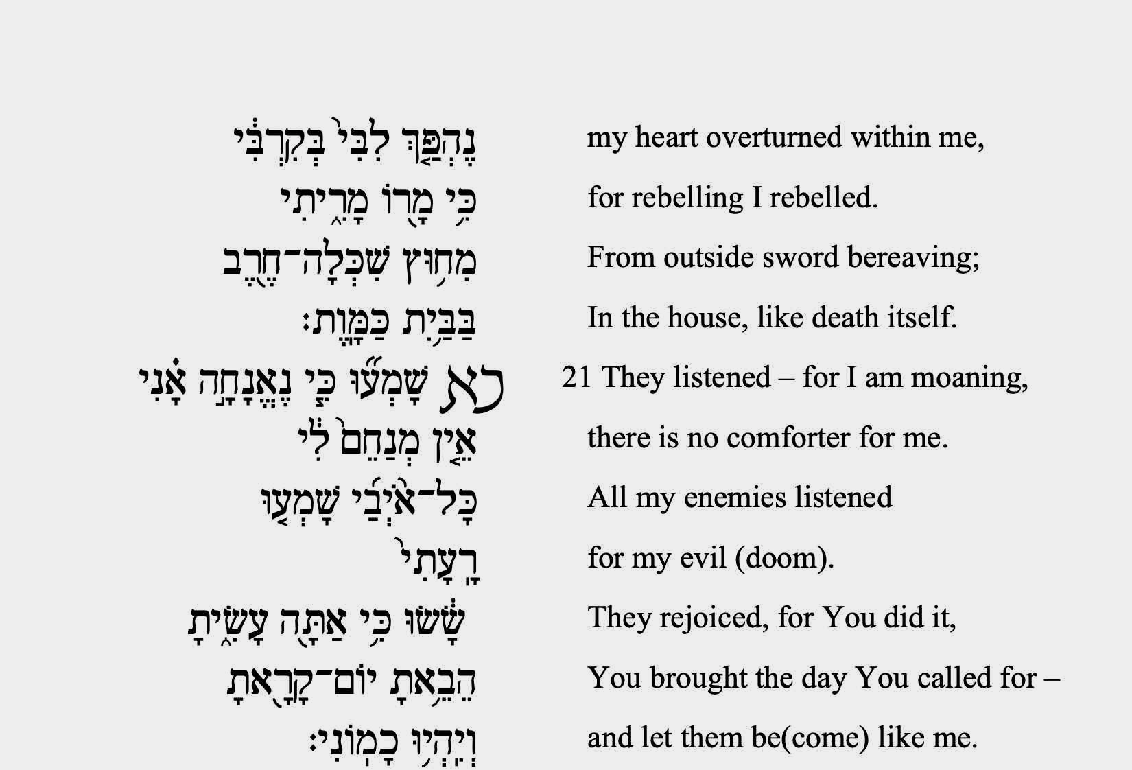

Slide 14
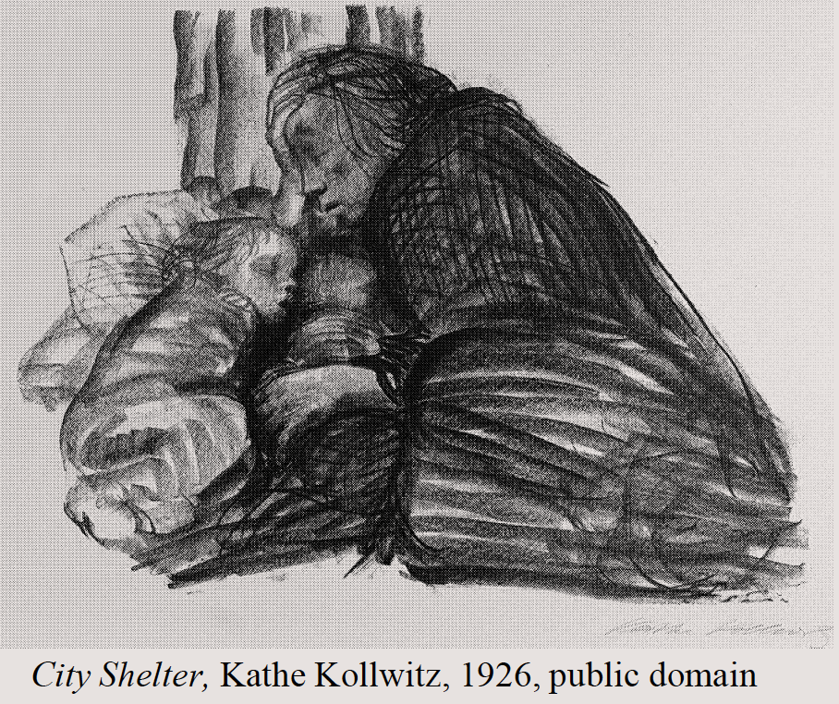
In the real world: Stop KKL-JNF from making the Sumarin family homeless. Info here and below.
Count the Sefirot from Malkhut to Chesed starting Friday night til Rosh Hashanah. Use the Omer Counter or Omer Count app:
neohasid.org/omer/apps/

Slide 17
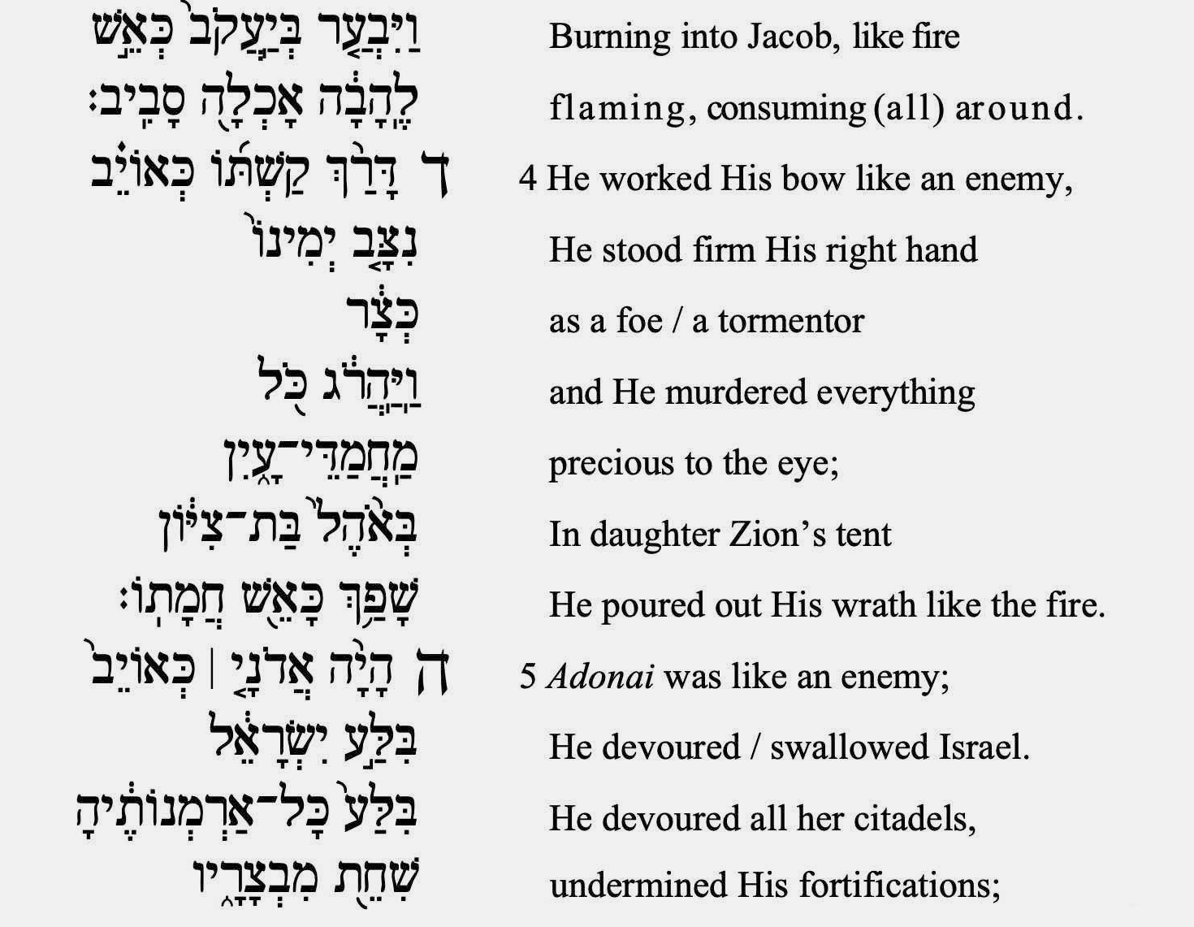

Slide 19
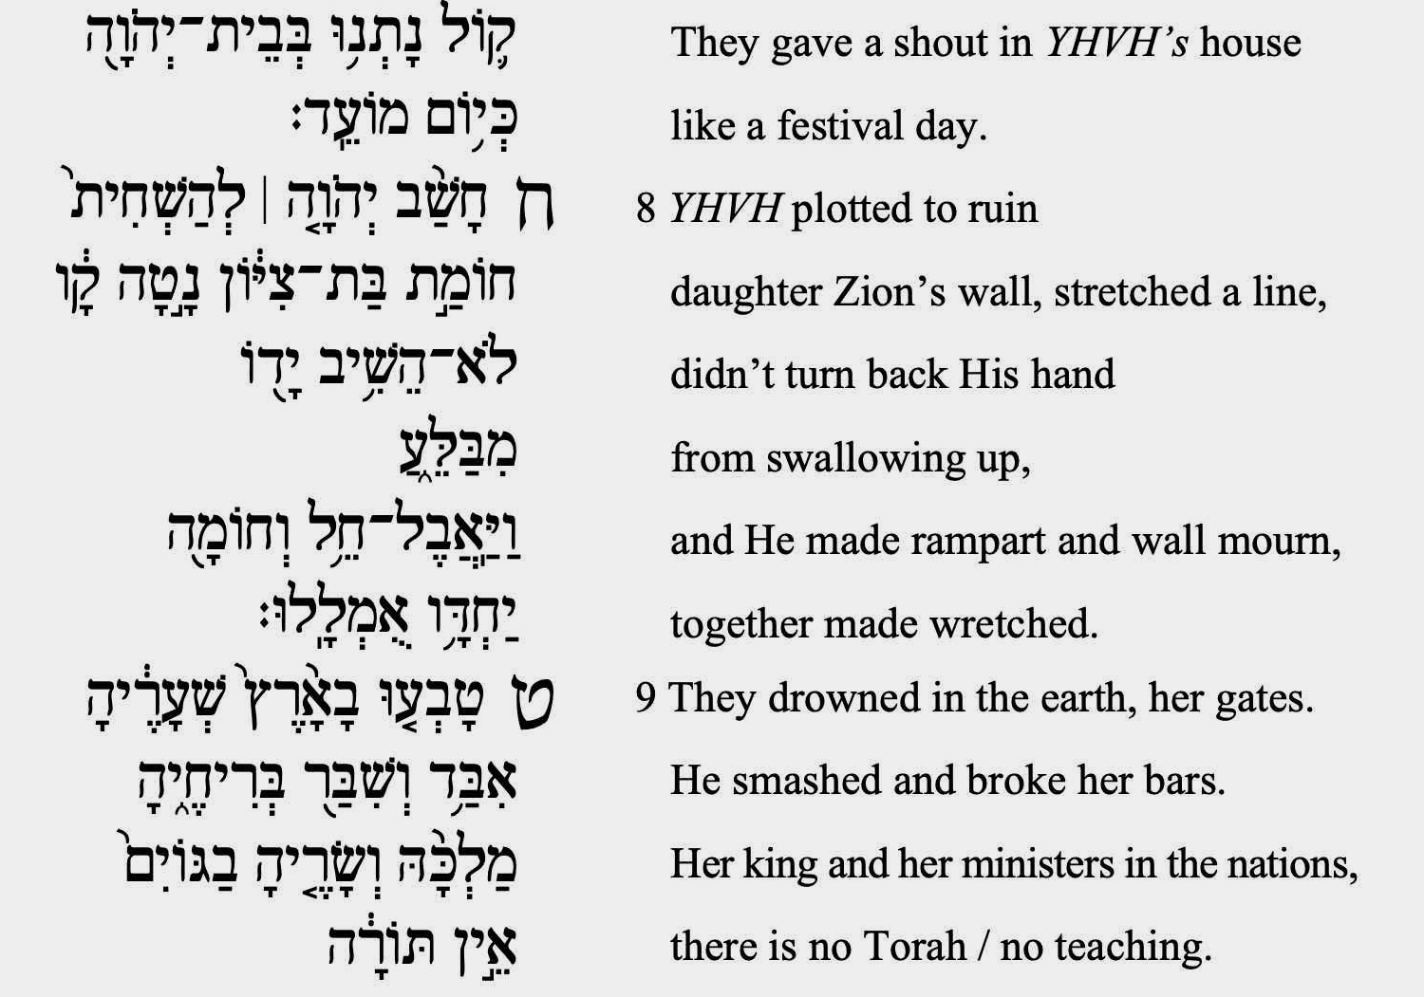

Slide 20
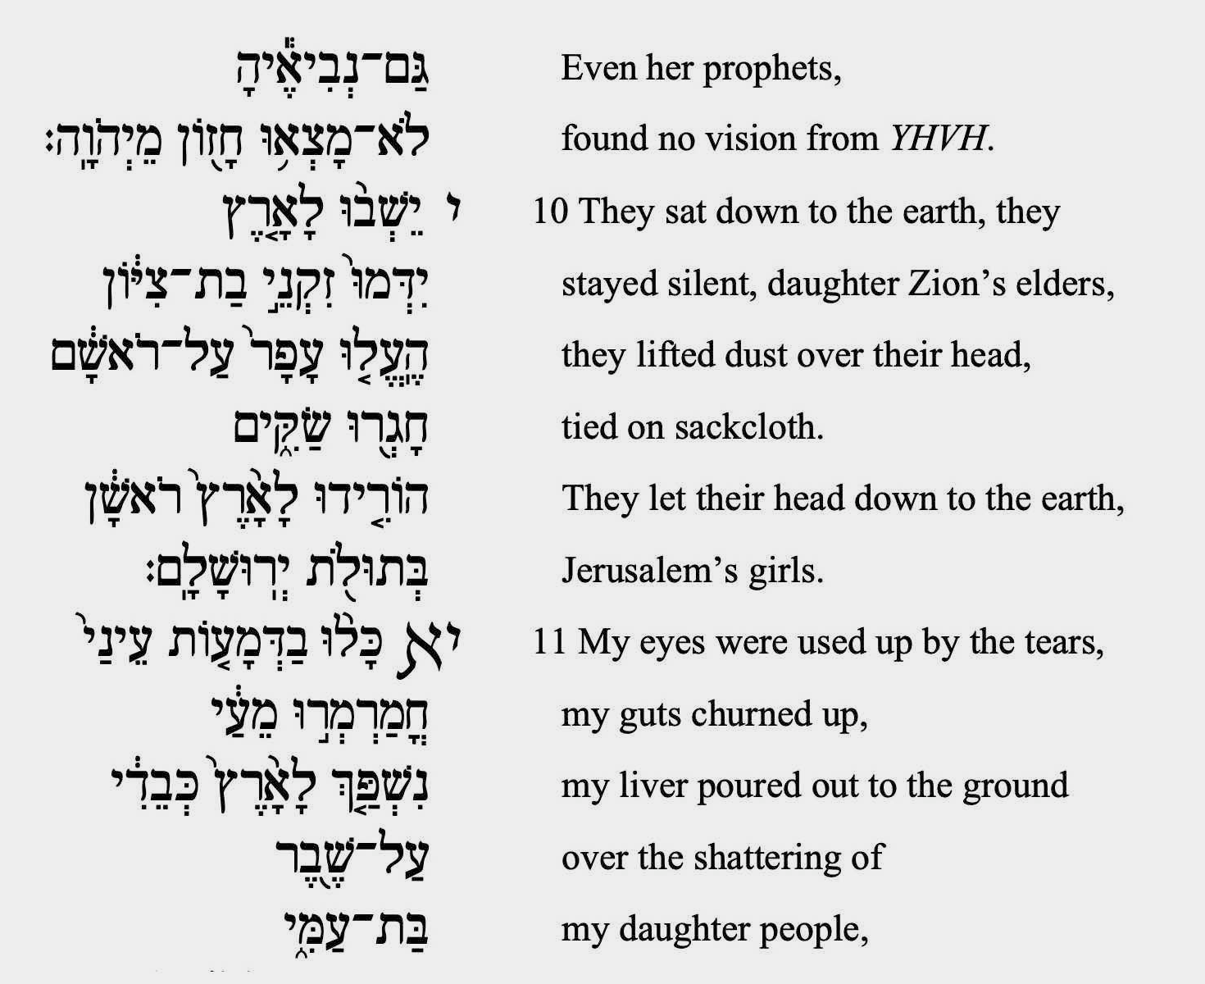

Slide 21
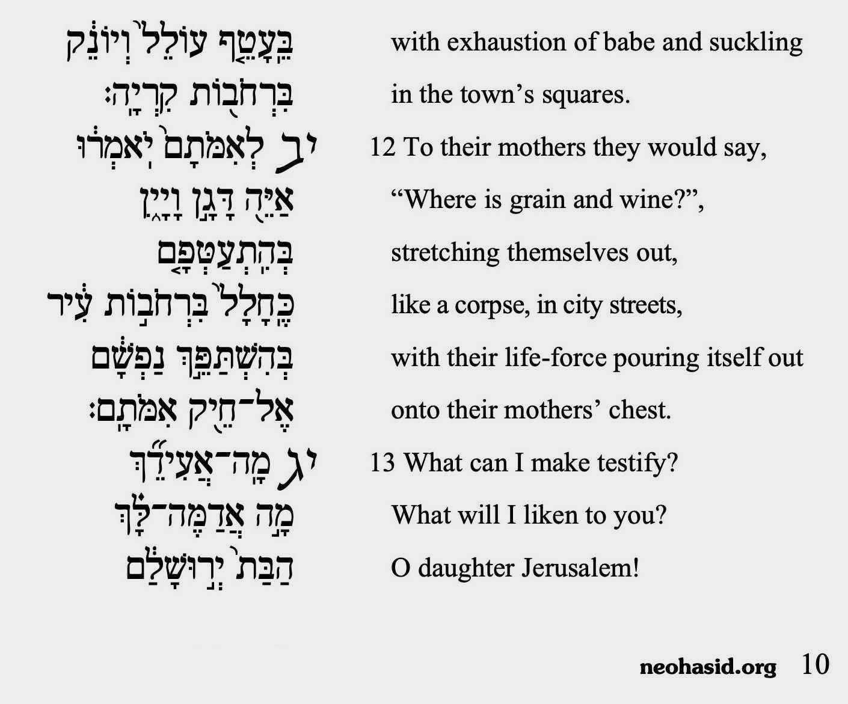

Slide 22
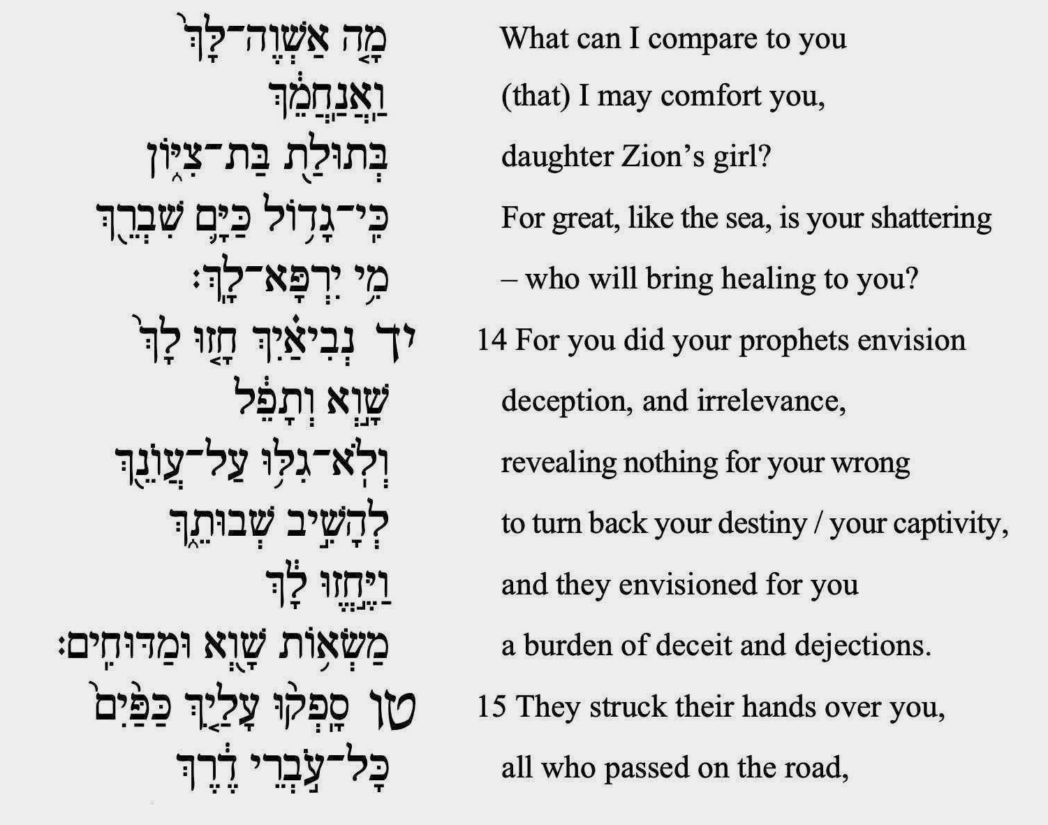

Slide 24
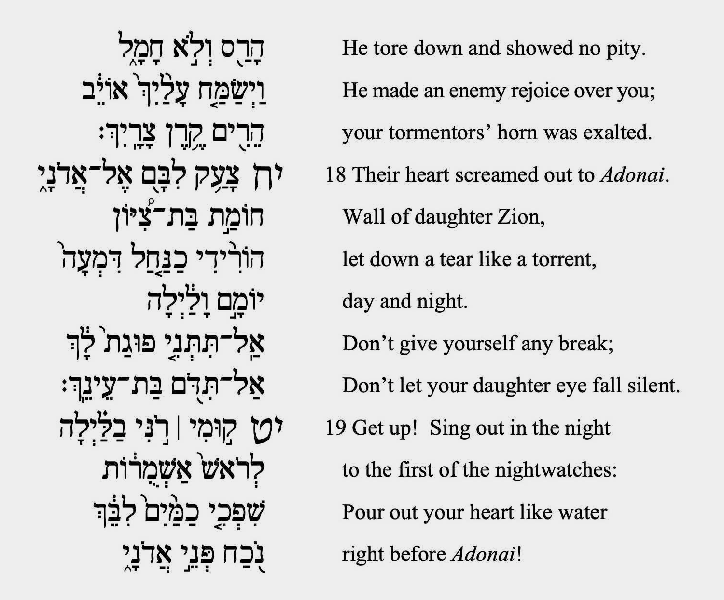

Slide 25
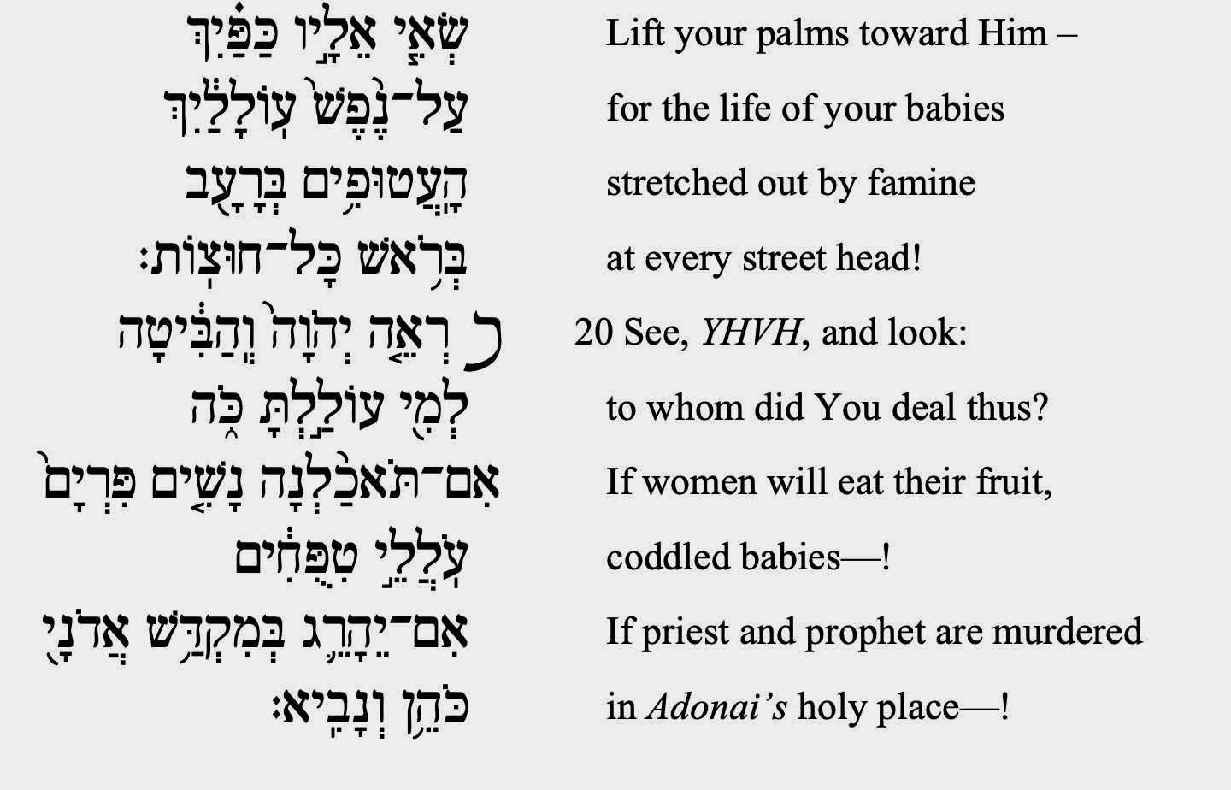

Slide 26
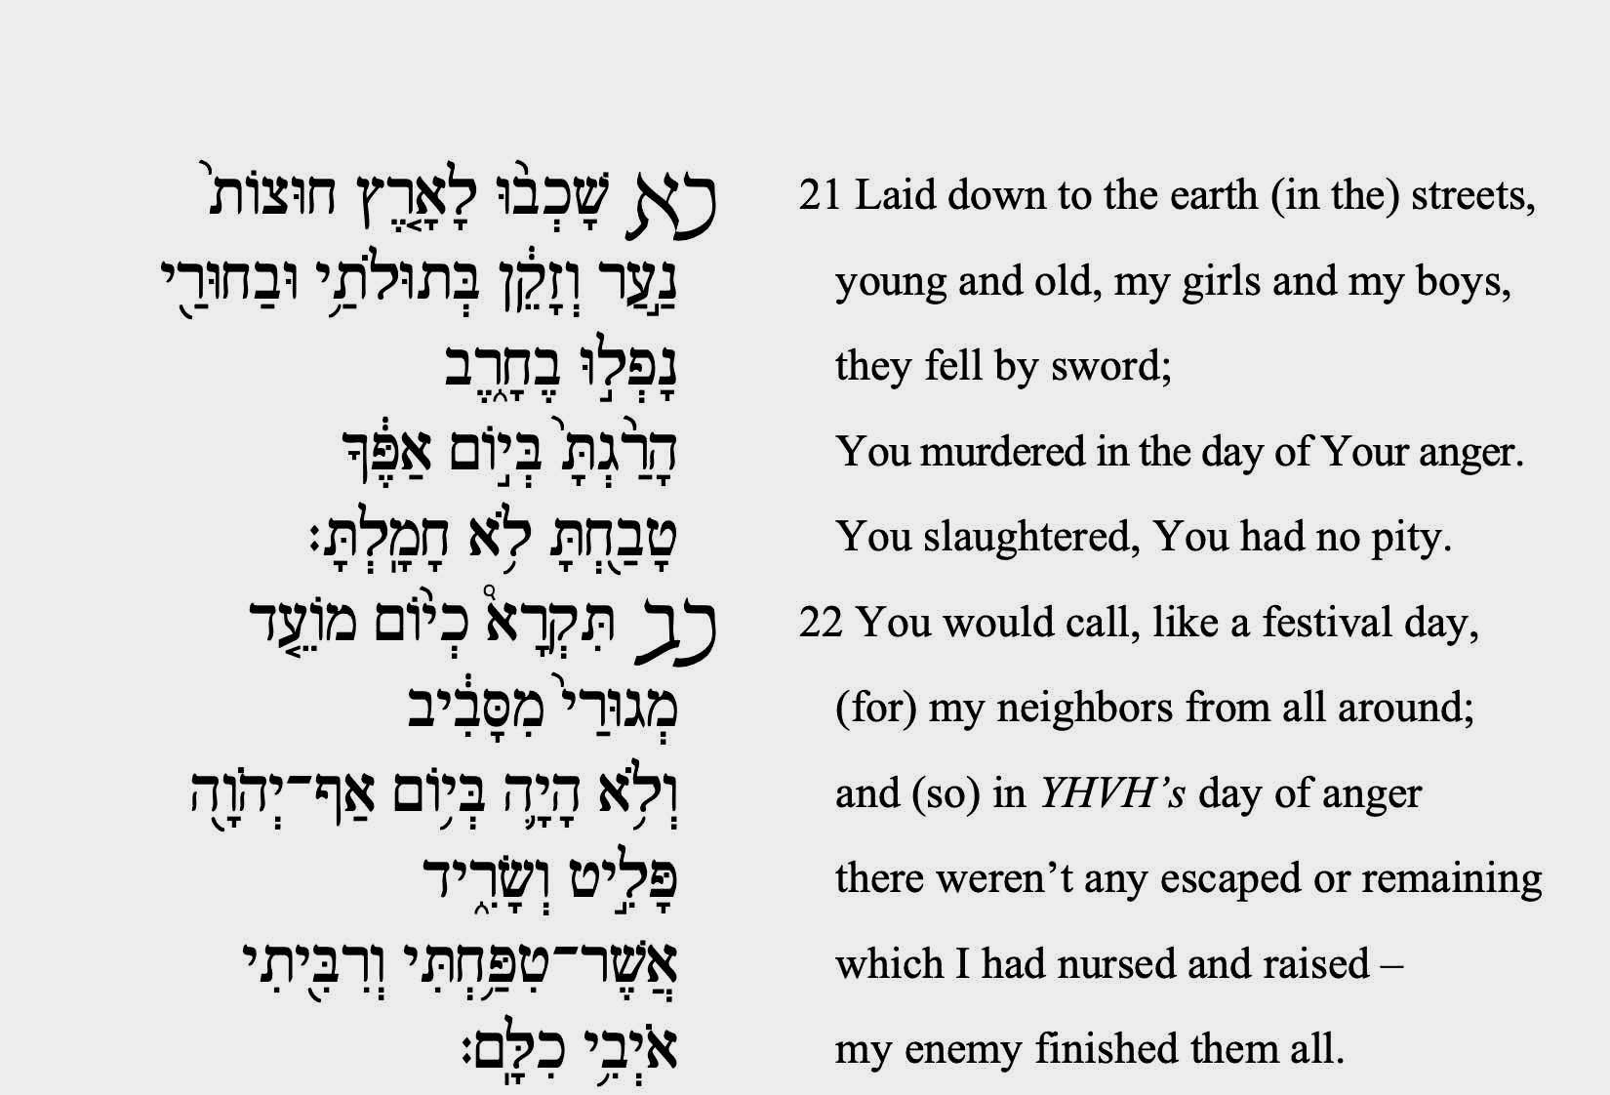

Slide 27
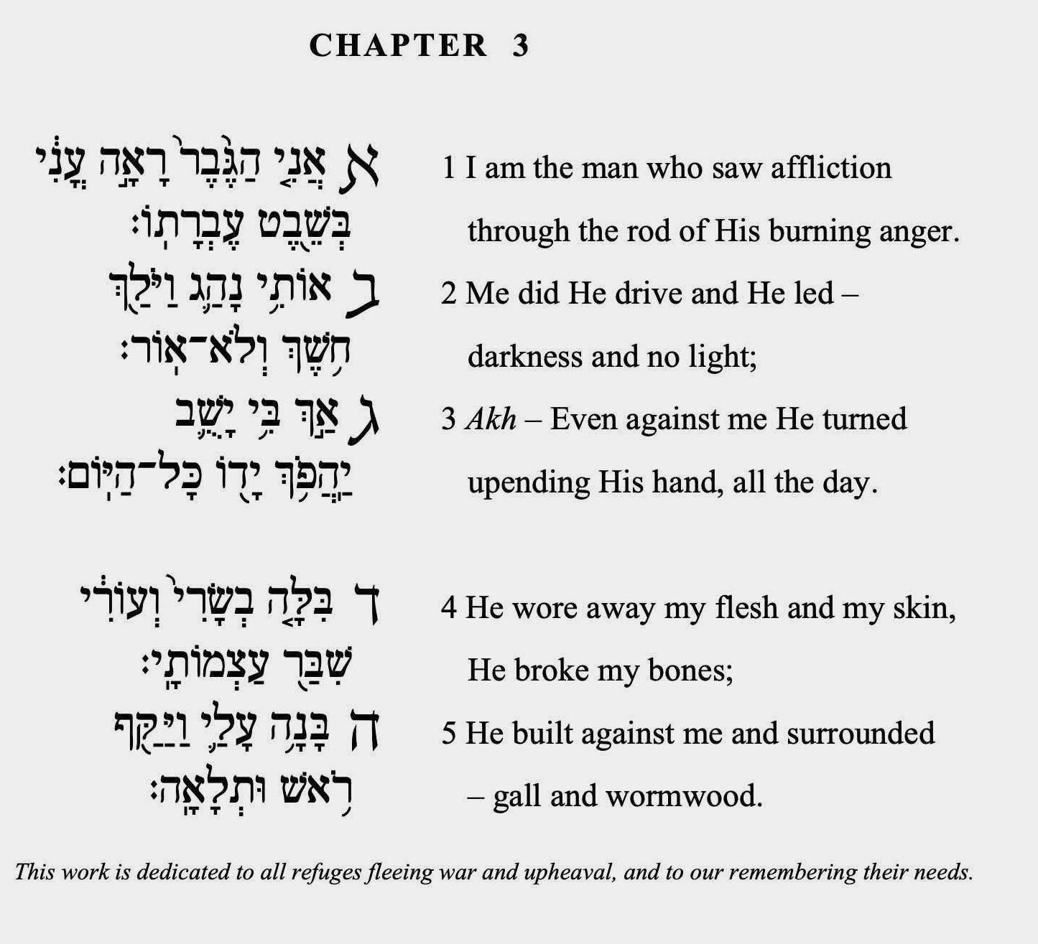

Slide 28
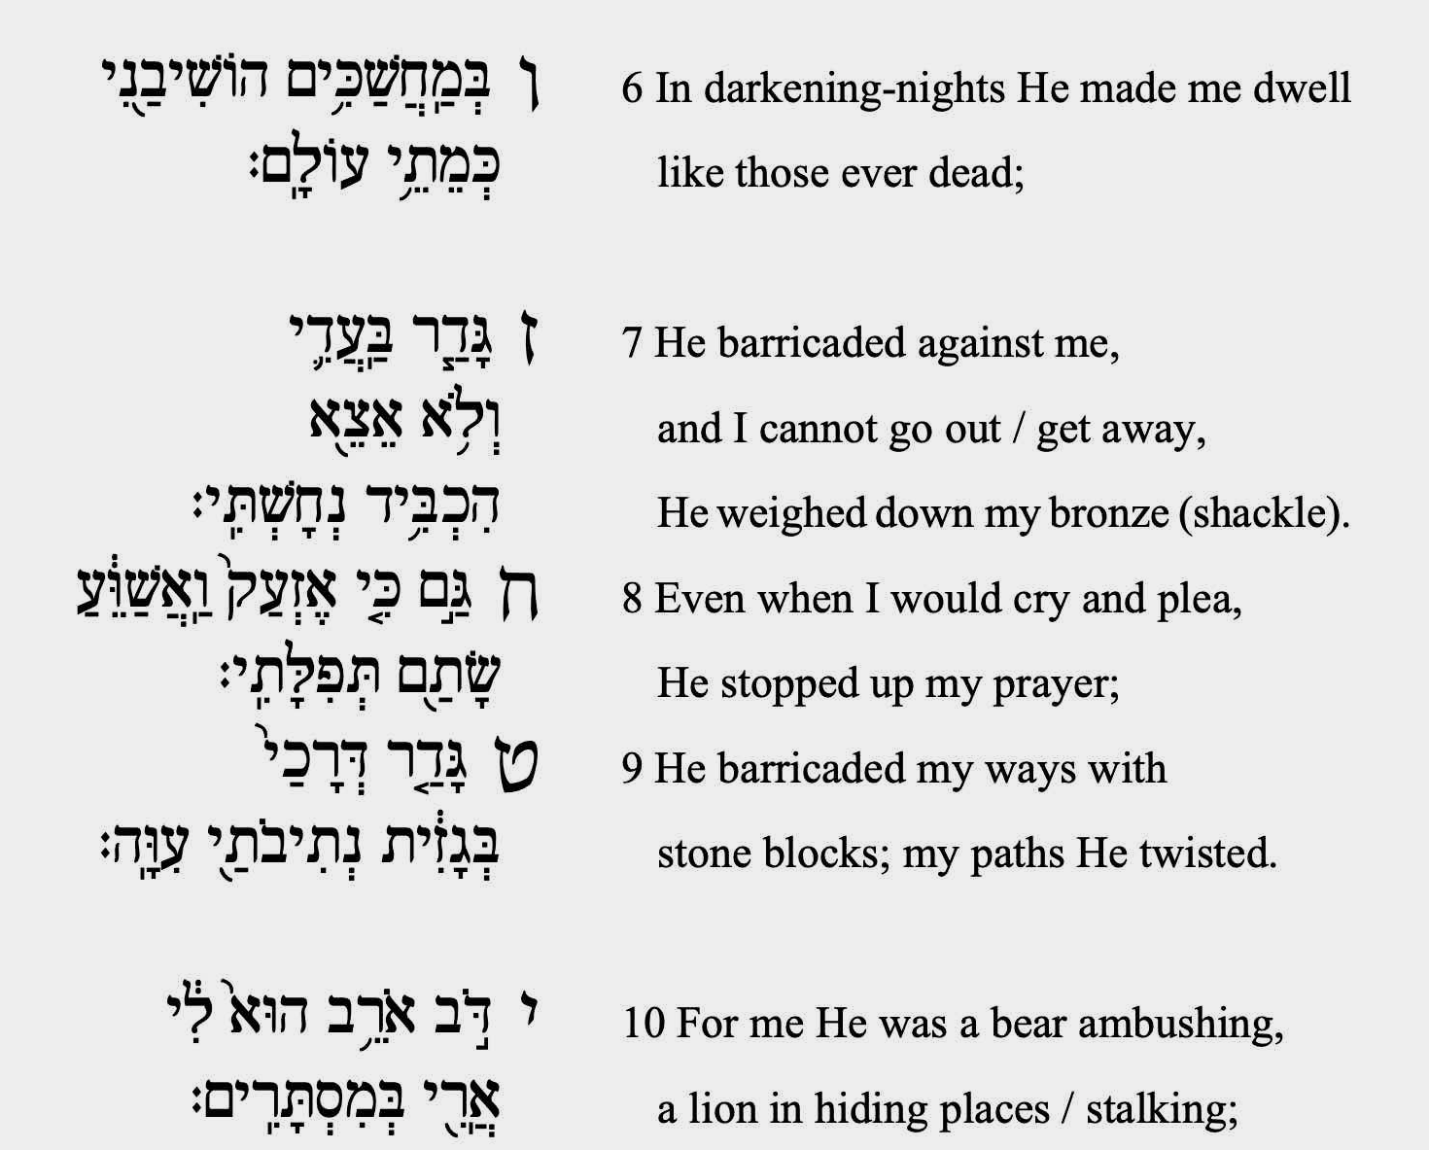

Slide 31
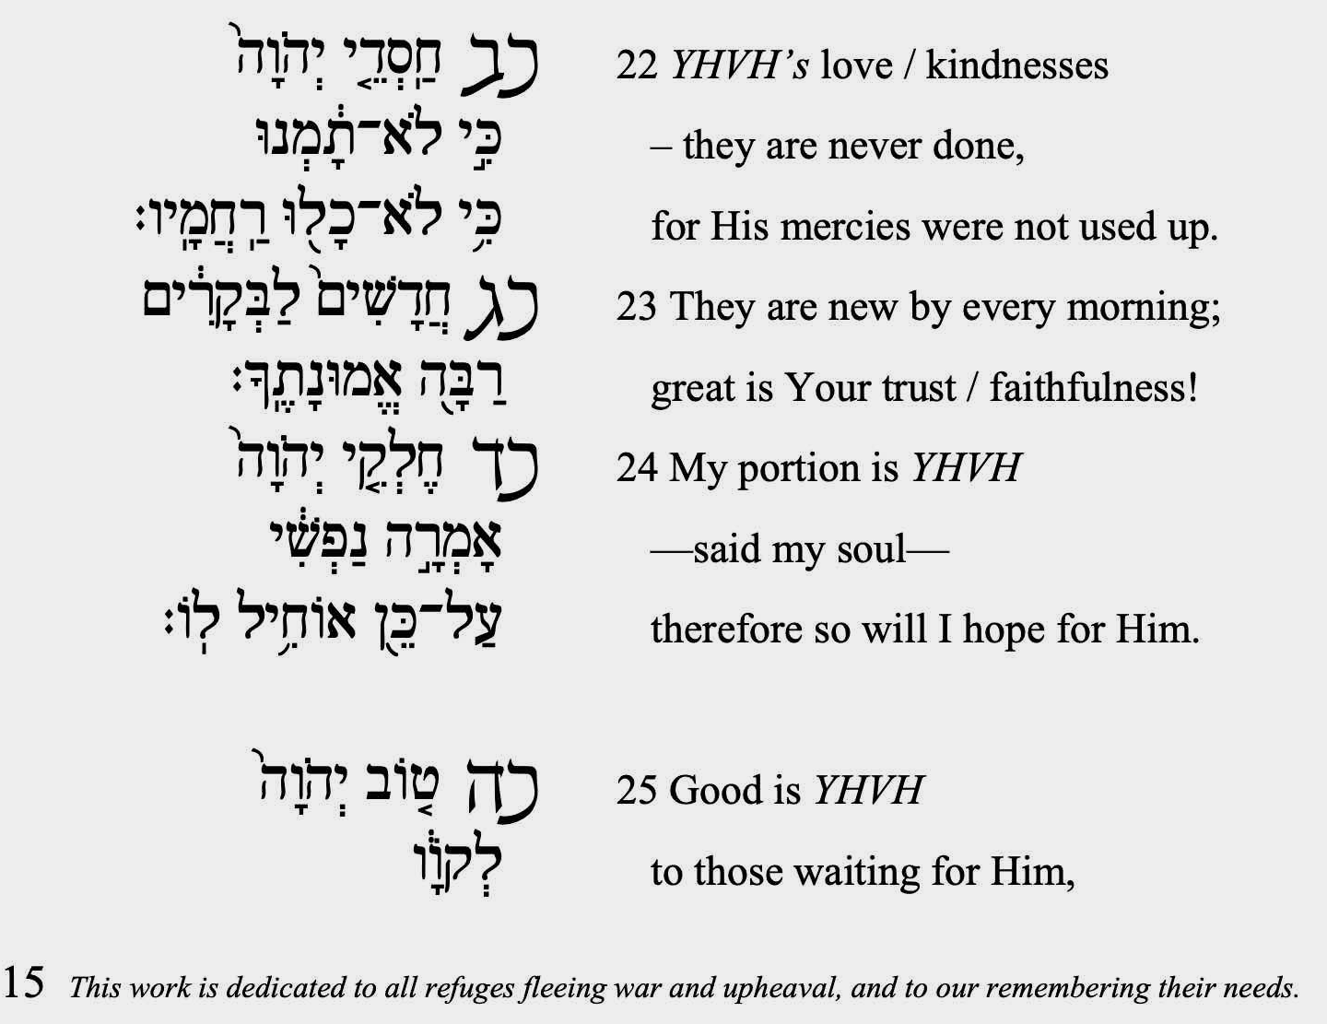

Slide 32
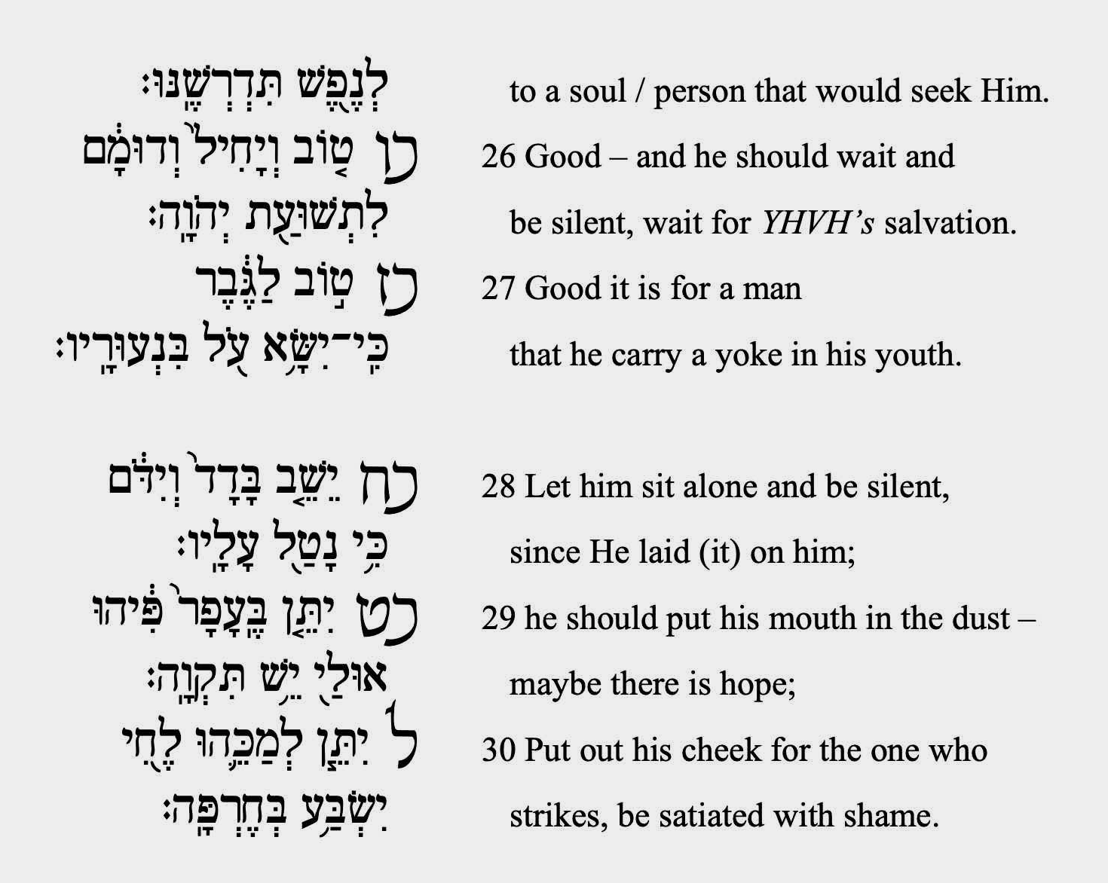

Slide 33
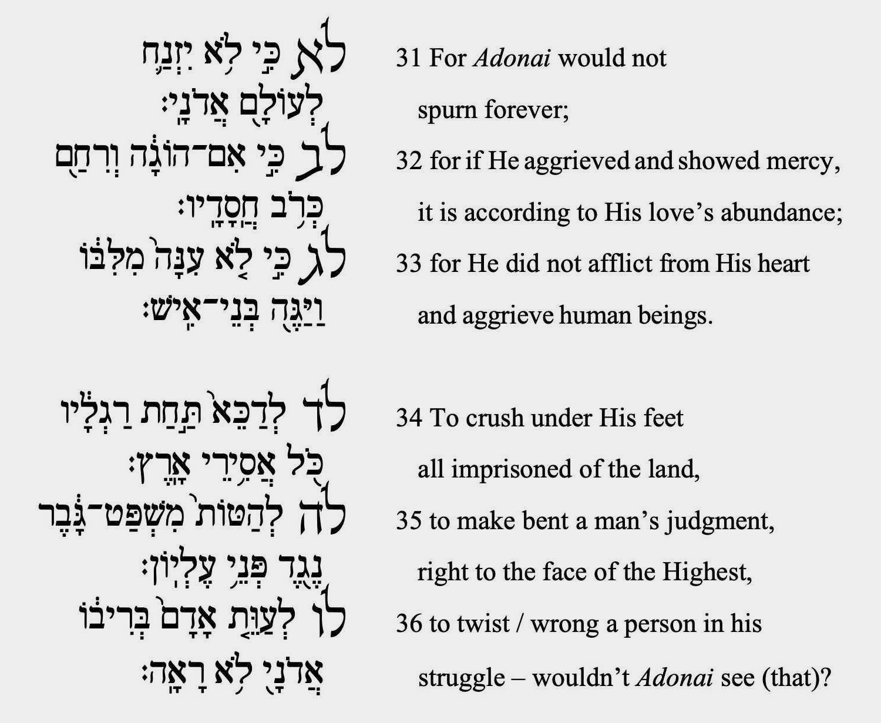

Slide 34
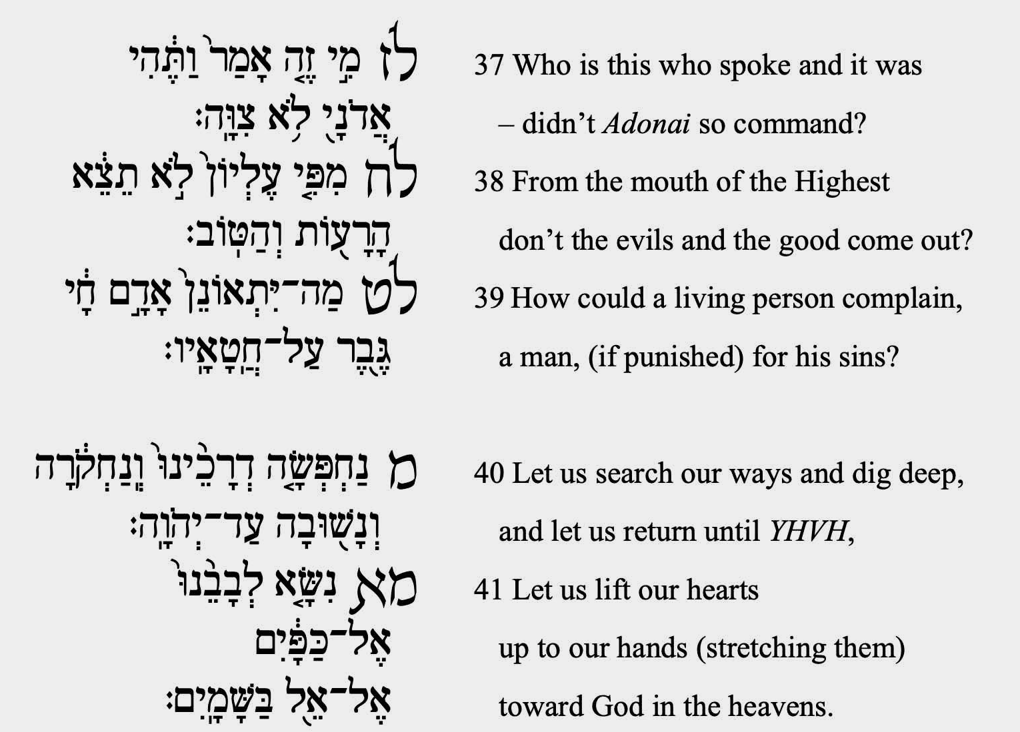

Slide 36
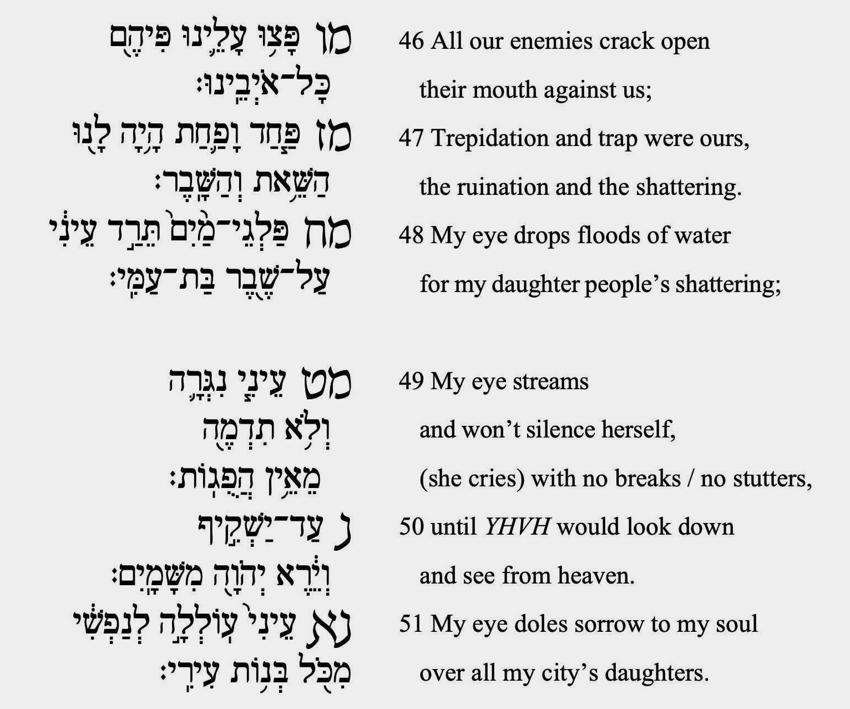

Slide 38
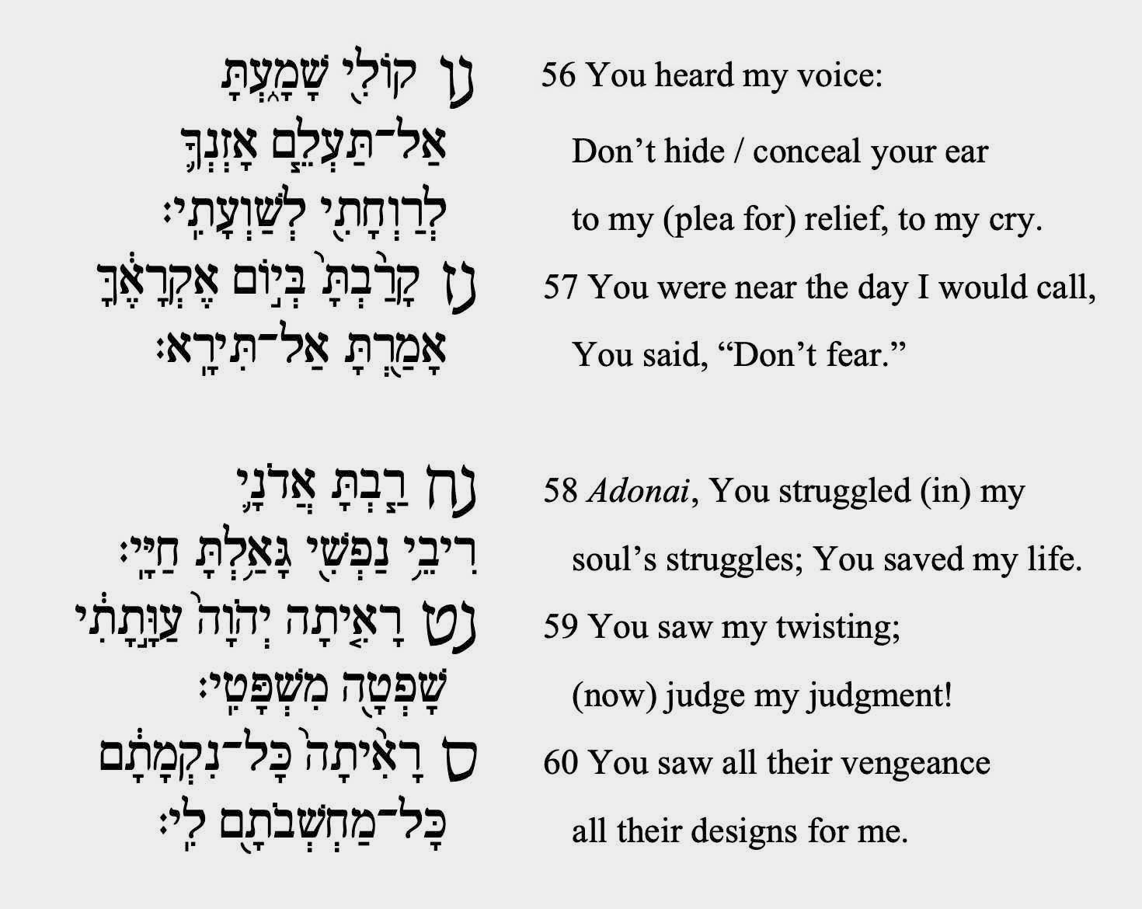

Slide 39
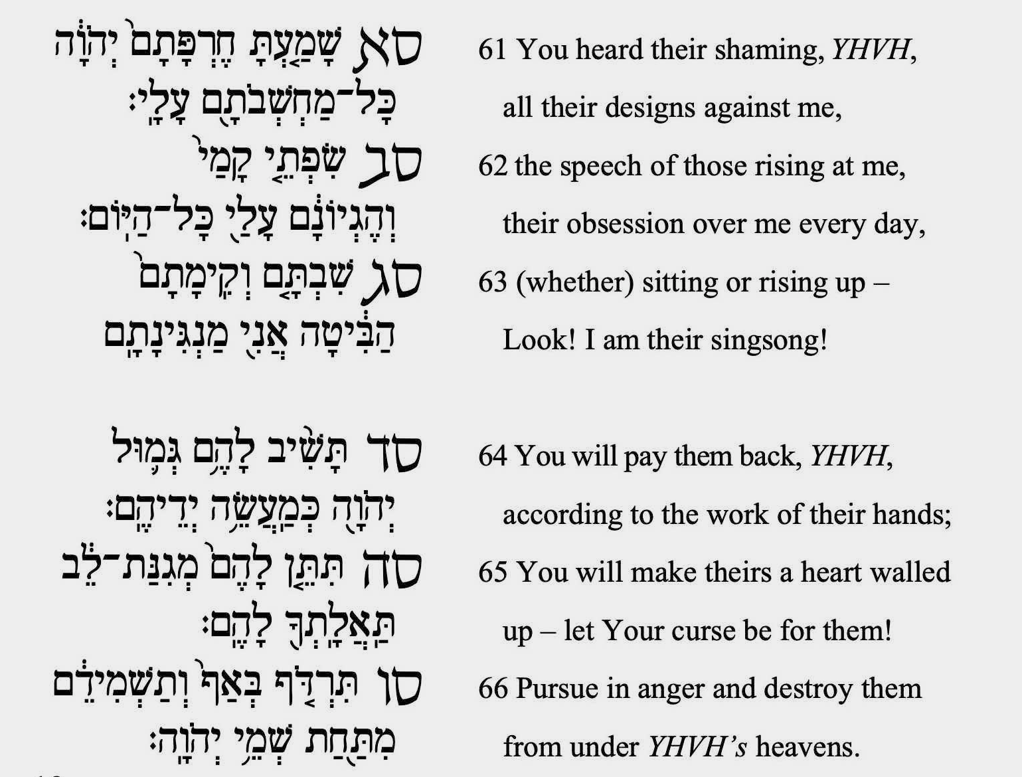

Slide 40
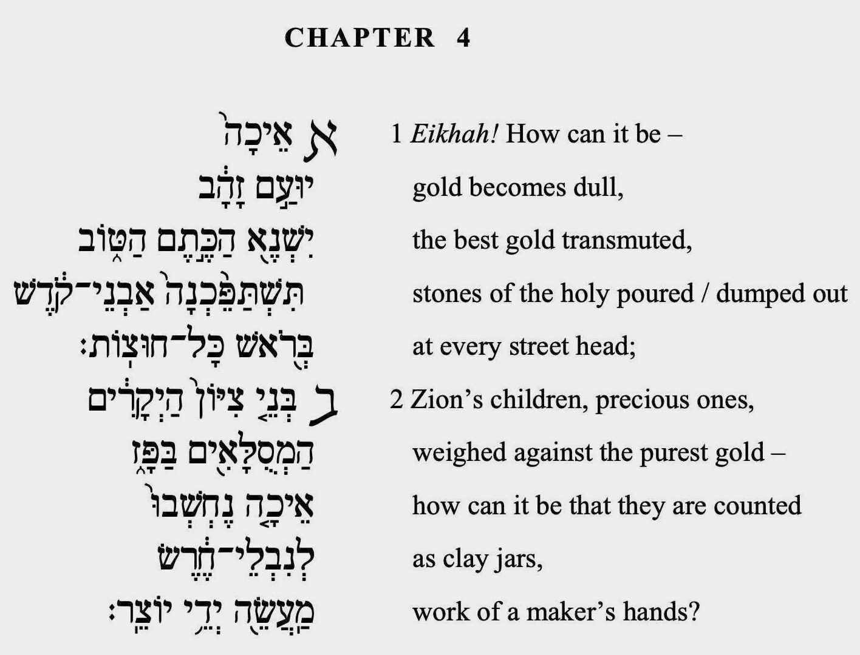

Slide 41
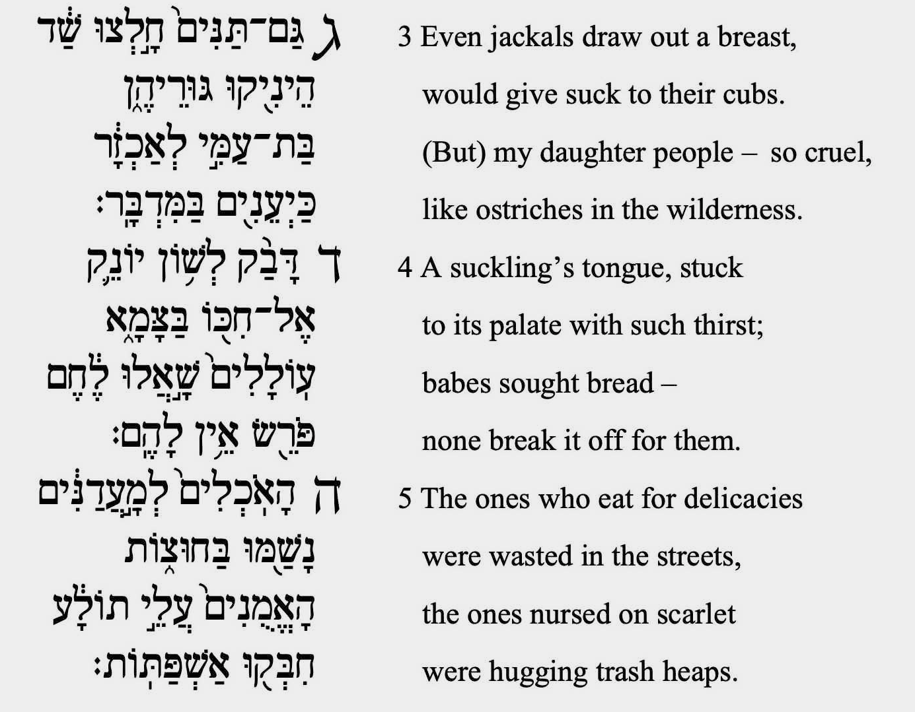

Slide 42
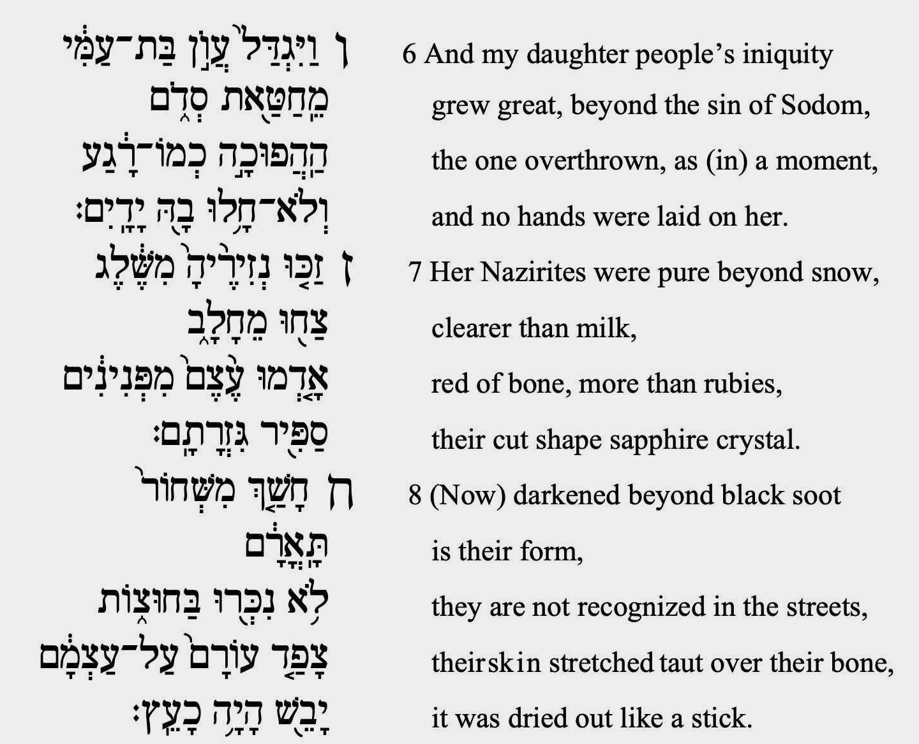

Slide 43
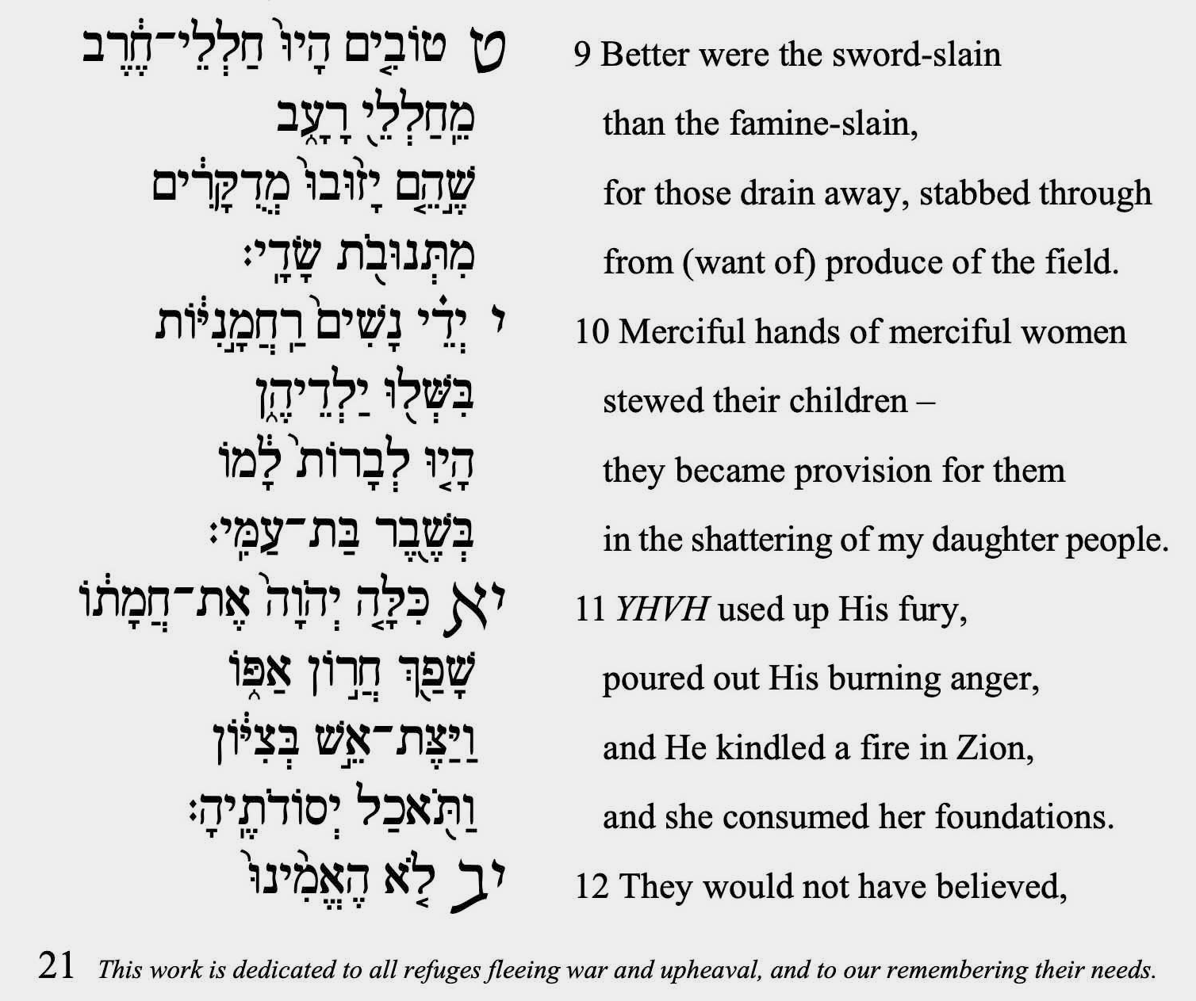

Slide 44
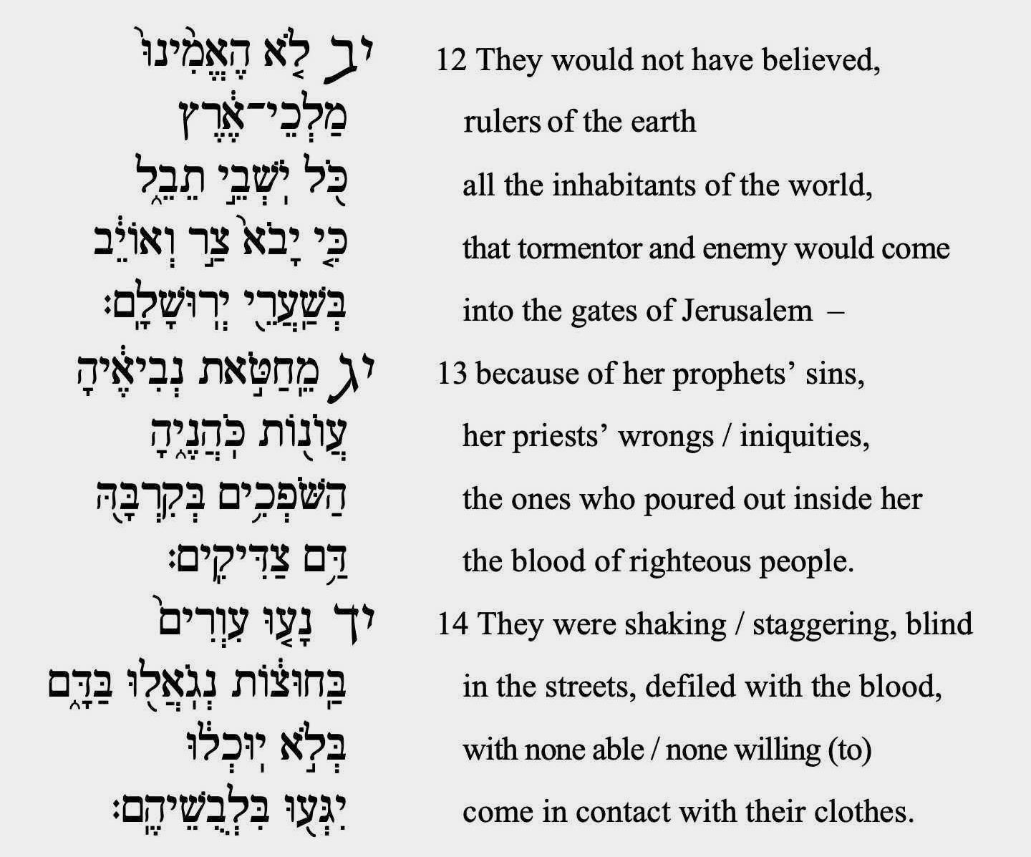

Slide 45
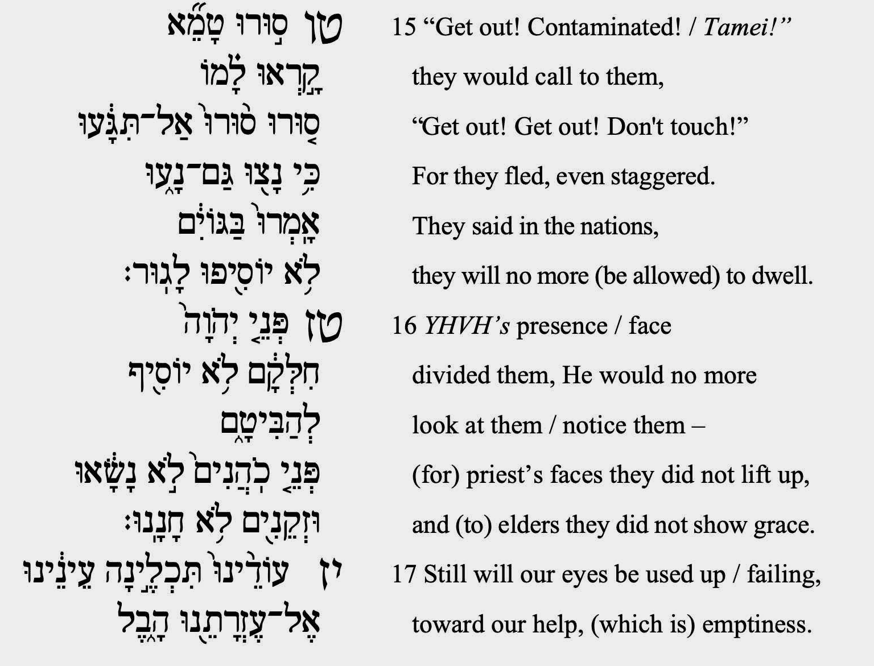

Slide 48
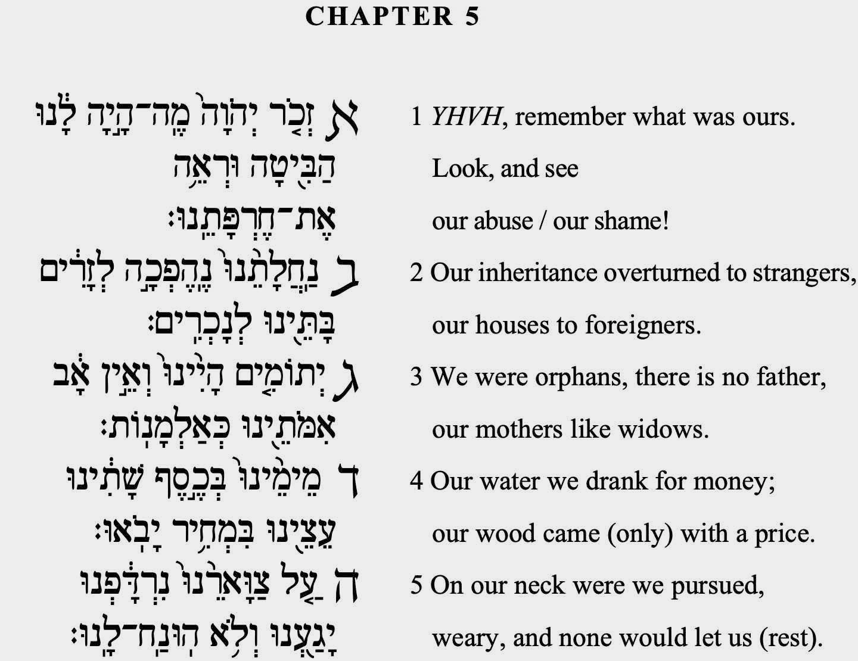

Slide 51
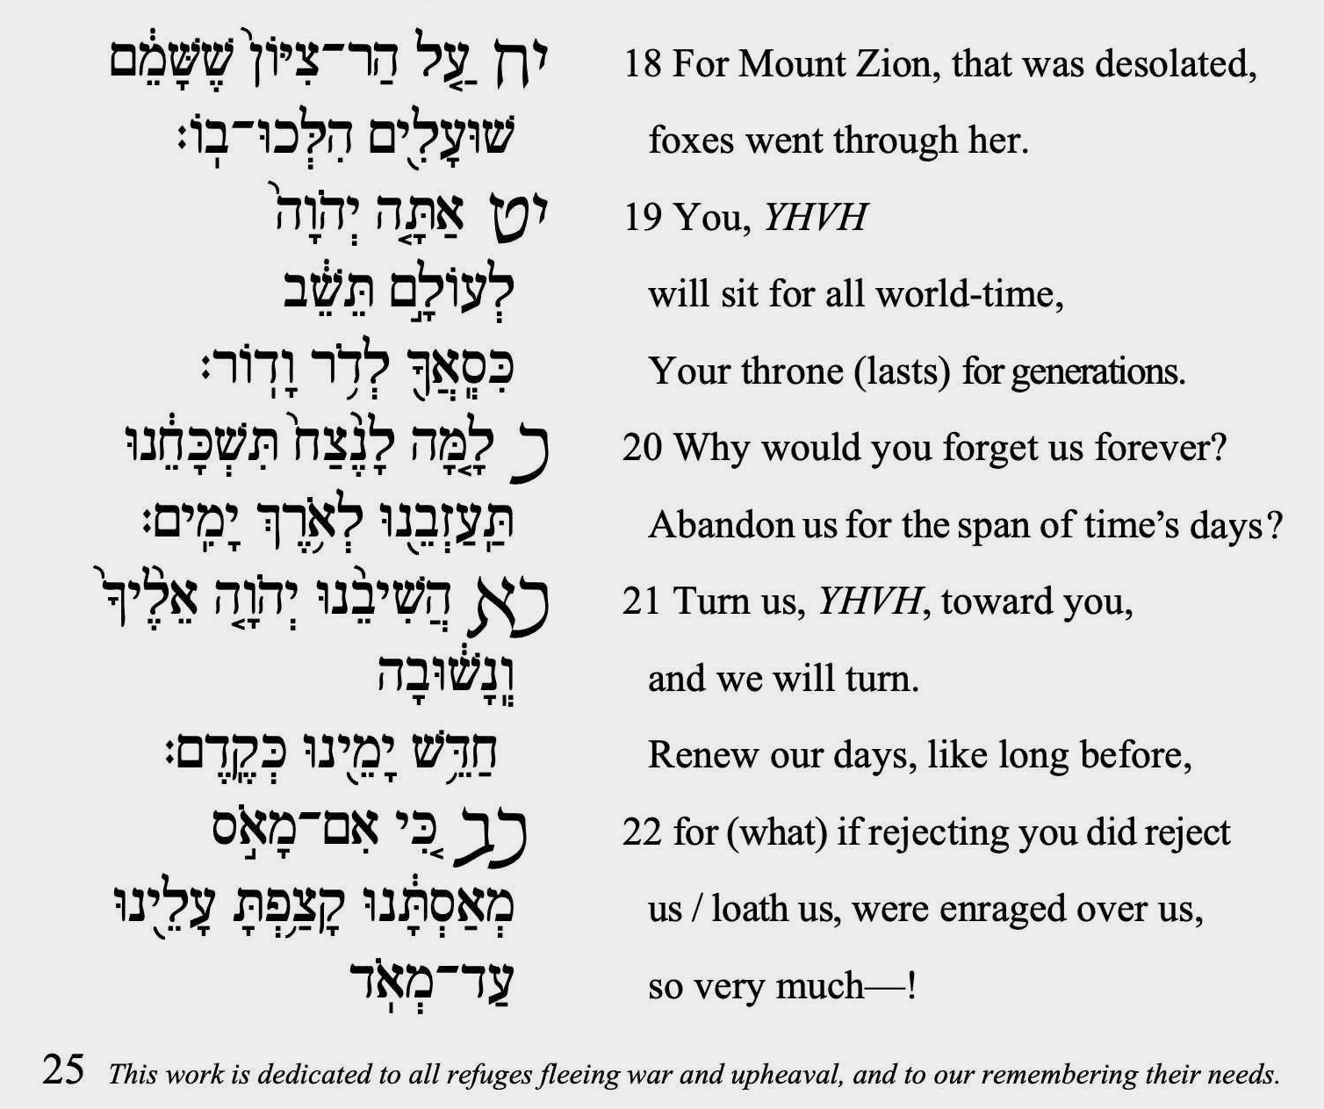

Slide 52
We think of Tish’a B’Av as a time of mourning, but it is more importantly a call to identify with the experience of refugees who are forced to risk their lives and even their children’s lives in order to escape violence, hunger, devastation. That’s what the Jewish people went through when the Temple, and the nation and society it stood for, were destroyed, when they became “like deer, not finding a place to graze, walking without strength before a pursuer.” (1:6)
The observances of Tish’a B’Av—not wearing fresh clothes, not washing, fasting from eating and drinking and sexual contact, not greeting each other, not sitting anywhere except on the ground—are closer to the experience of being a refugee than to being a mourner. The destruction of the Temple stands not just for the destruction of Jerusalem, but for the city being turned into a war zone, and the people becoming prey to hunger, violence, and death.

Slide 54
The author(s) of Eikhah (traditionally Jeremiah) believed that what happened to Jerusalem expressed divine judgment. For our ancestors, the choice was either that the destruction was God’s punishment, or that God no longer cared about them.
Even though Eikhah sounds like it’s about God punishing us, it’s not really a theodicy, a justification that explains why evil happens. Rather, it expresses the hope that tragedy proves that God cares about us, instead of proving the opposite. It is easy to imagine people choosing a punishing God over an uncaring God (though the latter possibility is also suggested in the last verse of Eikhah).
The real theology of Eikhah is summed up in the verse, “What can I compare to you, daughter Jerusalem, that I may comfort you?” (2:13) What images, what words, can help people bear the memory of tragedy? The poet is willing to say whatever is needed to enable the people to find meaning.
Find more Tisha B’Av resources, interpretations, teachings, and songs, go to: http://neohasid.org/zman/tisha_bav/ http://theshalomcenter.org/node/1733
Count from Malkhut to Chesed from Friday night to Rosh Hashanah – get the app: neohasid.org/omer/apps/

Slide 55
“The Hope of How” - By Yehudah Webster & Zahara Zahav
(via Detroit Jews for Justice)
“My insides are churning” A most sacred home, in flames, deemed worthless, disposable; How? Eikhah? A pastor and worshipers slain, heads bowed, in the sanctuary; How? A mother sits in the street where her son’s soul was poured out; How? A world turns its back again, again, again – there is none to comfort her; How? A people shown their Black bodies, tears, families do not matter; How? How have we fallen to such disgrace? How long will we slink away from justice? How do we allow?
How do we hope? How do we dance when so heavy with grief? How do we turn to face each other? A woman climbs where no one dared, tears down a flag of hatred; How? A mother refuses to back down, power yields to her demands; How? A wave of clergy rise up to meet resounding call for a different world; How? A movement plants seeds everywhere, sprouts flowers over burial ground; How? A black man’s cry, “I can’t breathe” amplified in the streets for all to hear; How?
With this hope we pray that we do not reach the point of total destruction We pray that we desist from senseless hatred and brutality That sacred places remain holy, unstained from the blood of racism That we do not repeat the mistakes of our ancestors, taking instead honest account of our obligations May community, allyship and love forge new bridges of understanding and trust That we continue to hope and believe in each other Demanding as one that black lives truly do matter All these things we pray in solidarity together

Slide 56
In ancient times, people believed that the Temple existed to promote fertility and abundance. Temple rituals were performed for the sake of the land and for all life, not just for the Jews or even for all humanity. The Temple’s purpose had already been destroyed by the way people treated the land.
There is related way to understand the destruction of Jerusalem. According to Jeremiah, the reason for the exile was that Israel did not let the land rest every seven years after they entered the land. (II Chron. 36:21) Since 490 years had passed without a sabbatical year, Israel had to go into exile for 70 years.
Should people be exiled from their homes? Where should we stand in the struggle for East Jerusalem. Read: neohasid.org/Sumarin/ to learn more.
To make a donation to support this work: go to www.neohasid.org/contribute-laments.html
or send via venmo to David-RM-Seidenberg

Slide 57
This Creation is compared to a sacred Temple (Tanchuma Pekudei, P’ri Eitz Hadar). The Zohar teaches, “All who wound God’s works wound God’s image.”
What happens when we ourselves tear down the Temple? We are living in an age when our ecological “sins” are coming home to roost. (Cantor Richard Kaplan’s Kinah L’churban Gan Eden, on neohasid.org, can help you explore this theme.) The crises of this moment, however great they are, are child’s play compared to the disruption of the climate that we are causing by doubling the CO2 content of the atmosphere. When the Jerusalem Temple was destroyed, there were other lands to flee to. If we destroy the Temple that is this Earth, there will be no place to flee.
We can expect more wars over resources, as well as people leave areas that have flooded or become deserts, and as climate change puts more pressure on our ecosystems and our social systems. We need all the spiritual resources we can muster to stay open to the humanity of the refugee and the stranger while also taking care of each other. Eikhah is an invitation to move towards justice for all people, for all species, and for the land herself.

Slide 58
Laments ©2020 (v.4.2.2) by David Mevorach Seidenberg. First published on neohasid.org in 2007, based on translations for the Aleph Kallah and National Havurah Institute in 2002 and 2003; translation begun 1993, completed in 2018. Layout based on 2003 design by Mark Frydenberg. For print versions: this work contains the sacred name in Hebrew for God. Please do not destroy or dispose of improperly. Download this translation in pdf booklet format from: neohasid.org/resources/laments. Rights granted for ten copies per download. Unlimited rights granted for sharing the digital version. Donate to neohasid.org neohasid.org/contribute-laments.html.
Rabbi Seidenberg is the author of the groundbreaking book Kabbalah and Ecology: God’s Image in the More-Than- Human World (Cambridge U. Press, 2015). Read sections and reviews at: kabbalahandecology.com.
Read David’s most recent publication on Jews and indigenousness, “The Third Promise: Can Judaism’s indigenous core help us rise above the damaging politics of our time?” in Tikkun magazine.

