Slide 1
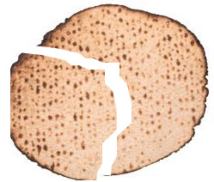
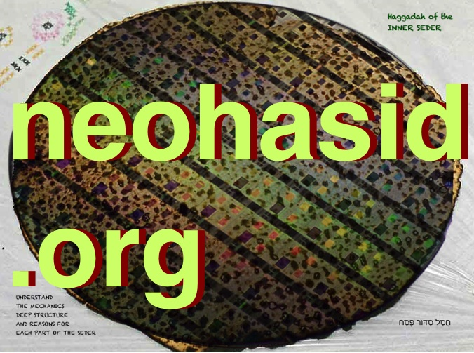
Passover 2021
Connecting to Jews around the world
Slides for a Zoom seder
Slides about customs and communities
by Sarah Bunin Benor, sbenor@huc.edu
Revised and edited, with added commentary
by Rabbi David Seidenberg, rebduvid86@gmail.com, neohasid.org
Haggadah text and commentary by Rabbi David Seidenberg,
from Haggadah of the Inner Seder
Dedicated to Jewlia Eisenberg, a”h

Slide 3
Preface
This PowerPoint presentation is intended for use during a Zoom seder or to be projected at a home seder. For Zoom, you might want to begin screensharing around slide 5 and turn it off periodically for discussion. The formal Haggadah begins on slide 13. It ends on slide 82, followed by songs. The core of Magid (the Haggadah story) is slides 31-36 – and it’s enough if you’re looking to abridge.
This presentation includes most of the traditional Haggadah in Hebrew and English, as well as videos, texts, and traditions from around the world, including multiple Jewish languages. You can tailor the slides to your own seder. After all the songs you will find the full Hebrew of the omitted or abridged sections as it appears in the Ashkenazi Haggadah, which you can insert in their appropriate locations, using sefaria.org as a guide.

Slide 4
One whole year
Short cuts
We began an unwelcome journey through the pandemic last year at Purim, and many of us did a seder over Zoom one month later to be with friends and family. This year, people who have finished their vaccinations might be gathering in person. But we might still want to use zoom, because travel is still limited and even without the pandemic, family and friends may be far-flung and sorely missed.
May we all find healing and find the strength to make a better world out of this one. And may this presentation of the Haggadah help you find wonderful ways to celebrate!
This Haggadah is open source, meaning you can change anything, but please give credit to its sources on neohasid.org and the Jewish Language Project.

Slide 5
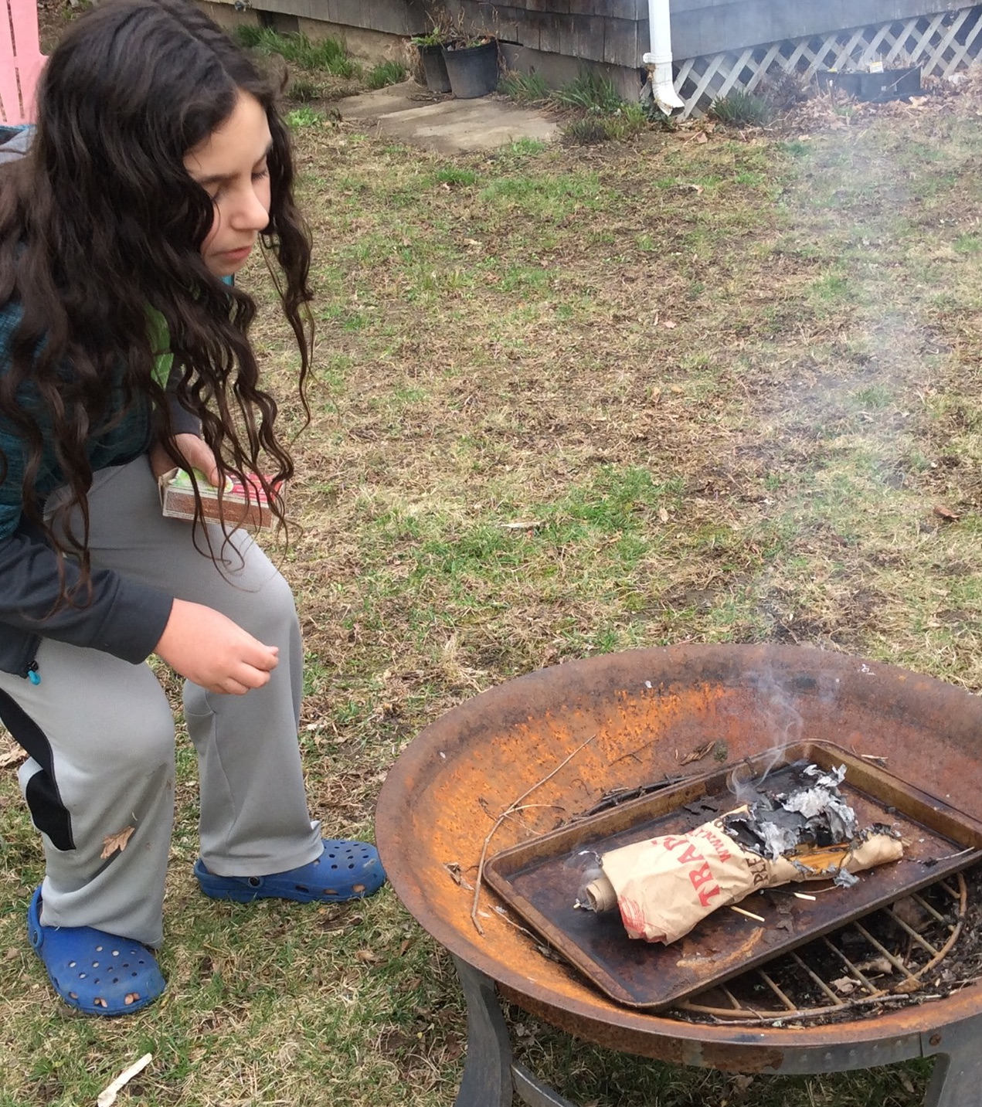
Burning/Removing Chametz
After searching for chametz and then again when again when you burn it, say, “All the chametz that is in my possession or domain, which I (did see or) did not see and which I (did remove or) did not remove, let it be nullified, let it become like the dirt of the earth/afra d’ar’a.”
Kol chamira v’chami`a d’ika bir’shuti (d’chaziteih u)d’la chaziteih, (d’vi`arteih u)d’la vi`arteih lev’tul v’lehevei k`afra d`ar`a.
May we remember on this day that just as we do not own this chametz, we do not own this Earth. May we recall that Adam, the human, is made of afar min ha’adamah, soil, dirt, and that we belong to the soil. May we cherish the soil that comes from centuries of rocks breaking and life growing and decomposing. We too are "hewn from the rock and dug from the mine" of Abraham and Sarah. And so, may it be Your will, Adonai Eloheinu, that we give truth to Your promise to Abraham, that his progeny would become “like the dirt of the earth, ka`afar ha’aretz” – k`afra d’ar’a – and that, like the soil, we may live to nourish all Life.
Many have the custom to light the fire using lulavs from Sukkot as kindling.

Slide 6
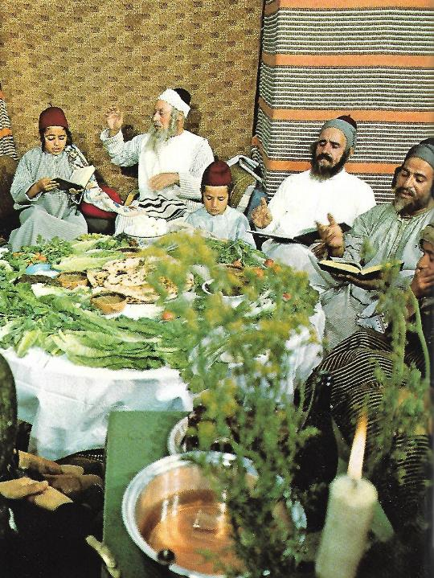
Welcome
Zoom Introductions: Invite each guest individually to share:
Name
Location
Coronavirus/vaccine check-in
A thought about how the Exodus story relates to our situation
Why an international seder?
When we are stuck in the “narrow place” of our homes, we can still connect symbolically with Jewish communities around the world

Slide 7
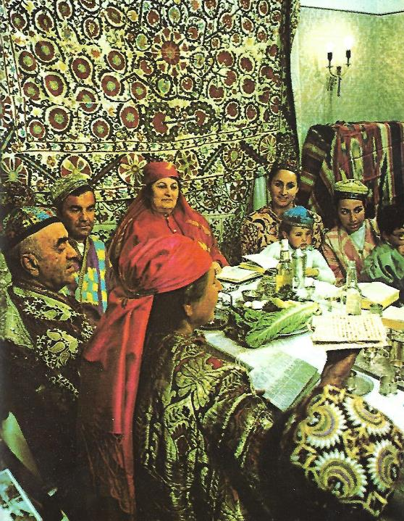
Welcome
How is this an international seder?
Songs Images Phrases
Traditions Foods
This seder also illuminates the deep structure of the haggadah.
Words in blue are added to the English translation to help the Hebrew make sense.
Words in red are commentary or directions.

Slide 8
Some short cuts
Even if you just do the core of the Maggid story, slides 31-36, you’ve accomplished the seder!
Kiddush – slide 13
Karpas – slide 15
Ha lachma anya – slide 19
The four questions – slide 20
The four children – slide 22
The core of the Maggid story – slide 31
The plagues – slide 36
Dayenu – slide 37
The climax of the haggadah – slide 43
Second cup – slide 47
Eating matzah, maror and korekh (the “Hillel sandwich”) – slide 50
Afikoman – slide 65
Birkat hamazon, main blessing – slide 68
Third cup – slide 74
Pour out Your wrath/Elijah’s cup – slide 75
Fourth cup – slide 80
Songs – slide 83
Chad gadya – slide 95

Slide 9
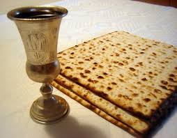
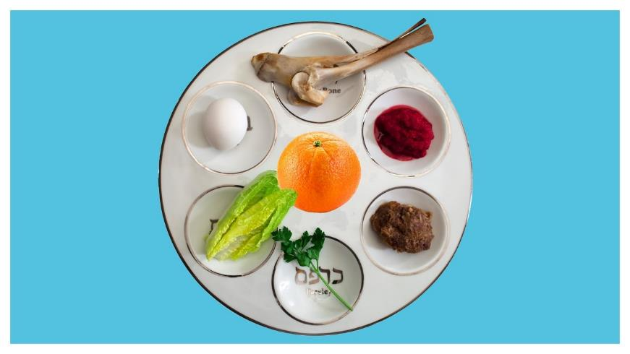
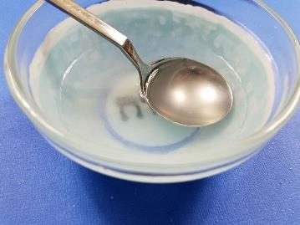
Seder plate
Many people place a cup of water on the table to remember Miriam’s well that followed the Israelites through the desert.
Salt water
Matzah, wine, Elijah’s cup

Slide 10
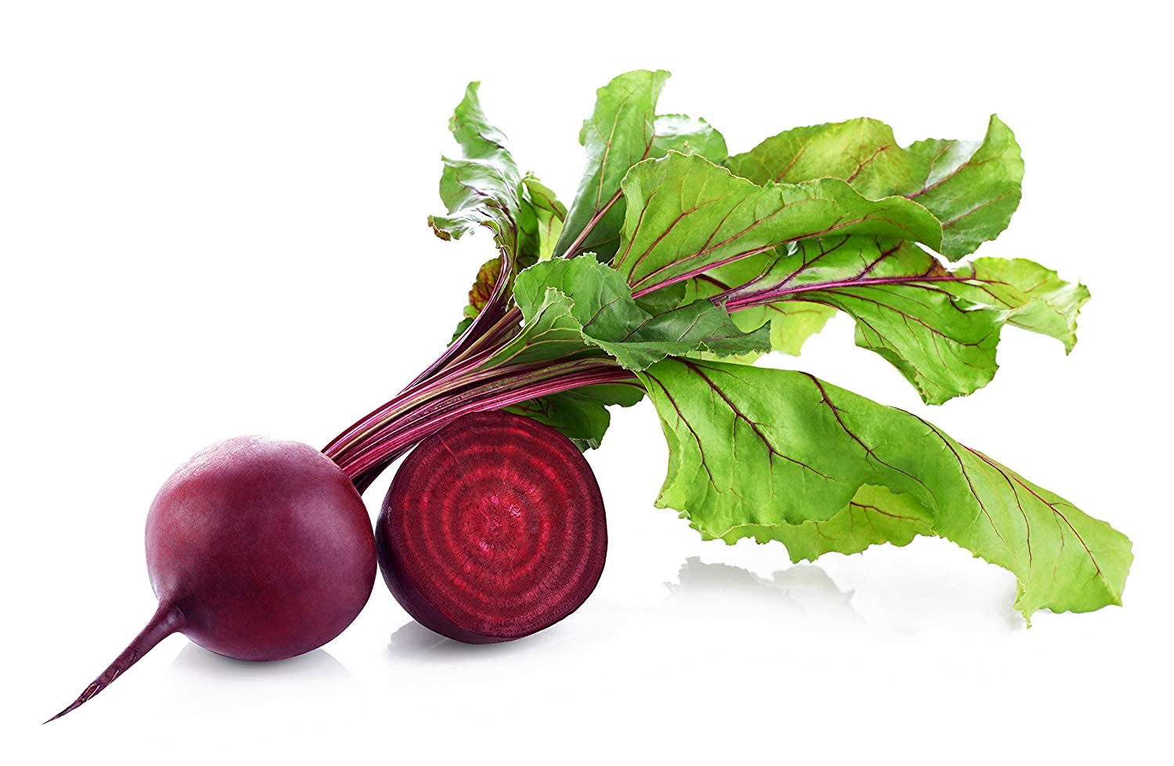
Seder plate
There are many different customs about how to arrange the seder plate. The next four slides show examples.
Z’ro’a:
the shank bone representing the Paschal lamb can be replaced by a “paschal yam” or roasted beet
Beitzah: Roasted egg
Maror:
Bitter herb – horseradish, can also be dandelion, romaine lettuce (Sephardi), or other greens
Orange:
American innovation to represent inclusion, originally of women or of lesbians, now for anyone who might have been excluded
Chazeret:
Romaine lettuce or other bitter herbs for the Hillel sandwich
Charoset:
Fruit or fruit and nut mixture (below you’ll learn more about worldwide charoset customs)
Karpas:
Parsley, celery – and greens you can forage where you live, symbolizing spring

Slide 11
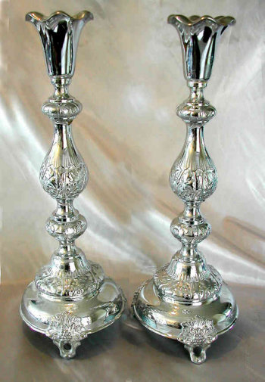
Candle lighting
בָּרוּךְ אַתָּה ה', אֱלֹהֵינוּ מֶלֶךְ הָעוֹלָם אֲשֶׁר קִדְּשָׁנוּ בְּמִצְוֹתָיו וְצִוָּנוּ לְהַדְלִיק נֵר שֶׁל יוֹם־טוֹב
Barukh atah Adonai Eloheinu melekh ha’olam asher kidishanu b'mitzvotav v'tzivanu l'hadlik ner shel yom-tov.
Blessed be You YHVH Adonai our God Ruler of all space and time, who made us holy through commandments and commanded us to kindle the light of the holy day.
Some Sefardim light candles after kiddush. Candles are traditionally lit from an already burning candle.

Slide 12
Shehecheyanu - שֶׁהֶחֱיָנוּ
בָּרוּךְ אַתָּה ה', אֱלֹהֵינוּ מֶלֶךְ הַעוֹלָם שֶׁהֶחֱיָנוּ וְקִיְּמָנוּ וְהִגִּיעָנוּ לַזְּמַן הַזֶּה
Barukh atah Adonai Eloheinu melekh ha'olam shehecheyanu vekiyemanu vehigi’anu lazman hazeh.
Blessed be You, YHVH Adonai our God, Ruler of all space and time, who has granted us life, sustained us and enabled us to reach this season.
May it become a season of healing for all the world.

Slide 13
Table of contents – order of the seder
1. Kadesh 2. Urchatz 3. Karpas 4. Yachatz 5. Magid 6. Rochtzah 7. Motzi, Matzah 8. Maror 9. Korekh 10. Shulchan orekh 11. Tzafun 12. Barekh 13. Hallel 14. Nirtzah | קַדֵש וּרְחַץ כַּרְפַּס יחץ מגיד רָחְצָה מוֹצִיא, מַצָּה מָרוֹר כּוֹרֵך שֻׁלְחָן עוֹרֵך צָפוּן בָּרֵך הלל נרצה | 1. Recite the Kiddush (Sanctification - blessing over wine)​ 2. Wash hands without a blessing 3. Parsley dipped in salt water 4. Break the middle matzah, and hide part to be Afikomen 5. Tell the Exodus story 6. Wash hands with a blessing 7. Recite the blessings for bread and matzah 8. Eat a bitter herb (maror) 9. Each matzah, maror, and charoset together in a sandwich​ 10. Festive meal 11. Afikoman​​ 12. Say Grace after the meal 13. Remainder​ of Hallel 14. Prayer for acceptanc​e of the service, fun songs

Slide 14
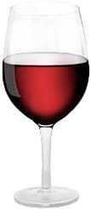
Kadesh - קַדֵּשׁ - first cup
Short cuts
Barukh atah Adonai Eloheinu melekh ha’olam borey pri hagafen. Blessed be You YHVH Adonai, our God, ruler of all space-and-time, who chose us from every people and exalted us from every tongue, and made us holy through God’s commandments. And You YHVH our God gave us in love celebrations for joy and seasons for rejoicing, this holy day of matsot, season of our freedom, called holy, a remembrance of going out from Egypt. For us You chose and us You made holy [from all the peoples], and the convocations of Your holiness in joy and rejoicing, you made us inherit. Blessed be You YHVH Adonai, who makes Israel and the seasons holy. Blessed be You, YHVH Adonai our God, Ruler of all space and time, who has granted us life, sustained us and enabled us to reach this season. | בָּרוּךְ אַתָּה, יהוה אֱלֹהֵינוּ, מֶלֶךְ הָעוֹלָם בּוֹרֵא פְּרִי הַגָּפֶן. בָּרוּךְ אַתָּה יהוה אֱלהֵינוּ מֶלֶךְ הָעוֹלָם אֲשֶׁר בָּחַר בָּנוּ מִכָּל-עָם וְרוֹמְמָנוּ מִכָּל-לָשׁוֹן וְקִדְּשָׁנוּ בְּמִצְוֹתָיו. וַתִּתֶּן לָנוּ ה' אֱלֹהֵינוּ בְּאַהֲבָה מוֹעֲדִים לְשִׂמְחָה, חַגִּים וּזְמַנִּים לְשָׂשוֹן, אֶת יוֹם חַג הַמַּצּוֹת הַזֶּה זְמַן חֵרוּתֵנוּ, מִקְרָא קֹדֶשׁ זֵכֶר לִיצִיאַת מִצְרָיִם. כִּי בָנוּ בָחַרְתָּ וְאוֹתָנוּ קִדַּשְׁתָּ ]מִכָּל הָעַמִּים[, וּמוֹעֲדֵי קָדְשֶׁךָ בְּשִׂמְחָה וּבְשָׂשוֹן הִנְחַלְתָּנוּ. בָּרוּךְ אַתָּה יהוה, מְקַדֵּשׁ יִשְׂרָאֵל וְהַזְּמַנִּים. בָּרוּךְ אַתָּה יהוה אֱלֹהֵינוּ מֶלֶךְ הַעוֹלָם שֶׁהֶחֱיָנוּ וְקִיְּמָנוּ וְהִגִּיעָנוּ לַזְּמַן הַזֶּה Drink while reclining to the left

Slide 15
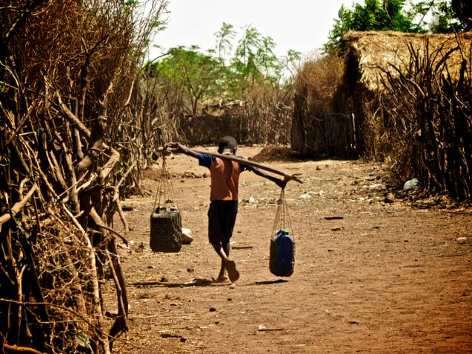
Urchatz - ורחץ
This washing prepares us to dip the Karpas into the salt water.
You can bring a cup of water and bowl to the seder table to wash.
Wash your hands without a blessing.
In contrast to many people in our country and around the world, especially refugees, we're fortunate to have easy access to water.
A kavannah to recite together:
In thanks for this water that we use to uplift our hands, may we use our hands to keep the waters pure.

Slide 16
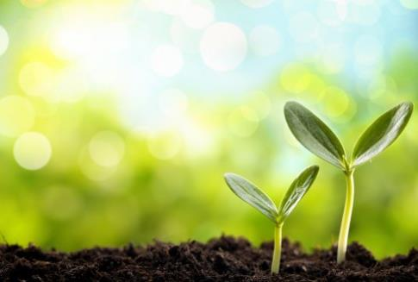
Karpas – כרפס – blessing
בָּרוּךְ אַתָּה ה', אֱלֹהֵינוּ מֶלֶךְ הָעוֹלָם, בּוֹרֵא פְּרִי הָאֲדָמָה.
Barukh atah Adonai Eloheinu melekh ha’olam borei pri ha’adamah.
Blessed be You, YHVH Adonai, our God, ruler of all space-and-time, who creates the fruit of the earth.
Eat parsley or other green vegetable – if you grow your own make sure you pick it before the holiday begins!
Despite the crisis, spring is sprouting up around us.
Other ideas for karpas besides parsley:
Syrians use celery. Russians use potatoes (nothing green would be growing yet). What other customs do you know about?

Slide 17
Karpas – כרפס – reflection
The sparkling flowers are seen in the land, the time of song has arrived, the voice of the dove is heard in our land. ~ Song of Songs 2:12
If the Earth Could Speak, What Might it Say?
As you dip the beauty of greens into the water of tears, please hear my cry. Can’t you see that I am slowly dying? My forests are being clear cut, diminished. My diverse and wondrous creatures — birds of the sky and beasts of the fields—small and large are threatened with extinction in your lifetimes. My splendid, colorful floral and fauna are diminishing in kind. My tropical places are disappearing before us, and my oceans are warming. Don’t you see that my climate is changing, bringing floods and heat, more extreme cycles of cold and warm, all affecting you and all our Creation? It doesn’t have to be!
— Rabbi Warren Stone
…May these waters into which we dip greens become healing waters that soothe and restore, as tears do.
For lots more Pesach Earth-torah: see
The Promise of the Land haggadah

Slide 18
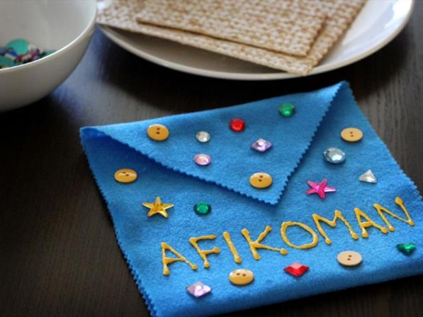
Yachatz - יחץ
Split the middle matzah in two unequal pieces, and hide the larger piece to use for the afikoman.
The Syrian custom is to break the matsah so that the bigger half is like a letter Dalet (ד – kind of like a Pacman), and the smaller half like a Yud (י). The two pieces then spell Yad, for the strong hand that redeemed us.

Slide 19
Yachatz – a Syrian Jewish custom
The seder participants then ask each person these questions while they hold the matzah‫:
Min wen jayye? – Where are you coming from?
They answer:
Mimmitsrayim – From Egypt!
Lawen rayyich? – Where are you going?
Lirushalayim – To Jerusalem!
Ishu zawatak? What are your provisions?
Matsah u-maror – matsah and maror!
Each participant holds the afikoman wrapped in cloth in their right hand over their left shoulder and recites:
Mishe'arotam tserurot besimlotam al shekhmam. Ubenei yisra'el asu kidbar Moshe.
…“Their kneading bowls/ their leftover things (were) tied up in their cloaks on their shoulder. And the children of Israel did according to Moshe’s word...” (Exod. 12:34-35) .

Slide 20
Ha Lachma Anya - הָא לַחְמָא עַנְיָא
Short cuts
Uncover the smaller half of the broken middle matzah, raise it, and recite:
Ha lachma anya di akhalu avhatana b'ar'a d'mitzrayim, b'ar'a d'mitzrayim. Kol dichfin yetei v’yekhol, kol ditzrikh yetei v'yifsach. Hashata hakha, l'shanah haba'ah b'ar'a d'yisrael. Hashata av'dei, l'shanah haba’ah benei chorin.
This is the bread of poverty and oppression that our ancestors ate in the land of Egypt. Anyone hungry, let them come and eat. Anyone needing, let them come and make Passover. Now – here. Next year – in the land of Israel. Now – slaves. Next year – freed people.
הָא לַחְמָא עַנְיָא דִּי אֲכָלוּ אַבְהָתָנָא בְאַרְעָא דְמִצְרָיִם. כָּל דִכְפִין יֵיתֵי וְיֵיכֹל, כָּל דִצְרִיךְ יֵיתֵי וְיִפְסַח. הָשַּׁתָּא הָכָא, לְשָׁנָה הַבָּאָה בְּאַרְעָא דְיִשְׂרָאֵל. הָשַּׁתָּא עַבְדֵי, לְשָׁנָה הַבָּאָה בְּנֵי חוֹרִין.
This is the first explanation given for matzah. This matzah is the matzah of slavery.
Why would anyone want to share this meal of poverty and degradation?
The small half represents not having enough. What else can it represent?
Ha Lachma Anya is the first of four times we begin telling the story.

Slide 21
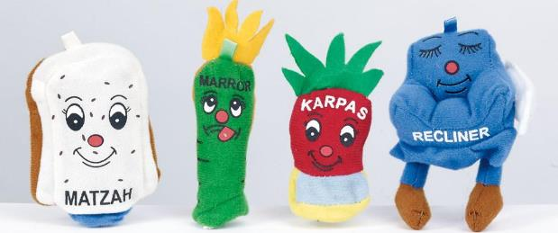
Four Questions (cover or remove the seder plate)
Ma nishtana halayla hazeh mikol halelot?
What makes this night different than all other nights ~
(Why is it) that in all other nights we eat chametz or matzah, but this night it’s all matsah?
(Why is it) that in all other nights we eat the rest of the vegetables, but this night maror?
(Why is it) that in all other nights we don’t dip once, but this night two times?
מַה נִּשְׁתַּנָּה הַלַּיְלָה הַזֶּה מִכָּל הַלֵּילוֹת?
שֶׁבְּכָל הַלֵּילוֹת אָנוּ אוֹכְלִין חָמֵץ וּמַצָּה, הַלַּיְלָה הַזֶּה – כֻּלּוֹ מַצָּה.
שֶׁבְּכָל הַלֵּילוֹת אָנוּ אוֹכְלִין שְׁאָר יְרָקוֹת – הַלַּיְלָה הַזֶּה (כֻּלּוֹ) מָרוֹר.
שֶׁבְּכָל הַלֵּילוֹת אֵין אָנוּ מַטְבִּילִין אֲפִילוּ פַּעַם אֶחָת – הַלַּיְלָה הַזֶּה שְׁתֵּי פְעָמִים.
שֶׁבְּכָל הַלֵּילוֹת אָנוּ אוֹכְלִין בֵּין יוֹשְׁבִין וּבֵין מְסֻבִּין – הַלַּיְלָה הַזֶּה כֻּלָּנוּ מְסֻבִּין.

Slide 22
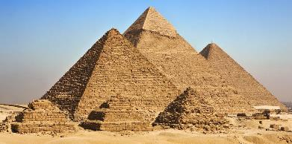
We Were Slaves in Egypt - עֲבָדִים הָיִינו
Short cuts
Slaves we were to Pharaoh in Egypt, and YHVH our God brought us out from there with a strong hand and a stretched out arm. (Deut. 6:21) And were it not for the Holy One bringing our ancestors out from Egypt, still would we and our children and our children’s children be enslaved to Pharaoh in Egypt.
עֲבָדִים הָיִינוּ לְפַרְעֹה בְּמִצְרָיִם, וַיּוֹצִיאֵנוּ ה' אֱלֹהֵינוּ מִשָּׁם בְּיָד חֲזָקָה וּבִזְרֹעַ נְטוּיָה. וְאִלּוּ לֹא הוֹצִיא הַקָּדוֹשׁ בָּרוּךְ הוּא אֶת אֲבוֹתֵינוּ מִמִּצְרָיִם, הֲרֵי אָנוּ וּבָנֵינוּ וּבְנֵי בָנֵינוּ מְשֻׁעְבָּדִים הָיִינוּ לְפַרְעֹה בְּמִצְרָיִם. וַאֲפִילוּ כֻּלָּנוּ חֲכָמִים כֻּלָּנוּ נְבוֹנִים כֻּלָּנוּ זְקֵנִים כֻּלָּנוּ יוֹדְעִים אֶת הַתּוֹרָה מִצְוָה עָלֵינוּ לְסַפֵּר בִּיצִיאַת מִצְרָיִם. וְכָל הַמַּרְבֶּה לְסַפֵּר בִּיצִיאַת מִצְרַיִם הֲרֵי זֶה מְשֻׁבָּח.
Avadim hayinu, hayinu, l'faroh b'mitzrayim, b’mitzrayim.
(Some wait til later to sing:) Avadim hayinu. Ata, ata, bnei chorin. Avadim hayinu. Ata, ata, bnei chorin, bnei chorin.
We already began the story at Ha Lachma Anya – but here we begin the story a second time.

Slide 23
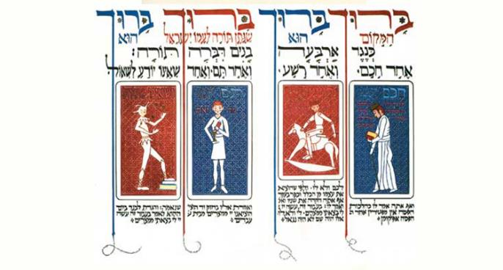
Four Children
Short cuts
Blessed be the Makom, the Place. Blessed be. Blessed be the One who gave Torah to God’s people Israel. Blessed be. And the Torah speaks about four children:
A wise one, an evil one, a simple one, and one who doesn't know to ask.
בָּרוּךְ הַמָּקוֹם, בָּרוּךְ הוּא, בָּרוּךְ שֶׁנָּתַן תּוֹרָה לְעַמּוֹ יִשְׂרָאֵל, בָּרוּךְ הוּא.
כְּנֶגֶד אַרְבָּעָה בָנִים דִּבְּרָה תוֹרָה: אֶחָד חָכָם, וְאֶחָד רָשָׁע, וְאֶחָד תָּם, וְאֶחָד שֶׁאֵינוֹ יוֹדֵעַ לִשְׁאוֹל.
Barukh Hamakom Barukh Hu
Barukh shenatan Torah l’amo Yisrael
Barukh Hu
B’ruchah Hi
The four children, Moss Haggadah

Slide 24
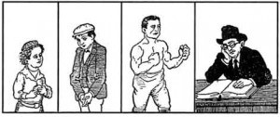
Four Children – #1, the ”wise one”
A wise one (chakham) – what does that one say? What are the testimonies and statutes and just laws which YHVH our God commanded you-all? (Deut. 6:20) So should you even talk to them the same way about the laws of the Pesach offering. Tell them: “they don’t add after the Pesach any afikoman.”
The children go up in levels of purity, presence, openness.
The wise one is amenable but is also less connected and unable to have a visceral experience of leaving Egypt. The response to the wise one is similarly disembodied: not “we don’t add”, but “they don’t add…”
חָכָם מָה הוּא אוֹמֵר? מָה הָעֵדוֹת וְהַחֻקִּים וְהַמִּשְׁפָּטִים אֲשֶׁר צִוָּה ה' אֱלֹהֵינוּ אֶתְכֶם. וְאַף אַתָּה אֱמוֹר לוֹ כְּהִלְכוֹת הַפֶּסַח: אֵין מַפְטִירִין אַחַר הַפֶּסַח אֲפִיקוֹמָן:
The “wise one” receives information, not meaning, not revelation. At least the “wicked one” takes a stand for something.

Slide 25
Four Children – #2, the “wicked one”
A wicked one (rasha) – what does that one say? What is this service/servitude to you all? (Exod. 12:26)
To you all – meaning not to them. And when they have brought themself out from the whole – they have denied the root.
And even you, knock their teeth, and go say to them: “Because of this YHVH acted for me in my going out from Egypt / Ba'avur zeh `asah li Adonai b’tseiti mimitsrayim.” (Exod. 13:8) For me and not for them. If they were there, they were not redeemed.
This is the first of four times we mention the verse “Ba'avur zeh”. Here it’s used to exclude someone else. The teacher has not learned the lesson.
רָשָׁע מָה הוּא אוֹמֵר? מָה הָעֲבוֹדָה הַזּאֹת לָכֶם. לָכֶם - וְלֹא לוֹ. וּלְפִי שֶׁהוֹצִיא אֶת עַצְמוֹ מִן הַכְּלָל כָּפַר בְּעִקָּר. וְאַף אַתָּה הַקְהֵה אֶת שִׁנָּיו וֶאֱמוֹר לוֹ: "בַּעֲבוּר זֶה עָשָׂה ה' לִי בְּצֵאתִי מִמִּצְרָיִם". לִי וְלֹא-לוֹ. אִלּוּ הָיָה שָׁם, לֹא הָיָה נִגְאָל:
“Knock his teeth (hak’heh et shinav)” – this is what the midrash says Adam and Eve experienced when they ate the fruit from the tree of knowing.
The rasha may be irreverent, but the rasha is ready to be engaged, knocked off balance.

Slide 26
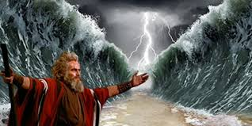
Four Children – #3, the simple one
An innocent/simple/whole one (tam) – what does that one say? What’s this? (Exod. 13:14) And you will say unto him: by a strong hand YHVH brought us out from Egypt, from the house of slaves. (Exod. 13:14)
The tam is present and open.
But the next child, the one who doesn’t know to ask, is the one who is ready for the deepest opening and transformation.
תָּם מָה הוּא אוֹמֵר? מַה זּאֹת? וְאָמַרְתָּ אֵלָיו: בְּחוֹזֶק יָד הוֹצִיאָנוּ ה' מִמִּצְרַיִם מִבֵּית עֲבָדִים".

Slide 27
Four Children – #4, one who needs help asking
And one who doesn’t know to ask (she’eino yode`a lish’ol)? You open for them, as it is says: And you will tell your child in that day: Because of this YHVH acted for me in my going out from Egypt / Ba`avur zeh… (Exod. 13:8)
The verse used to answer this child, the one who doesn’t know, is the same as the one used to answer the “wicked” child. But the meaning is almost the opposite. This is the first step in transforming how we understand “Ba'avur zeh”, from the meaning of excluding others to including oneself.
וְשֶׁאֵינוֹ יוֹדֵעַ לִשְׁאוֹל - אַתְּ פְּתַח לוֹ, שֶׁנֶּאֱמַר: וְהִגַּדְתָּ לְבִנְךָ בַּיּוֹם הַהוּא לֵאמֹר, בַּעֲבוּר זֶה עָשָׂה ה' לִי בְּצֵאתִי מִמִּצְרָיִם
“You open.” Open what? Open yourself. The word for you, “aht”, is the feminine form in Hebrew. So this is also interpreted by some to mean, enter the feminine part of yourself.
When do we tell the story? When matsah and maror are before you, as it says, “Because of this / Ba’avur zeh… (Exod. 13:8 again!)
This is the second step in transforming the verse: now it calls us to focus on the present moment and on our bodies. The climax of the seder is the final transformation.

Slide 28
Beginning the story again
Short cuts
Before the “promise” section (“V’hi she'amdah”), the traditional Haggadah begins the story for a third time:
“From beginning, our ancestors were servants of idolatry, and now the Makom (Place) drew us near to service of the One, as it is said: And Yehoshua said to all the people, so said YHVH, Israel’s God – over beyond the River your ancestors were settled from forever and they served other Gods, and I took your father, Avraham, over beyond the River, and I made him walk through all the land of Canaan… and Yaakov and his children went down Egypt”. (Josh. 24:2-4)
After “the promise” and “v’hi she’amdah”, the haggadah begins the story for the fourth and final time (slide 30), which starts with verse 26:5 from Deuteronomy:
אֲרַמִּי אֹבֵד אָבִי
An Aramean who wanders lost was my father…
How would you begin the story?
The traditional Haggadah has four beginnings. Why does the Haggadah “stutter” and retrace its steps by beginning to tell the story four times?
If you skip the first three beginnings and just start with the fourth (slide 30), that still counts as telling the story!

Slide 29
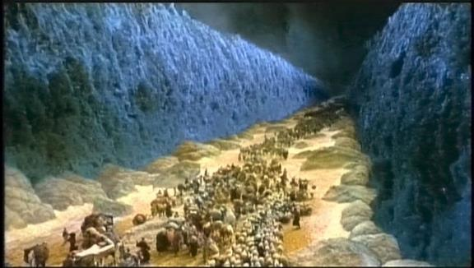
God’s promise – our fate
Lift the cup, cover the matsah, and say:
Blessed be the One who guards the promise to Israel. Blessed be!
For the Holy One calculated the end at the beginning,
telling it like this to Abraham our father at the covenant of the sacrificial halves:
And God said to Avram, know, you must know that your seed will be a stranger/ a refugee/ an immigrant (ger) in a land that is not for them, and they will serve them, and they will harm them and impoverish them four hundred years. And also I will judge that nation that they serve, and after they will go out with great wealth. (Gen. 15:13-14)

Slide 30
V’hi she’amdah - וְהִיא שֶׁעָמְדָה
Continue lifting the cup:
And she (the promise) is what stood up for our ancestors and for us, for it wasn’t only one who stood over us to finish us off, but in each and every generation they stand over us to finish us off. But the Holy One rescues us from their hand.
V’hi she’amdah, v’hi she’amdah, la’avoteinu v’lanu, le’imoteinu v’lanu. x2
Shelo echad bilvad amad aleinu l’khaloteinu,
Ela sheb’khol dor vador omdim aleinu l’khaloteinu
v'hakadosh barukh hu matzilenu miyadam.
וְהִיא שֶׁעָמְדָה לַאֲבוֹתֵינוּ וְלָנוּ. שֶׁלֹּא אֶחָד בִּלְבָד עָמַד עָלֵינוּ לְכַלּוֹתֵנוּ, אֶלָּא שֶׁבְּכָל דּוֹר וָדוֹר עוֹמְדִים עָלֵינוּ לְכַלוֹתֵנוּ, וְהַקָּדוֹשׁ בָּרוּךְ הוּא מַצִּילֵנוּ מִיָּדָם.

Slide 31
Magid – the core of the story
Short cuts
Now the Haggadah begins telling the story for the fourth and final time!
צֵא וּלְמָד
Go out and learn!
For the rest of the storytelling, the Haggadah goes phrase by phrase through the story told in Deut. 26:5-8, mostly using verses from elsewhere in the Bible to explain what each phrase means.
Arami oveid avi אֲרַמִּי אֹבֵד אָבִי
An Aramean who wanders lost was my father…
The traditional haggadah interprets this to mean “An Aramean wanted to destroy my father” The words for “lost” and “destroy” are similar in Hebrew. So it begins:
Come and learn what Lavan the Aramean wanted to do to Jacob our father! For Pharoah only decreed against the males, but Lavan sought to uproot everything, as it says, “Arami oveid avi…”
It’s as if the Haggadah were afraid or superstitious about beginning the story this final time and so it hides it.

Slide 32
Magid – the core of the story
You can skip ahead two slides to get to the story!
5 An Aramean who wanders lost was my father, and he went down Egyptward, and he sojourned there in few numbers, and he became there a nation, great, mighty and many. 6 And they did evil to us / they made us out to be evil, and they oppressed us, and they put on us heavy service. 7 And we cried out unto YHVH God of our ancestors, and YHVH heard our voice and saw our oppression/ our humiliation, and our laboring, and our being squeezed. 8 And YHVH brought us out from Egypt with a strong hand and arm outstretched, with great fear and with signs and with wonders. 9 And brought us unto this place, and gave to us this land, a land dripping milk and honey. 10 And now, here, I have brought the first of the fruit of the earth that YHVH gave to me. (Deut. 26:5-10)
The traditional haggadah is based on the first four verses of the Exodus story as it is retold in Deuteronomy 26:
אֲרַמִּי אֹבֵד אָבִי וַיֵּרֶד מִצְרַיְמָה וַיָּגָר שָׁם בִּמְתֵי מְעָט וַיְהִי שָׁם לְגוֹי גָּדוֹל עָצוּם וָרָב
וַיָּרֵעוּ אֹתָנוּ הַמִּצְרִים וַיְעַנּוּנוּ וַיִּתְּנוּ עָלֵינוּ עֲבֹדָה קָשָׁה
וַנִּצְעַק אֶל יְהוָה אֱלֹהֵי אֲבֹתֵינוּ וַיִּשְׁמַע יְהוָה אֶת קֹלֵנו וַיַּרְא אֶת עָנְיֵנוּ וְאֶת עֲמָלֵנוּ וְאֶת לַחֲצֵנוּ
וַיּוֹצִאֵנוּ יְהוָה מִמִּצְרַיִם בְּיָד חֲזָקָה וּבִזְרֹעַ נְטוּיָה וּבְמֹרָא גָּדֹל וּבְאֹתוֹת וּבְמֹפְתִים
וַיְבִאֵנוּ אֶל הַמָּקוֹם הַזֶּה וַיִּתֶּן לָנוּ אֶת הָאָרֶץ הַזֹּאת אֶרֶץ זָבַת חָלָב וּדְבָשׁ
וְעַתָּה הִנֵּה הֵבֵאתִי אֶת רֵאשִׁית פְּרִי הָאֲדָמָה אֲשֶׁר נָתַתָּה לִּי יְהוָה

Slide 33
Magid – the core: we explain each verse – verse 1
Here we begin telling the story for the fourth time…
An Aramean who wanders lost was my father, and he went down Egyptward, and he sojourned there in few numbers, and he became there a nation, great, mighty and many. (Deut. 26:5)
and he went down – forced by the promise of the Word –that Avram’s children were fated to become slaves.
and he sojourned – dwelled-as-a-stranger (vayagar) – teaching that (Jacob) didn’t go down to sink [roots] in Egypt, only to take refuge temporarily.
in few numbers – like what's said: With seventy souls your ancestors went down to Egypt.
great, mighty – as it’s said: And Israel’s children bore fruit and swarmed and multiplied (v’yirbu) and grew mighty, very very so, and the land filled with them.
אֲרַמִּי אֹבֵד אָבִי ויֵּרֶד מִצְרַיְמָה וַיָּגָר שָׁם בִּמְתֵי מְעָט וַיְהִי שָׁם לְגוֹי גָּדוֹל עָצוּם וָרָב
The last comment on this verse is left out of many haggadahs. Feel free to skip, but it’s a unique commentary that is worth discussing. and many (rav) – like what’s said: Swelling (r’vavah), like the growth of the field, so did I make you, and you increased (tarbi) and grew great, and came into such charms – your breasts grew firm and your hair grew, and you were naked and bare. And I passed over you and I saw you squatting in your bloods, and I said to you, in your bloods live! and I said to you, in your bloods live! (Ezek. 16:7, 16:6)

Slide 34
Magid – the core: we explain each verse – verse 2
And they did evil to us / they made us out to be evil, and they oppressed us, and they put on us heavy service. (Deut. 26:6)
They “eviled us” – this mean both that they did evil to us, and they saw us as evil: “Let us deal wisely with them…lest they join our enemies…” (Exod. 1:10)
and they put on us heavy service – as it’s said: And Egypt made Israel serve, with force b’farekh. (Exod. 1:13)
A Hasidic teaching understands this word to be like “b’feh rakh”, “with a soft mouth” – the Egyptians deceived the Hebrews by talking with gentleness.
וַיָּרֵעוּ אֹתָנוּ הַמִּצְרִים וַיְעַנּוּנוּ וַיִּתְּנוּ עָלֵינוּ עֲבֹדָה קָשָׁה
What lesson are we supposed learn from our experience? The Torah tells us:
When a stranger/refugee/ ger sojourns with you in your land you shall not mistreat him. The stranger who sojourns with you shall be for you like a native among you, and you shall love them as yourself, for you were strangers in the land of Egypt. I am YHVH, your God. (Lev. 19:16)

Slide 35
Magid – the core: we explain each verse – verse 3
And we cried out unto YHVH God of our ancestors, and YHVH heard our voice and saw our oppression/ our humiliation, and our laboring, and our being squeezed / our oppression. (Deut. 26:7)
And we cried out – like what’s said: And it was in those many days that the king of Egypt died, and Israel’s children were tortured from the servitude/from the service, and they screamed, and their pleading rose up unto Elohim (God). (Exod. 2:23)
and YHVH heard our voice – like what is said: And Elohim (God) heard their anguish, and Elohim remembered God’s covenant with Avraham, with Isaac, and with Jacob. (Exod. 2:24) => but didn’t God also remember our mothers, whose effort aroused redemption? See the next two comments:
וַנִּצְעַק אֶל יְהוָה אֱלֹהֵי אֲבֹתֵינוּ וַיִּשְׁמַע יְהוָה אֶת קֹלֵנו וַיַּרְא אֶת עָנְיֵנוּ וְאֶת עֲמָלֵנוּ וְאֶת לַחֲצֵנוּ
and saw our humiliation – this means the separation between women and men of “the way of the land”– because they were afraid to bring children into the world
and our laboring – these are the sons that the women labored to give birth to who were thrown into the Nile
and our being squeezed – this is the pressure, because they were not allowed to expand their dwellings when their families grew

Slide 36
Short cuts
Magid – the core: we explain each verse – verse 4
And YHVH brought us out from Egypt with a strong hand and arm outstretched, with great fearsome-ness, and with signs and with wonders. (Deut. 26:8)
And YHVH brought us out from Egypt – it was not by means of an angel. It was the Holy One blessed be who did it in glory, openly, as it says: And I will pass through the land of Egypt in this night, and I will strike down all first-born in the land of Egypt, from human to beast, and I will make judgments against all Egypt’s gods – I am YHVH. (Exod. 12:12)
with a strong hand – this is the pestilence (dever), like what’s said: Here, the hand of YHVH is going to be upon your herd in the field, on the horses, on the donkeys, on the camels, on the cattle and on the flocks. (Exod. 9:3) The oppression committed by humans against each other always comes to harm other creatures as well.
וַיּוֹצִאֵנוּ יְהוָה מִמִּצְרַיִם בְּיָד חֲזָקָה וּבִזְרֹעַ נְטוּיָה וּבְמֹרָא גָּדֹל וּבְאֹתוֹת וּבְמֹפְתִים
and with great fearsomeness – this is the revelation of the Shekhinah/God’s presence
and with signs – this is the staff (of Moses)
and with wonders – this is the blood, like what is said: And I will put my wonders in the skies and in the land, blood, and fire, and pillars of smoke. (Joel 3:3)
with a strong hand – two words, and arm outstretched – two words, and with great fearsomeness – two words, and with signs – two of them, and with wonders – two of them. This makes ten blows, ten plagues…

Slide 37
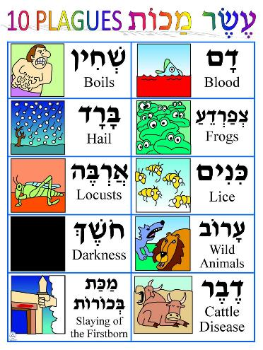
The Ten Plagues
אֵלּוּ עֶשֶׂר מַכּוֹת שֶׁהֵבִיא הַקָּדוֹשׁ בָּרוּךְ הוּא עַל הַמִּצְרִים בְּמִצְרַיִם, וְאֵלוּ הֵן:
דָּם
צְפַרְדֵּעַ
כִּנִּים
עָרוֹב
דֶּבֶר
שְׁחִין
בָּרָד
אַרְבֶּה
חשֶׁךְ
מַכַּת בְּכוֹרוֹת
רַבִּי יְהוּדָה הָיָה נוֹתֵן בָּהֶם
סִמָּנִים: דְּצַ״ךְ עַדַ״שׁ בְּאַחַ״ב.
This makes ten blows, ten plagues, that the Holy One, blessed be, brought on the Egyptians in Egypt, and they are:
Dam - Blood
Tzfarde'a - Frogs
Kinim - Lice
Arov - Wild animals
Dever - Pestilence
Shchin - Boils
Barad - Hail
Arbeh - Locusts
Choshech - Darkness
Makat Bechorot - Slaying of the firstborn

Slide 38
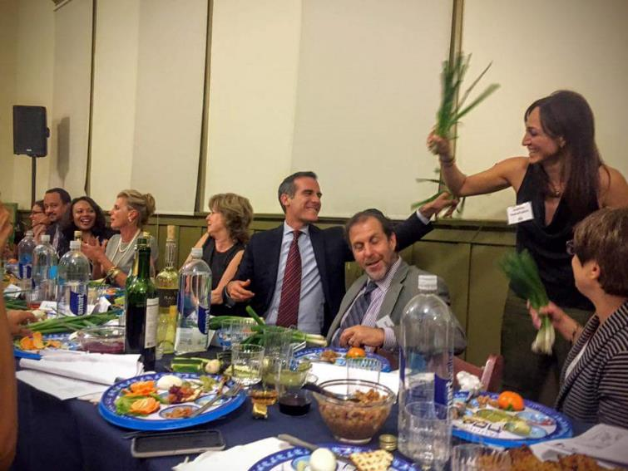
Dayenu! – short
Short cuts
אִלּוּ הוֹצִיאָנוּ מִמִצְרַיִם, דַּיֵּנוּ.
אִלּוּ נָתַן לָנוּ אֶת הַשַׁבָּת, דַּיֵּנוּ.
אִלּוּ נַתַן לָנוּ אֶת הַתּוֹרָה, דַּיֵּנוּ.
If the One only brought us out of Egypt…
If the One only gave us the Sabbath…
If the One only gave us the Torah…
It would be enough!
Ilu hotsi- hotsi’anu, hotsi’anu mimitzrayim, hotsi’anu mimitzrayim, dayenu.
Dai- dayenu, dai- dayenu, dai- dayenu, dayenu dayenu (x2)
Ilu natan natan lanu, natan lanu et hashabat, natan lanu et hashabat, dayenu.
Dai- dayenu, dai- dayenu, dai- dayenu, dayenu dayenu (x2)
Ilu natan natan lanu, natan lanu et hatorah, natan lanu et hatorah, dayenu.
Dai- dayenu, dai- dayenu, dai- dayenu, dayenu dayenu (x2)
It is a Persian custom to wack each other with green onions during Dayenu.

Slide 39
Dayenu! – long – #1
כַּמָה מַעֲלוֹת טוֹבוֹת לַמָּקוֹם עָלֵינוּ
How many good steps by the Makom (Place = God) raised us up!
If the One brought us out from Egypt, and did not do judgments on them – that would be enough for us! Dayeinu!
If the One did judgments on them, and did not do so on their gods – Dayeinu!
If the One did so on their gods, and did not kill their firstborn – Dayeinu!
If the One killed their firstborn, and did not give us their wealth – Dayeinu!
If the One gave us their wealth, and did not split the sea for us – Dayeinu!
If the One split the sea for us, and did not make us pass through on dry land – Dayeinu!
If the One made us pass through on dry land, and did not drown our oppressors – Dayeinu!
If the One drowned our oppressors in its midst, and did not fill our needs in the desert forty years – Dayeinu!
If the One filled our needs in the wilderness/desert forty years, and did not feed us manna – Dayeinu!
If the One fed us manna, and did not give us Shabbat – Dayeinu!
If the One gave us Shabbat, and did not bring us near before Mt. Sinai – Dayeinu!
If the One brought us near before Mt. Sinai, and did not give us the Torah – Dayeinu!
If the One gave us the Torah, and did not make us enter the land of Israel – Dayeinu!
If the One made us enter the land of Israel, and did not build for us the chosen House (the Temple) – Dayeinu!

Slide 40
Dayenu! – long – #2
Beyond each one, so much more so all of them – goodness doubled and redoubled by the Makom (Place) for us…
For the One brought us out from Egypt, and did judgments with them and did with their gods, and killed their firstborn and gave us their wealth, and split the sea for us and made us pass through on dry land, and drowned our oppressors in its midst, and stopped our needing in the wilderness/desert forty years and fed us manna, and gave us Shabbat, and brought us near before Mt. Sinai and gave us the Torah, and made us enter the land of Israel and built for us the chosen House (the Temple) to atone for our sins.
עַל אַחַת, כַּמָה וְכַּמָה, טוֹבָה כְפוּלָה וּמְכֻפֶּלֶת לַמָּקוֹם עָלֵינוּ: שֶׁהוֹצִיאָנוּ מִמִּצְרַיִם, וְעָשָׂה בָהֶם שְׁפָטִים, וְעָשָׂה בֵאלֹהֵיהֶם, וְהָרַג אֶת בְּכוֹרֵיהֶם, וְנָתַן לָנוּ אֶת מָמוֹנָם, וְקָרַע לָנוּ אֶת הַיָּם, וְהֶעֱבִירָנוּ בְּתוֹכוֹ בֶּחָרָבָה, וְשִׁקַּע צָרֵנוּ בְּתוֹכוֹ, וְסִפֵּק צָרְכֵּנוּ בַּמִדְבָּר אַרְבָּעִים שָׁנָה, וְהֶאֱכִילָנוּ אֶת הַמָּן, וְנָתַן לָנוּ אֶת הַשַּׁבָּת, וְקֵרְבָנוּ לִפְנֵי הַר סִינַי, וְנַתָן לָנוּ אֶת הַתּוֹרָה, וְהִכְנִיסָנוּ לְאֶרֶץ יִשְׂרָאֵל, וּבָנָה לָנוּ אֶת בֵּית הַבְּחִירָה לְכַפֵּר עַל כָּל עֲוֹנוֹתֵינוּ.
Would it really be enough for us if the sea split but our ancestors didn’t pass through it?

Slide 41
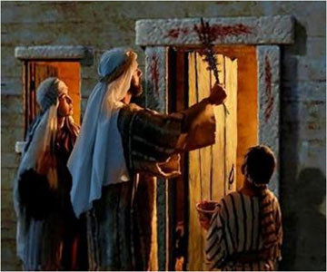
Rabban Gamliel’s Three Things - #1
Short cuts
Rabban Gamliel would say: Anyone who did not mention these three things on Pesach has not been brought out from the grip of their obligation, and these are: Pesach, Matsah, and Maror.
רַבָּן גַּמְלִיאֵל הָיָה אוֹמֵר:
כָּל שֶׁלֹּא אָמַר שְׁלשָׁה דְּבָרִים אֵלּוּ בַּפֶּסַח, לא יָצָא יְדֵי חוֹבָתוֹ, וְאֵלּוּ הֵן: פֶּסַח, מַצָּה, וּמָרוֹר.
1) Pesach that our ancestors were eating in the time when the House of the Sanctuary (the Temple) was standing, is because of what? Because the Holy One skipped over the houses of our ancestors in Egypt, as it is said: And you all will say: it is a sacrifice of Pesach for YHVH, who skipped (pasach-ed) over the houses of the children of Israel in Egypt when God plagued Egypt, and our houses the One rescued. And the people bowed and prostrated. (Exod. 12:27)
פֶּסַח שֶׁהָיוּ אֲבוֹתֵינוּ אוֹכְלִים בִּזְמַן שֶׁבֵּית הַמִּקְדָּשׁ הָיָה קַיָּם, עַל שׁוּם מָה? עַל שׁוּם שֶׁפָּסַח הַקָּדוֹשׁ בָּרוּךְ הוּא עַל בָּתֵּי אֲבוֹתֵינוּ בְּמִצְרַיִם, שֶׁנֶּאֱמַר: וַאֲמַרְתֶּם זֶבַח פֶּסַח הוּא לַה, אֲשֶׁר פָּסַח עַל בָּתֵּי בְנֵי יִשְׂרָאֵל בְּמִצְרַיִם בְּנָגְפּוֹ אֶת מִצְרַיִם, וְאֶת בָּתֵּינוּ הִצִּיל. וַיִּקֹּד הָעָם וַיִּשְׁתַּחווּ.

Slide 42
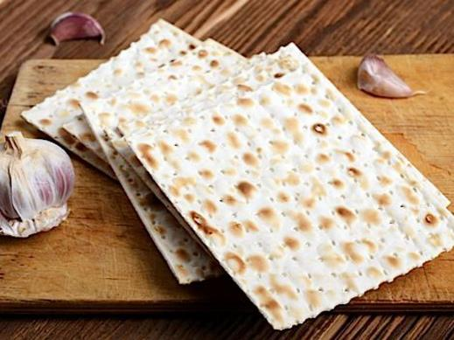
Rabban Gamliel’s Three Things - #2
Point to or lift the matzah.
2) This matsah that we are eating is because of what? Because their dough didn’t have time to rise to become chamets before the Ruler of the kings of kings, the Holy One, blessed be, was revealed over them and redeemed them, as it’s said: And they baked the dough which they brought out from Egypt, cakes of matsot, for it didn’t rise, for they were driven from Egypt, and they couldn’t linger or hesitate, and they couldn’t even prepare provisions for themselves. (Exod. 12:39)
מַצָּה זוֹ שֶׁאָנוֹ אוֹכְלִים, עַל שׁוּם מָה? עַל שׁוּם שֶׁלֹּא הִסְפִּיק בְּצֵקָם שֶׁל אֲבוֹתֵינוּ לְהַחֲמִיץ עַד שֶׁנִּגְלָה עֲלֵיהֶם מֶלֶךְ מַלְכֵי הַמְּלָכִים, הַקָּדוֹשׁ בָּרוּךְ הוּא, וּגְאָלָם, שֶׁנֶּאֱמַר: וַיֹּאפוּ אֶת הַבָּצֵק אֲשֶׁר הוֹצִיאוּ מִמִּצְרַיִם עֻגֹת מַצּוֹּת, כִּי לֹא חָמֵץ, כִּי גֹרְשׁוּ מִמִּצְרַיִם וְלֹא יָכְלוּ לְהִתְמַהְמֵהַּ, וְגַם צֵדָה לֹא עָשׂוּ לָהֶם.
This is the second explanation given for matsah. It is the beginning of the transformation of matsah from symbol of slavery to a symbol of freedom.

Slide 43
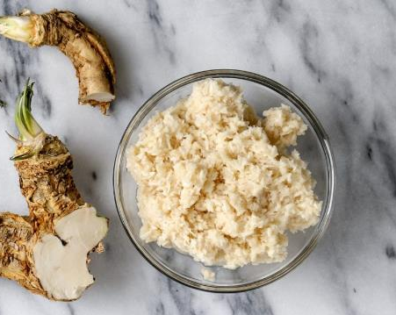
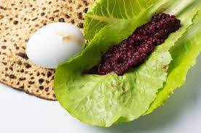
Rabban Gamliel’s Three Things - #3
Short cuts
Point to or lift the maror.
3) This maror [bitter herbs] that we are eating, for the sake of what [is it]? For the sake [to commemorate] that the Egyptians embittered the lives of our ancestors in Egypt, as it is stated (Exodus 1:14); "And they made their lives bitter with hard service, in mortar and in brick, and in all manner of service in the field; in all their service, wherein they made them serve with rigor."
In Sephardi custom greens are used. Syrians use romaine lettuce and add a bit of date charoset. Dandelion greens make the best bitters, and you can pick them from the earth yourself in many places.
מָרוֹר זֶה שֶׁאָנוּ אוֹכְלִים, עַל שׁוּם מָה? עַל שׁוּם שֶׁמֵּרְרוּ הַמִּצְרִים אֶת חַיֵּי אֲבוֹתֵינוּ בְּמִצְרַיִם, שֶׁנֶּאֱמַר: וַיְמָרְרוּ אֶת חַיֵּיהֶם בַּעֲבֹדָה קָשָה, בְּחֹמֶר וּבִלְבֵנִים וּבְכָל-עֲבֹדָה בַּשָּׂדֶה אֶת כָּל עֲבֹדָתָם אֲשֶׁר עָבְדוּ בָהֶם בְּפָרֶךְ.

Slide 44
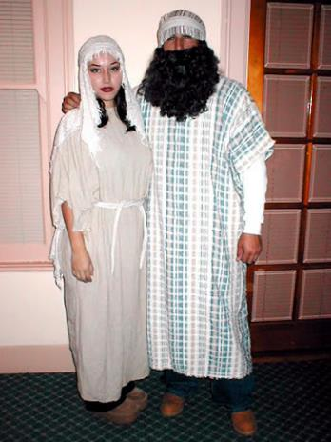
The Climax of the Seder - #1
בְּכָל דּוֹר וָדוֹר חַיָּב אָדָם לִרְאוֹת אֶת עַצְמוֹ כְּאִלּוּ הוּא יָצָא מִמִּצְרַיִם, שֶׁנֶּאֱמַר: וְהִגַּדְתָּ לְבִנְךָ בַּיּוֹם הַהוּא לֵאמֹר, בַּעֲבוּר זֶה עָשָׂה ה׳ לִי בְּצֵאתִי מִמִּצְרַיִם.
=> We cannot include ourselves by excluding others. Excluding others can only happen when we are telling a story about the past. Now, we become fully present in the story, a part of the story, like the child, witnessing, experiencing.
In each and every generation, a person is obligated to see themself (and to show themself) as if they went out from Egypt, as it says: And you will tell to your child in that day, Because of this YHVH acted for me in my going out from Egypt / Ba`avur zeh `asah li YHVH b’tseiti mimitsrayim. (Exod. 12:26)
This is the fourth and final transformation of the verse “Ba`avur zeh”. Hopefully when we get to this point of the seder we have understood the lesson =>

Slide 45
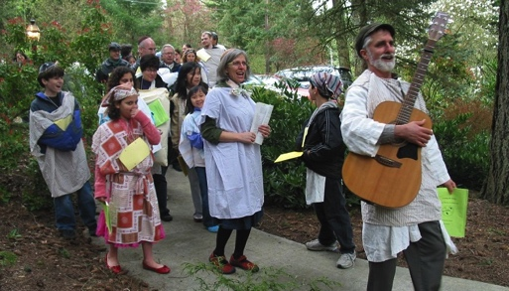
The Climax of the Seder - #2
Short cuts
For not only our ancestors alone did the Holy One redeem, blessed be. Rather, even us the One redeemed with them, as it says: And us God brought from there, in order to bring us, to give to us the land sworn to our ancestors. (Deut. 6:23)
This is a great moment to do some play-acting with costumes and props!
שֶׁלֹא אֶת אֲבוֹתֵינוּ וְאִמּוֹתֵינוּ בִּלְבָד גָּאַל הַקָּדוֹשׁ בָּרוּךְ הוּא, אֶלָּא אַף אוֹתָנוּ גָּאַל עִמָּהֶם, שֶׁנֶּאֱמַר: וְאוֹתָנוּ הוֹצִיא מִשָּׁם, לְמַעַן הָבִיא אוֹתָנוּ, לָתֶת לָנוּ אֶת הָאָרֶץ אֲשֶׁר נִשָׁבַּע לַאֲבֹתֵינוּ.

Slide 46
Hallel - הלל - first part - #1
Therefore we owe and are compelled to give thanks, to praise, to extol, to beautify, to exalt, to adorn, to bless, to raise up, and to be jubilant to the One who did for our ancestors and for us all these miracles, who brought us out from slavery to freedom, from agony to joy, from servitude to redemption – and so we sing!
Praise Yah! Servants of YHVH, praise, praise the name YHVH. May the name YHVH be blessed from now and for all-time. From the shining of the sun until it’s coming own, may the name YHVH be praised. High over all the nations is YHVH, God’s glory is over the heavens. Who is like YHVH our God, the One who is on high (even when) sitting? the One who bends low to see (even) the heavens and the earth? The One who raises up the impoverished from the dirt, who from the trash-heap will raise up the poor, to make him sit with the nobles, with the nobles of his people; The One who makes sit/ be set the barren of the house (to become) a mother of children, joyful. Praise Yah!
הַלְלוּיָהּ הַלְלוּ עַבְדֵי יְהוָה
הַלְלוּ אֶת שֵׁם יְהוָה
יְהִי שֵׁם ה׳ מְבֹרָךְ מֵעַתָּה וְעַד עוֹלָם
מִמִּזְרַח שֶׁמֶשׁ עַד מְבוֹאוֹ מְהֻלָּל שֵׁם יְהוָה
רָם עַל כָּל גּוֹיִם יְהוָה עַל הַשָּׁמַיִם כְּבוֹדוֹ
מִי כַּיי אֱלֹהֵינוּ הַמַּגְבִּיהִי לָשָׁבֶת
הַמַּשְׁפִּילִי לִרְאוֹת בַּשָּׁמַיִם וּבָאָרֶץ?
מְקִימִי מֵעָפָר דָּל, מֵאַשְׁפֹּת יָרִים אֶבְיוֹן,
לְהוֹשִׁיבִי עִם נְדִיבִים עִם נְדִיבֵי עַמּוֹ
מוֹשִׁיבִי עֲקֶרֶת הַבַּיִת,
אֵם הַבָּנִים שְׂמֵחָה. הַלְלוּיָהּ.

Slide 47
Hallel - הלל - first part - #2
Short cuts
בְּצֵאת יִשְׂרָאֵל מִמִצְרַיִם, בֵּית יַעֲקֹב מֵעַם לֹעֵז, הָיְתָה יְהוּדָה לְקָדְשׁוֹ, יִשְׂרָאֵל מַמְשְׁלוֹתָיו. הַיָּם רָאָה וַיַּנֹס, הַיַּרְדֵּן יִסֹּב לְאָחוֹר! הֶהָרִים רָקְדוּ כְאֵילִים, גְּבַעוֹת כִּבְנֵי צֹאן! מַה לְּךָ הַיָּם כִּי תָנוּס, הַיַּרְדֵּן תִּסֹּב לְאָחוֹר, הֶהָרִים - תִּרְקְדוּ כְאֵילִים, גְּבַעוֹת כִּבְנֵי-צֹאן? מִלְּפְנֵי אָדוֹן חוּלִי אָרֶץ, מִלְּפְנֵי אֱלוֹהַ יַעֲקֹב. הַהֹפְכִי הַצּוּר אֲגַם מָיִם, חַלָּמִיש לְמַעְיְנוֹ מָיִם!
B’tseit Yisra’el mimistrayim, beit Ya’akov me’am lo’ez. Haytah Y’hudah l’kodsho, Yisra’el mamsh’lotav. Hayam ra’ah v’yanos, hayarden yisov l’achor. Heharim rak’du k’eilim, g’va’ot kiv’nei tson. Mah l’kha hayam ki tanus, hayarden tisov l’achor. Heharim tirkedu k’eilim, g’va’ot kiv’nei tson. Milifnei Adon chuli arets, milifnei Elo’ah Ya’akov. Hahofkhi hatsur agam mayim, chalamish l’ma’yino mayim
In Israel’s going forth from Egypt, Jacob’s house from a foreign people, Judah was God’s holiness, Israel was God’s dominion. The sea saw and fled, the Jordan River turned round backwards. The mountains danced like rams, the hills like lambs of the flock. What’s with you, sea, that you fled, O Jordan, that you turned backwards? Mountains will dance like rams, hills like lambs of the flock. Before the Lord the land dances and writhes / goes into labor, before Jacob’s God, the One who transforms the rock into a pool of water, and flint into a spring of water!

Slide 48
Second cup
בָּרוּךְ אַתָּה יהוה אֱלֹהֵינוּ מֶלֶךְ הָעוֹלָם, אֲשֶׁר גְּאָלָנוּ וְגָאַל אֶת־אֲבוֹתֵינוּ מִמִּצְרַיִם, וְהִגִּיעָנוּ הַלַּיְלָה הַזֶּה לֶאֱכָל־בּוֹ מַצָּה וּמָרוֹר. כֵּן יהוה אֱלֹהֵינוּ וֵאלֹהֵי אֲבוֹתֵינוּ יַגִּיעֵנוּ לְמוֹעֲדִים וְלִרְגָלִים אֲחֵרִים הַבָּאִים לִקְרָאתֵנוּ לְשָׁלוֹם, וְנוֹדֶה לְךָ שִׁיר חָדָש עַל גְּאֻלָּתֵנוּ וְעַל פְּדוּת נַפְשֵׁנוּ.
בָּרוּךְ אַתָּה יהוה גָּאַל יִשְׂרָאֵל.
בָּרוּךְ אַתָּה יהוה אֱלֹהֵינוּ מֶלֶךְ הָעוֹלָם בּוֹרֵא פְּרִי הַגָּפֶן.
Blessed be You, YHVH our God, Ruler of all space-and-time, who redeemed us and redeemed our ancestors from Egypt, and who made us reach this night in which to eat matsah and maror. So may YHVH our God make us reach other celebrations and festivals coming to meet us, in peace, and we will give thanks to You (with) a new song for our redemption and for the rescuing our lives. Blessed be You who redeems Israel.
We say the blessing and drink while reclining to the left:
Barukh atah Adonai Eloheinu melekh ha'olam borey pri hagafen.
Blessed be You, YHVH Adonai our God, who creates the fruit of the vine.
Sefardi and Mizrachi Jews do not traditionally bless the second cup.

Slide 49
Second cup
Short cuts
Through this act we acknowledge the fullness of life, shaded by the gradations of experience; never black and white but a reflection of the full range of possibilities.
—Joy Levitt
From darkness to light, from slavery to freedom, from winter to spring, and now from bitterness to sweetness. But with the light, there is still darkness in the world. With our freedom, there are still those who are enslaved. It is still winter for some, (indeed, this year it feels like winter for most), and life remains bitter for many throughout our world.
Even in our own lives, we live within the tapestry of these contradictions. It is dark, and it is light; we are trapped, and we are liberated; we are cold, and we are warm; we experience pain and joy, just as we have eaten the maror with the charoset, taking the bitter with the sweet.

Slide 50
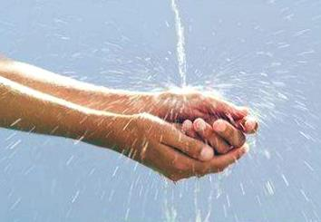
Rochtzah - רָחְצָה
We wash our hands and say the blessing.
Barukh atah adonay Eloheinu melekh ha'olam asher kidshanu b’mitzvotav v’tzivanu al nitilat yadayim.
Blessed be You, YHVH Adonai our God, Ruler of all space and time, who made us holy through commandments, and commanded us about uplifting hands.
The ritual handwashing elevates already clean hands. At the seder we do an extra handwashing – an even higher elevation. In these days when we wash our hands so many extra times, may we also reach for a higher elevation, for the sake of bringing healing.
בָּרוּךְ אַתָּה ה', אֱלֹהֵינוּ מֶלֶךְ הָעוֹלָם, אֲשֶׁר קִדְּשָׁנוּ בְּמִצְוֹתָיו וְצִוָּנוּ עַל נְטִילַת יָדַיִם.

Slide 51
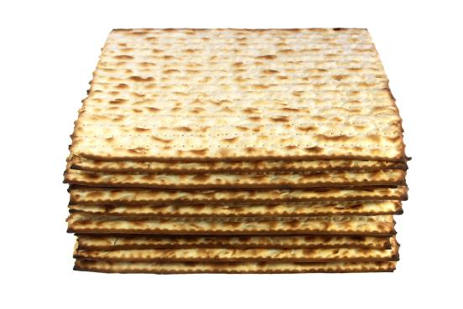
Motzi Matzah - מוֹצִיא מַצָּה
Barukh atah Adonai Eloheinu melekh ha'olam hamotsi lechem min ha'aretz.
Blessed be You, YHVH Adonai our God, Ruler of all space and time, who brings bread from out of the earth.
Barukh atah Adonai Eloheinu melekh ha'olam asher kid'shanu b'mitzvotav v'tzivanu al akhilat matzah.
Blessed be You, YHVH Adonai our God, Ruler of all space and time, who makes us holy through commandments and commanded us about eating matzah.
Everyone should get some of the middle matzah and some of the top matzah.
בָּרוּךְ אַתָּה ה', אֱלֹהֵינוּ מֶלֶךְ הָעוֹלָם הַמּוֹצִיא לֶחֶם מִן הָאָרֶץ.
בָּרוּךְ אַתָּה ה', אֱלֹהֵינוּ מֶלֶךְ הָעוֹלָם, אֲשֶׁר קִדְּשָׁנוּ בְּמִצְוֹתָיו וְצִוָּנוּ עַל אֲכִילַת מַצָּה.

Slide 52
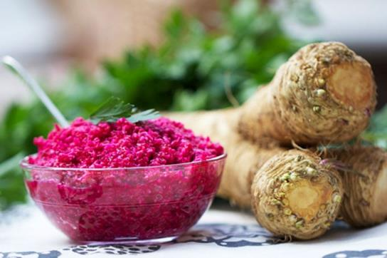
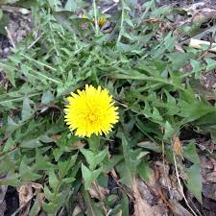
Maror - מרור
Barukh atah Adonai Eloheinu melekh ha'olam asher kidishanu b'mitzvotav v'tzivanu al achilat maror.
Blessed be You, YHVH Adonai our God, Ruler of all space and time, who made us holy through commandments, and commanded us about eating maror.
We eat some of the bitter herb. You can dip it in charoset.
Don’t recline – it’s the taste of slavery!
בָּרוּךְ אַתָּה ה', אֱלֹהֵינוּ מֶלֶךְ הָעוֹלָם, אֲשֶׁר קִדְּשָנוּ בְּמִצְוֹתָיו וְצִוָּנוּ עַל אֲכִילַת מָרוֹר.

Slide 53
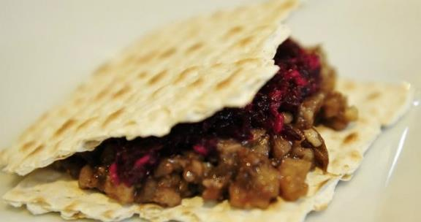
Korech - כורך
Short cuts
Maror/charoset sandwich with matzah:
In memory of the Temple according to Hillel. This is what Hillel would do when the Temple was standing:
He would wrap the matzah and maror and eat them together, in order to fulfill what it says, (Exodus 12:15): "You should eat the sacrifice on matzot and merorim.”
Korekh represents the matsah of the Temple, the redemption of the past, which didn’t last. It is sweet and bitter, and so we eat it with maror, and with charoset. This is the third transformation of the matsah.
זֵכֶר לְמִקְדָּשׁ כְּהִלֵּל. כֵּן עָשָׂה הִלֵּל
בִּזְמַן שֶׁבֵּית הַמִּקְדָּשׁ הָיָה קַיָּם:
הָיָה כּוֹרֵךְ מַצָּה וּמָרוֹר וְאוֹכֵל בְּיַחַד,
לְקַיֵּם מַה שֶּׁנֶּאֱמַר: עַל מַצּוֹת וּמְרוֹרִים יֹאכְלֻהוּ.

Slide 54
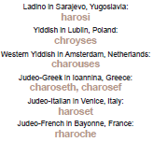
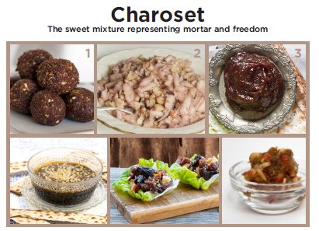
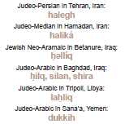

Slide 55
The Mystery of Charoset
Some say charoset represents the mortar or mud which was used to make bricks.
Some say the charoset is for lessening the bitterness or burning of the maror.
Some say it helps us remember the apple trees where the Israelite women seduced the men and where they gave birth, or to remember the blood. On the eros of charoset, see: "The Seder's Innermost Secret".
Charoset may also represent what is “sticky”, what is unresolved in our lives and doesn’t fit into the seder’s orderly progression from slavery to freedom. See: "The Mystery of Charoset”.
But whatever it means, the symbolism of the charoset is never explained in the text of the haggadah. What could be the reason for that?

Slide 56
Shulchan orekh – שֻׁלְחָן עוֹרֵךְ
Some international Passover foods
See more at www.jewishlanguages.org/passover-recipes
Morocco (Haketía/Judeo-Arabic/Judeo-Berber): Laḥliq – date-walnut ginger charoset
Romania (Yiddish): Kharoyses – apple walnut charoset
Azerbaijan (Judeo-Tat/Juhuri): Bodimjon Khoyagusht – eggplant onion frittata
Iraq (Judeo-Arabic): Hajji Badam – flourless almond cookies with rosewater and cardamom
Iran (Judeo-Persian/Median): Kuku Sabzi – baked herb omelette
Georgia (Judeo-Georgian): Espanakhi Pkhali – ground walnut spread with spinach, garlic, coriander, and onion

Slide 57
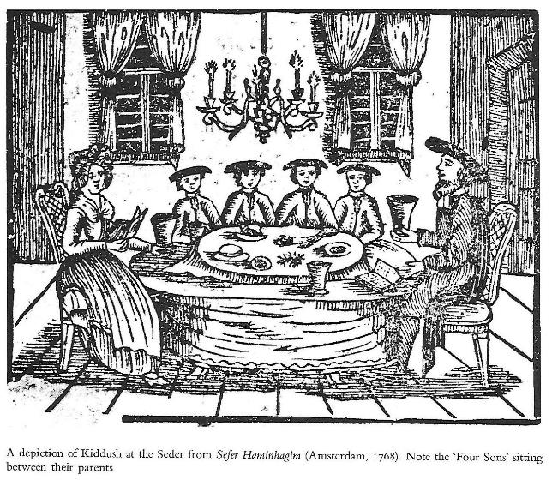
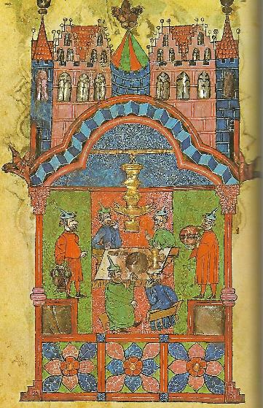
Shulchan orekh - שֻׁלְחָן עוֹרֵךְ Some pictures of the hoilday table to enjoy:
Short cuts

Slide 58
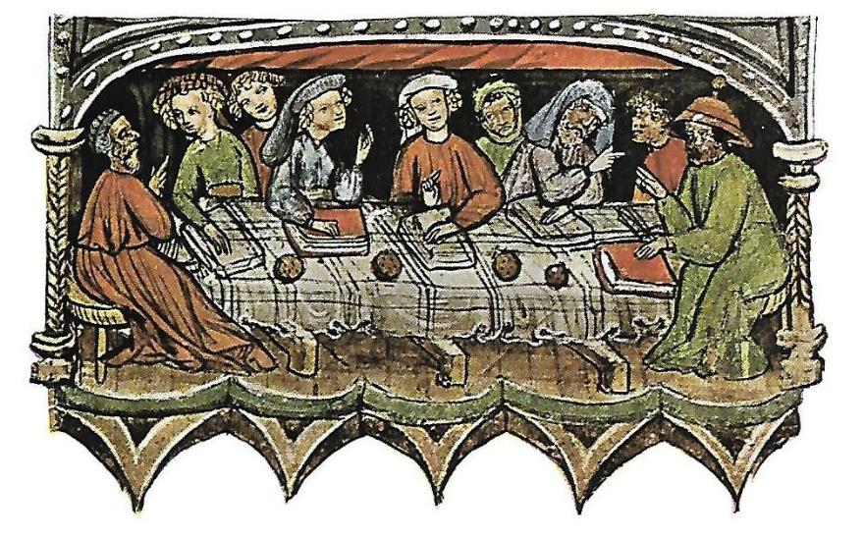
Shulchan orekh - שֻׁלְחָן עוֹרֵךְ

Slide 59
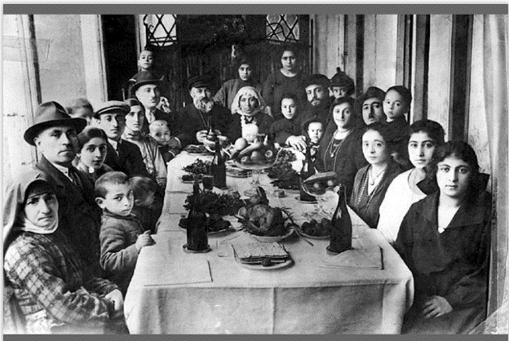
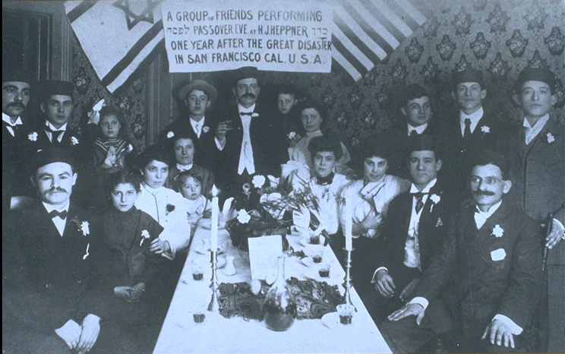
Shulchan orekh - שֻׁלְחָן עוֹרֵךְ

Slide 60
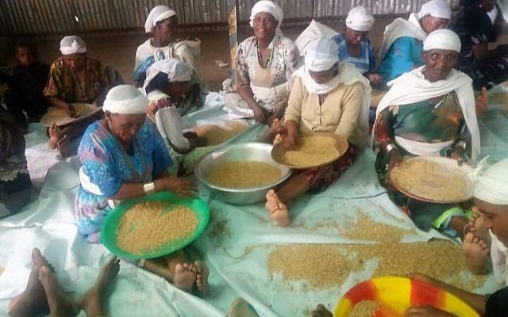
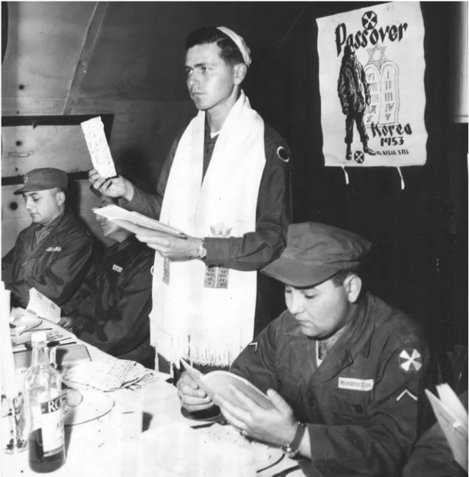
Shulchan orekh - שֻׁלְחָן עוֹרֵךְ
A soldiers’ seder
Sifting wheat for matsah in Gondar Ethiopia

Slide 61
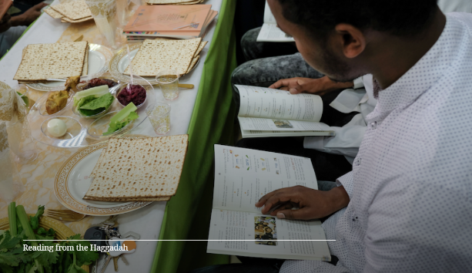
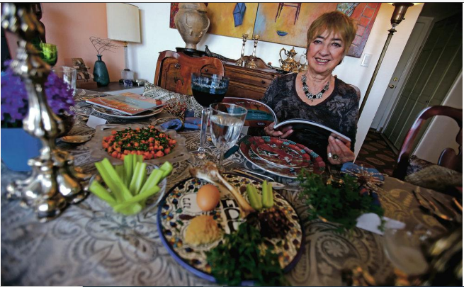
Shulchan orekh - שֻׁלְחָן עוֹרֵךְ

Slide 62
Shulchan orekh - שֻׁלְחָן עוֹרֵךְ
Proverbs:
Jewish Neo-Aramaic in Zakho, Iraq: ‘ez moshe, qazele mnoshe (Holiday of Moses, He provides Himself [God helps needy people celebrate Passover])
Yiddish in Vilna, Lithuania: Matses un vayn muz zayn, shmalts un eyer – nit zeyer (matzah and wine are a must, chicken fat and eggs – not so much)
Fun fact:
Some Jews in Arabic-speaking lands avoid eating chickpeas on Passover, even though they eat other kitniyot (beans). One explanation is that chummus (chickpea) sounds like the way the word chametz (leavened products forbidden on Passover) is pronounced in Mizrachi Hebrew: chames.

Slide 63
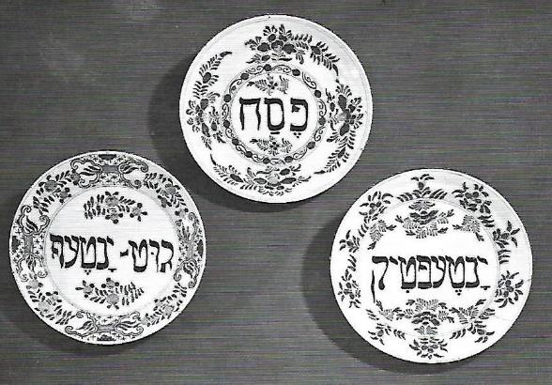
Shulchan orekh - שֻׁלְחָן עוֹרֵךְ
Ways to say “Kosher-for-Passover”:
Western Yiddish in Amrichshausen, Germany: yontefdig
Yiddish in Warsaw, Poland: paysechdik
Judeo-Georgian in Tbilisi, Georgia: kasheria pesaxistvin
Jewish Malayalam in Chennamangalam, India: pesaholle sadhangle
Judeo-Arabic in Sana‘a, Yemen: altavaqa almufatra (kashered room for preparing/storing Passover grains)

Slide 64
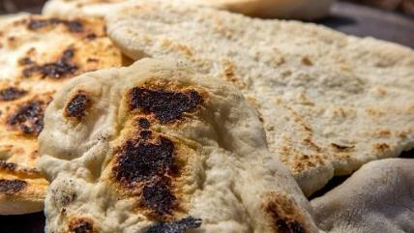
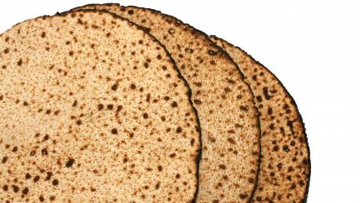
Shulchan orekh - שֻׁלְחָן עוֹרֵךְ
Matzah:
Jews in most communities use variants of מצה , but here are some additional names for Passover unleavened bread:
Judeo-Tat/Juhuri in Derbent, Dagestan: qoqol
Judeo-Provençal in Comtat Venaissin, France: coudolo
Ladino in Salonika, Greece: sensenya
Judeo-Arabic in Baghdad, Iraq: jərduqayi
Judeo-Arabic in Cairo, Egypt: faṭīr
Judeo-Arabic in Ḥugariyyah, Yemen: mašummōr

Slide 65
Shulchan orekh - שֻׁלְחָן עוֹרֵךְ
Passover seder:
Judeo-Greek in Ioannina, Greece: chova (duty)
Judeo-Arabic in Mossul, Iraq: fassah (verb – to conduct the seder)
Yiddish in Lvov/Lemburg, Ukraine: praven/uprichtn dem sayder, saydern (conduct the seder)
(The evening of) searching for and getting rid of chametz:
Yiddish in Bialystok, Poland: di nacht tsi chumets batlen (the night to void chametz); boydek chumets zaan (search for chametz [to be])
Haketía in Tetuan, Morocco: dechamezzar (de-chametz - infinitive verb)
Ladino in Salonica, Greece: des·hamesar (de-chametz), badkamiento (search [badkar]-ing), día de kal hamirá (day of kal chamira - formula renouncing possession of chametz)
Judeo-Arabic in Bengazi, Libya: lilet qto‘ el-ḥamiṣ (night of stopping the chametz)
Judeo-Arabic in Ksar Es-Souk, Morocco: bdikt ḥamiṣ (searching for chametz – also used by women as a curse, meaning ‘may [the person being cursed] become extinct’)

Slide 66
Tzafun - צפון - Afikoman
Short cuts
The afikoman is the fourth matsah, the hidden one, the missing half that completes what is broken. It is the matsah of redemption. Just as “we don’t know what we will serve Hashem with until we come there” – the meaning of this matsah is concealed. It is a taste of the matsah we will eat in the days and nights of Mashiach (Messiah) – which we let ourselves eat and savor even now, before we experience the fullness of redemption.
After the meal, hunt for the afikomen. Eat it as the last bite of the seder meal.
This time we eat the matsah without any words. (Ashkenazim)
(Sefardim say:) Zekher l’korban Pesach hane’ekhal `al hasova`.
A remembrance of the Pesach sacrifice, the one eaten on fullness.
Everyone should get a piece of the actual afikoman. If someone needs to leave early, send them home with a piece.

Slide 67
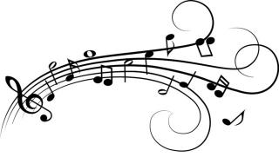
Barekh - ברך
Short cuts
We pour the third cup and recite Grace:
A Song of Ascents; When the Hashem will bring back the captivity of Zion, we will be like dreamers. Then our mouth will be full of mirth and our tongue joyful melody; then they will say among the nations; ”Hashem has done greatly with these." Hashem has done great things with us; we are happy. Hashem, return our captivity like streams in the desert. Those that sow with tears will reap with joyful song. Going, they may go and cry, carrying the bag of seed, coming back they will come in joyful song and carry their sheaves. (Psalms 126)
שִׁיר הַמַּעֲלוֹת, בְּשוּב ה׳ אֶת שִׁיבַת צִיּוֹן הָיִינוּ כְּחֹלְמִים. אָז יִמָּלֵא שְׂחוֹק פִּינוּ וּלְשׁוֹנֵנוּ רִנָּה. אָז יֹאמְרוּ בַגּוֹיִם: הִגְדִּיל ה׳ לַעֲשׂוֹת עִם אֵלֶּה. הִגְדִּיל ה׳ לַעֲשׂוֹת עִמָּנוּ, הָיִינוּ שְׂמֵחִים. שׁוּבָה ה' אֶת שְׁבִיתֵנוּ כַּאֲפִיקִים בַּנֶּגֶב. הַזֹּרְעִים בְּדִמְעָה, בְּרִנָּה יִקְצֹרוּ. הָלוֹךְ יֵלֵךְ וּבָכֹה נֹשֵׂא מֶשֶךְ הַזָּרַע, בֹּא יָבֹא בְרִנָּה נֹשֵׂא אֲלֻמֹּתָיו.

Slide 68
Barekh – ברך
Ashkenazi:
Leader: My friends, let’s bless!
Response (and leader repeats):
May the Name of YHVH Adonai be blessed from now and forever. (Psalms 113:2)
Leader: With the permission of my friends:
Sefardi:
Leader: Come on, let’s bless!
Response: With heavens permission!
Leader: With the permission of the exalted Holy Ruler and with your permission:
All continue: Let us bless [our God] from whose food we have eaten.
Response (and leader repeats): Blessed is [our God] from whose we have eaten and from whose goodness we live.
Ashkenazi: Blessed be the One and the Name.
אשכנזי:
חברי נְבָרֵךְ!
יְהִי שֵׁם יהוה מְבֹרָךְ מֵעַתָּה וְעַד עוֹלָם.
בִּרְשׁוּת חברי…
ספרדי:
הַב לָן וְנִבְרִיךְ לְמַלְכָּא עִלָּאָה קַדִּישָׁא.
שָׁמַיִם!
בִּרְשׁוּת מַלְכָּא עִלָּאָה קַדִּישָׁא
וּבִרְשׁוּתְכֶם...
...נְבָרֵך [אֱלֹהֵינוּ] שֶׁאָכַלְנוּ מִשֶּׁלוֹ:
בָּרוּךְ [אֱלֹהֵינוּ] שֶׁאָכַלְנוּ מִשֶּׁלוֹ וּבְטוּבוֹ חָיִינוּ.
בָּרוּךְ [אֱלֹהֵינוּ] שֶׁאָכַלְנוּ מִשֶּׁלוֹ וּבְטוּבוֹ חָיִינוּ.
אש׳: בָּרוך הוּא ובָרוּך שְׁמוֹ
Invitation (for three or more people)

Slide 69
Barekh – ברך
Short cuts
First blessing: For feeding the whole world
בָּרוּךְ אַתָּה יהוה, אֱלֹהֵינוּ מֶלֶךְ הָעוֹלָם, הַזָּן אֶת הָעוֹלָם כֻּלּוֹ בְּטוּבוֹ בְּחֵן בְּחֶסֶד וּבְרַחֲמִים, הוּא נוֹתֵן לֶחֶם לְכָל בָּשָׂר כִּי לְעוֹלָם חַסְדוֹ. וּבְטוּבוֹ הַגָּדוֹל תָּמִיד לֹא חָסַר לָנוּ, וְאַל יֶחְסַר לָנוּ מָזוֹן לְעוֹלָם וָעֶד. בַּעֲבוּר שְׁמוֹ הַגָּדוֹל, כִּי הוּא אֵל זָן וּמְפַרְנֵס לַכֹּל וּמֵטִיב לַכֹּל, וּמֵכִין מָזוֹן לְכָל בְּרִיּוֹתָיו אֲשֶׁר בָּרָא. בָּרוּךְ אַתָּה יהוה, הַזָּן אֶת הַכֹּל.
Blessed be You YHVH Adonai our God ruler of all space-and-time, who feeds the entire world with goodness and grace and compassion, who gives bread to all flesh, for God’s kindness is forever, and in whose great goodness food has never been lacking for us and never will lack for us forever and beyond. For this is the One, God, feeding and providing for all, who does good for all, preparing food for all God’s creatures that the One created, through great kindness, as it says “Your hand You open and satisfy every life. Blessed be the One who feeds all.

Slide 70
Barekh – ברך
Second blessing: For the land
נוֹדֶה לְךָ יהוה אֱלֹהֵינוּ עַל שֶׁהִנְחַלְתָּ לַאֲבוֹתֵינוּ אֶרֶץ חֶמְדָה טוֹבָה וּרְחָבָה, וְעַל שֶׁהוֹצֵאתָנוּ יהוה אֱלֹהֵינוּ מֵאֶרֶץ מִצְרַיִם, וּפְדִיתָנוּ מִבֵּית עֲבָדִים, וְעַל בְּרִיתְךָ שֶׁחָתַמְתָּ בְּבְשָׂרֵנוּ, וְעַל תּוֹרָתְךָ שֶׁלִּמַּדְתָּנוּ, וְעַל חֻקֶּיךָ שֶׁהוֹדַעְתָּנוּ, וְעַל חַיִּים חֵן וָחֶסֶד שֶׁחוֹנַנְתָּנוּ, וְעַל אֲכִילַת מָזוֹן שָׁאַתָּה זָן וּמְפַרְנֵס אוֹתָנוּ תָּמִיד, בְּכָל יוֹם וּבְכָל עֵת וּבְכָל שָׁעָה:
וְעַל הַכּל יהוה אֱלֹהֵינוּ, אֲנַחְנוּ מוֹדִים לָךְ וּמְבָרְכִים אוֹתָךְ, יִתְבָּרַךְ שִׁמְךָ בְּפִי כָּל חַי תָּמִיד לְעוֹלָם וָעֶד. כַּכָּתוּב: וְאָכַלְתָּ וְשָׂבַעְתָּ וּבֵרַכְתָּ אֶת יהוה אֱלֹהֵיךָ עַל הָאָרֶץ הַטּוֹבָה אֲשֶּׁר נָתַן לָךְ. בָּרוּךְ אַתָּה יהוה, עַל הָאָרֶץ וְעַל הַמָּזוֹן:
We give thanks to You YHVH our God for giving our ancestors a good wide land, and for bringing us out of Egypt and redeeming us from a domain of slaves, and for Your covenant and Your Torah, and for the life and food you have granted us – and for all, YHVH our God we thank You and bless You, as it says, “You will eat and be full/satisfied and bless YHVH Your God for the good land that the One gave to you”. Blessed be You YHVH for the land and for the food. (abridged)

Slide 71
Barekh - ברך
Please have mercy, Adonai our God, upon Israel, Your people; and upon Jerusalem, Your city; and upon Zion, the dwelling place of Your Glory; and upon the monarchy of the House of David, Your anointed one; and upon the great and holy house that Your name is called upon. Our God, our Father, tend us, sustain us, provide for us, relieve us from all of our troubles. And please do not make us needy, Adonai our God, not for the gifts of flesh and blood, but rather from Your full, open, holy and broad hand, forever and always.
An alternative:
Have compassion please YHVH our God on Israel Your people and on Jerusalem Your city and on Mt. Zion, that may it become the dwelling place of Your glory, and have compassion on all Your world, our healer, our provider and our sustainer, and protect all Your creatures, our relations, and sustain them, make abundance for all of us. Renew the face of the earth, please, and make Your land bloom with peace and Your reign with justice – soon and in our days.
Third blessing #1: For compassion on the land and the people
רַחֵם נָא ה' אֱלֹהֵינוּ עַל יִשְׂרָאַל עַמֶּךָ וְעַל יְרוּשָׁלַיִם עִירֶךָ וְעַל צִיּוֹן מִשְׁכַּן כְּבוֹדֶךָ וְעַל מַלְכוּת בֵּית דָּוִד מְשִׁיחֶךָ וְעַל הַבַּיִת הַגָּדוֹל וְהַקָּדוֹשׁ שֶׁנִּקְרָא שִׁמְךָ עָלָיו: אֱלֹהֵינוּ אָבִינוּ, רְעֵנוּ זוּנֵנוּ פַרְנְסֵנוּ וְכַלְכְּלֵנוּ וְהַרְוִיחֵנוּ, וְהַרְוַח לָנוּ ה' אֱלֹהֵינוּ מְהֵרָה מִכָּל צָרוֹתֵינוּ. וְנָא אַל תַּצְרִיכֵנוּ ה' אֱלֹהֵינוּ, לֹא לִידֵי מַתְּנַת בָּשָׂר וָדָם וְלֹא לִידֵי הַלְוָאתָם, כִּי אִם לְיָדְךָ הַמְּלֵאָה הַפְּתוּחָה הַקְּדוֹשָׁה וְהָרְחָבָה, שֶׁלֹא נֵבוֹשׁ וְלֹא נִכָּלֵם לְעוֹלָם וָעֶד.

Slide 72
Barekh – ברך
Third blessing #2 – addition for the Holy Day
אֱלֹהֵינוּ וֵאלֹהֵי אֲבוֹתֵינוּ, יַעֲלֶה וְיָבֹא וְיַגִּיעַ וְיֵרָאֶה וְיֵרָצֶה וְיִשָּׁמַע וְיִפָּקֵד וְיִזָּכֵר זִכְרוֹנֵנוּ וּפִקְדּוֹנֵנוּ, וְזִכְרוֹן אֲבוֹתֵינוּ, וְזִכְרוֹן מָשִׁיחַ בֶּן דָּוִד עַבְדֶּךָ, וְזִכְרוֹן יְרוּשָׁלַיִם עִיר קָדְשֶׁךָ, וְזִכְרוֹן כָּל עַמְּךָ בֵּית יִשְׂרָאַל לְפָנֶיךָ, לִפְלֵיטָה לְטוֹבָה לְחֵן וּלְחֶסֶד וּלְרַחֲמִים, לְחַיִּים וּלְשָׁלוֹם בְּיוֹם חַג הַמַּצּוֹת הַזֶּה זָכְרֵנוּ ה' אֱלֹהֵינוּ בּוֹ לְטוֹבָה וּפָקְדֵנוּ בוֹ לִבְרָכָה וְהושִׁיעֵנוּ בוֹ לְחַיִּים. וּבִדְבַר יְשׁוּעָה וְרַחֲמִים חוּס וְחָנֵּנוּ וְרַחֵם עָלֵינוּ וְהוֹשִׁיעֵנוּ, כִּי אֵלֶיךָ עֵינֵינוּ, כִּי אֵל מֶלֶךְ חַנּוּן וְרַחוּם אָתָּה. וּבְנֵה יְרוּשָׁלַיִם עִיר הַקֹּדֶשׁ בִּמְהֵרָה בְיָמֵינוּ.
בָּרוּךְ אַתָּה ה', בּוֹנֶה בְרַחֲמָיו ובשלום יְרוּשָׁלַיִם. אָמֵן.
Our God and God of our ancestors, may our remembrance arise and come and reach and be seen and desired and be heard and recalled and remembered, and the remembrance of our ancestors and of all Your people, before You for good life and peace, on this holy holiday of matsot, to fill it with compassion and to save us.
Blessed be You YHVH, who builds Jerusalem through compassion and peace.

Slide 73
Barekh – ברך
Fourth blessing: For all the goodness we receive
בָּרוּךְ אַתָּה ה', אֱלֹהֵינוּ מֶלֶךְ הָעוֹלָם, הָאֵל אָבִינוּ מַלְכֵּנוּ אַדִירֵנוּ בּוֹרְאֵנוּ גּוֹאֲלֵנוּ יוֹצְרֵנוּ קְדוֹשֵׁנוּ קְדוֹשׁ יַעֲקֹב רוֹעֵנוּ רוֹעֵה יִשְׂרָאַל הַמֶּלֶךְ הַטּוֹב וְהַמֵּטִיב לַכּל שֶׁבְּכָל יוֹם וָיוֹם הוּא הֵטִיב, הוּא מֵטִיב, הוּא יֵיטִיב לָנוּ. הוּא גְמָלָנוּ הוּא גוֹמְלֵנוּ הוּא יִגְמְלֵנוּ לָעַד, לְחֵן וּלְחֶסֶד וּלְרַחֲמִים וּלְרֶוַח הַצָּלָה וְהַצְלָחָה, בְּרָכָה וִישׁוּעָה נֶחָמָה פַּרְנָסָה וְכַלְכָּלָה וְרַחֲמִים וְחַיִּים וְשָׁלוֹם וְכָל טוֹב )וּמִכָּל טוּב לְעוֹלָם אַל יְחַסְּרֵנוּ(.
Blessed be You YHVH our God, ruler of all space-and-time, our Father, our Mother, who nourishes us, our Ruler, our Might, who creates us, who redeems us, who shapes us, our Holy One, Jacob’s Holy One, our shepherd, Israel’s shepherd, the good ruler who does good to all – in every day the One did good, does good, will do good for us, the One will return to us blessings of grace and love, mercy and abundance and rescue, and all goodness (and from all good will never let us lack).

Slide 74
Barekh – ברך
Asking for further blessings (abridged)
May the compassionate One rule over us and be praised through us and provide for us with honor and send abundant blessing through all the work of our hands. May the merciful One heal us and make peace between us and break our yoke and plant the Torah in our hearts and lead us in uprightness to our land. May the merciful One bring us good news of salvation and comfort. May the compassionate One bless every one among us as the One blessed our ancestors – so may the One bless us together as one with a whole complete blessing, and a complete healing, and let us say, Amen! May the merciful one let us inherit a day that is all good, and bring us alive to the Messianic days and the coming world. The One who makes peace in the heights will make peace for us and for all Israel and for all who inhabit the world and say, Amen! YHVH will give the people strength; YHVH will bless the people with peace.

Slide 75
Third cup
Short cuts
We say the blessing and drink while reclining to the left:
Barukh atah Adonai Eloheinu melekh ha'olam borey pri hagafen.
Blessed be You, YHVH Adonai our God, Ruler of all space and time, who creates the fruit of the vine.
בָּרוּךְ אַתָּה יהוה אֱלֹהֵינוּ מֶלֶךְ הָעוֹלָם בּוֹרֵא פְּרִי הַגָּפֶן.
Everyone says a blessing after this cup.

Slide 76
Pour out your wrath – opening the door for Elijah
Pour Your fierce anger onto the nations that did not know You and on the governments that did not call in Your name. For it has eaten Jacob and made his habitat desolate. (Psalms 79:6-7) Pour on them Your fury and make You burning anger grip them. (Psalms 69:25) Pursue in anger and destroy them from under YHVH’s heavens. (Lament. 3:66)
We can only welcome Elijah after we have given our anger over to God’s custodianship and truly let it go. Only then can we come into “the land” in a manner that is redemptive, as it says, “I will bring you into the land”. Pour Elijah’s cup.
Curious fact: In Judeo-Italian, shefokh can mean “to vomit,” based on this text.
שְׁפֹךְ חֲמָתְךָ אֶל הַגּוֹיִם אֲשֶׁר לֹא יְדָעוּךָ וְעַל מַמְלָכוֹת אֲשֶׁר בְּשִׁמְךָ לֹא קָרָאוּ. כִּי אָכַל אֶת יַעֲקֹב וְאֶת נָוֵהוּ הֵשַׁמּוּ. שְׁפָךְ עֲלֵיהֶם זַעֲמֶךָ וַחֲרוֹן אַפְּךָ יַשִּׂיגֵם. תִּרְדֹף בְּאַף וְתַשְׁמִידֵם מִתַּחַת שְׁמֵי ה’.
Many liberal haggadahs leave out this paragraph, which calls on God to destroy the nations. But we need to do something with the anger we rightly feel when thinking about Jewish history. Should we repress or deny that anger? Act it out in the desire for vengeance? The haggadah instead asks God to take over our anger from us and find its right use. This only works if the moment is cathartic and not a hardening of anger or fear.

Slide 77
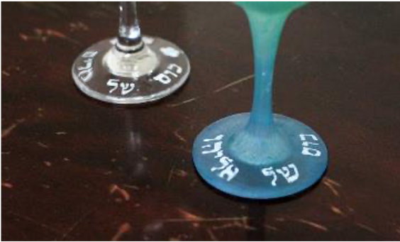
Eliyahu Hanavi
Short cuts
There is a modern custom to pour Miriam’s cup – a cup of water to remember the well that sprang up in the desert in the merit of Miriam the prophet!
We open the door to welcome Eliyahu Hanavi - Elijah the Prophet.
Eliyahu hanavi,
Eliyahu hatishbi,
Eliyahu, Eliyahu, Eliyahu hagiladi.
Bimheirah b'yameinu,
yavo eileinu,
im Mashiach ben David,
im Mashiach ben David.
A Moroccan tradition: say, “Did he drink from his cup? Did he sit in his chair?”
אֵלִיָהוּ הַנָבִיא, אֵלִיָהוּ הַתִּשְׁבִּי, אֵלִיָהוּ הַגִלְעָדִי בִּמְהֵרָה בְּיָמֵנוּ יָבוֹא אֵלֵינוּ עִם מָשִׁיחַ בֶּן דָוִד

Slide 78
Hallel - הלל (selections)
Short cuts
ה׳ זְכָרָנוּ יְבָרֵךְ. יְבָרֵךְ אֶת בֵּית יִשְׂרָאֵל, יְבָרֵךְ אֶת בֵּית אַהֲרֹן, יְבָרֵךְ יִרְאֵי ה׳, הַקְּטַנִים עִם הַגְּדֹלִים. יֹסֵף ה׳ עֲלֵיכֶם, עֲלֵיכֶם וְעַל בְּנֵיכֶם. בְּרוּכִים אַתֶּם לַה׳, עֹשֵׂה שָׁמַיִם וָאָרֶץ. הַשָּׁמַיִם שָׁמַיִם לַה׳ וְהָאָרֶץ נָתַן לִבְנֵי אָדָם. לֹא הַמֵּתִים יְהַלְלוּ יָהּ וְלֹא כָּל יֹרְדֵי דוּמָה. וַאֲנַחְנוּ נְבָרֵךְ יָהּ מֵעַתָּה וְעַד עוֹלָם. הַלְלוּיָהּ.
הַלְלוּ אֶת ה׳ כָּל גּוֹיִם, שַׁבְּחוּהוּ כָּל הָאֻמִּים. כִּי גָבַר עָלֵינוּ חַסְדּוֹ, וֶאֱמֶת ה' לְעוֹלָם. הַלְלוּיָהּ. הוֹדוּ לַה׳ כִּי טוֹב כִּי לְעוֹלָם חַסְדּוֹ. יֹאמַר נָא יִשְׂרָאֵל כִּי לְעוֹלָם חַסְדּוֹ. יֹאמְרוּ נָא בֵית אַהֲרֹן כִּי לְעוֹלָם חַסְדּוֹ. יֹאמְרוּ נָא יִרְאֵי ה׳ כִּי לְעוֹלָם חַסְדּוֹ.
YHVH Adonai who remembers us, will bless; The One will bless the House of Israel; will bless the House of Aaron; will bless all who revere YHVH. Praise Yah! Halleluyah! (Psalms 115)
Praise the name of YHVH Adonai, all nations; extol the One, all peoples, for God’s love overpowers us… Praise Yah! Give thanks to YHVH who is good, whose love is forever… Let those that revere YHVH say it now, for divine love is forever.” (Psalms 117-118:4)

Slide 79
Hallel - הלל (selections)
Min hametzar karati yah
Anani bamerchav yah
From the narrow space I called Yah; Yah answered me from the wide space.
Pitchu li sha’arei tzedek, avo vam, odeh yah. (x2) Zeh hasha’ar ladonay, tzadikim yavo’u vo. (x2)
Open up for me the gates of righteousness; I will enter them and thank YHVH. This is the gate of YHVH, the righteous will enter it. (Psalms 118:5-20)
Ana Adonai hoshi’a na! (x2) Ana Adonai hatslichah na! (x2) Please YHVH, please save! Please YHVH, please rescue!
מִן הַמֵּצַר קָרָאתִי יָּהּ,
עָנָנִי בַמֶּרְחַב יָהּ.
פִּתְחוּ לִי שַׁעֲרֵי צֶדֶק, אָבֹא בָם, אוֹדֶה יָהּ. זֶה הַשַּׁעַר לַה׳, צַדִּיקִים יָבֹאוּ בוֹ.
אוֹדְךָ כִּי עֲנִיתָנִי וַתְּהִי לִי לִישׁוּעָה. אוֹדְךָ כִּי עֲנִיתָנִי וַתְּהִי לִי לִישׁוּעָה. אֶבֶן מָאֲסוּ הַבּוֹנִים הָיְתָה לְראשׁ פִּנָּה. אֶבֶן מָאֲסוּ הַבּוֹנִים הָיְתָה לְראשׁ פִּנָּה. מֵאֵת ה׳ הָיְתָה זֹּאת הִיא נִפְלָאת בְּעֵינֵינוּ. מֵאֵת ה׳ הָיְתָה זֹּאת הִיא נִפְלָאת בְּעֵינֵינוּ.
אָנָּא ה׳, הוֹשִיעָה נָּא. אָנָּא ה׳, הוֹשִיעָה נָּא. אָנָּא ה׳, הַצְלִיחָה נָא. אָנָּא ה׳, הַצְלִיחָה נָא.

Slide 80
Hallel - הלל
מִן הַמֵּצַר קָרָאתִי יָּהּ, עָנָנִי בַמֶּרְחַב יָהּ. יהוה לִי, לֹא אִירָא – מַה יַּעֲשֶׂה לִי אָדָם, יהוה לִי בְּעֹזְרָי וַאֲנִי אֶרְאֶה בְּשׂנְאָי. טוֹב לַחֲסוֹת בַּיי מִבְּטֹחַ בָּאָדָם. טוֹב לַחֲסוֹת בַּיהוה מִבְּטֹחַ בִּנְדִיבִים.
From the narrow space I called, Yah, God; Yah answered me from the wide space. God is for me, I will not fear, what can any human do to me? YHVH comes for me along with my helpers, and I will see it despite those that hate me. It is good to take refuge with YHVH, better than to trust in humanity. It is good to take refuge with YHVH, better than to trust in leaders.
Play >
Chloe Pourmorady and Asher Shasho Levy: Min Hamessar – Syrian, Iraqi, and Sephardic melodies. If you’re short on time, start at 5:43 with the beautiful duet.

Slide 81
Fourth cup
Short cuts
We say the blessing and drink while reclining to the left:
Barukh atah Adonai Eloheinu melekh ha’olam borey pri hagafen.
Blessed be You, YHVH Adonai our God, Ruler of all space and time, who creates the fruit of the vine.
בָּרוּךְ אַתָּה יהוה אֱלֹהֵינוּ מֶלֶךְ הָעוֹלָם בּוֹרֵא פְּרִי הַגָּפֶן.
Ashkenazim say a blessing after this cup.
Sefardim and Mizrachim do not.

Slide 82
Nirtzah - נרצה
The Pesach order has been unfolded according to its law, justice and statute. As we merited to tell in order the story of leaving Egypt, so may we merit to do it (the sacrifice). Pure One dwelling in the exalted place, sustain the community of the congregation – who can count them? Soon lead those plantings of the stock, redeemed, to Zion with glad song!
L'shana haba'a b'yerushalayim x3
L'shana haba'a b'yerushalayim habnuyah
Next year, in the rebuilt Jerusalem.
May it be rebuilt through peace, and may all the peoples living there live in peace with each other.
חֲסַל סִדּוּר פֶּסַח כְּהִלְכָתוֹ, כְּכָל מִשְׁפָּטוֹ וְחֻקָּתוֹ. כַּאֲשֶׁר זָכִינוּ לְסַדֵּר אוֹתוֹ כֵּן נִזְכֶּה לַעֲשׂוֹתוֹ. זָךְ שׁוֹכֵן מְעוֹנָה, קוֹמֵם קְהַל עֲדַת מִי מָנָה. בְּקָרוֹב נַהֵל נִטְעֵי כַנָּה פְּדוּיִם לְצִיּוֹן בְּרִנָּה.
לְשָׁנָה הַבָּאָה בִּירוּשָלָיִם הַבְּנוּיָה.

Slide 83
Counting of the Omer - ספירת העומר
Short cuts
The second night of Pesach is the first night of the Omer, the 49-day count between Passover and Shavuot, between the barley and wheat harvests:
Blessed be You, YHVH Adonai our God, Ruler of all space and time, who has made us holy through commandments and has commanded us about counting of the omer.
Today is the first day of the omer.
בָּרוּךְ אַתָּה ה', אֱלֹהֵינוּ מֶלֶךְ הָעוֹלָם, אֲשֶׁר קִדְּשָׁנוּ בְּמִצְוֹּתָיו וְצִוָּנוּ עַל סְפִירַת הָעֹמֶר.
הַיּוֹם יוֹם אֶחָד בָּעֹמֶר.
Lovingkindness in lovingkindness
Chesed sheb’chesed
Art: https://bestomerever.tumblr.com/
Omer counting song: http://www.neohasid.org/audio/omer_dance/
Get neohasid’s Omer Counter app:http://neohasid.org/omer/apps/

Slide 84
Adir Hu - אדיר הוא – part 1
Short cuts
אַדִּיר הוּא יִבְנֶה בֵּיתוֹ בְּקָרוֹב. בִּמְהֵרָה, בִּמְהֵרָה, בְּיָמֵינוּ בְּקָרוֹב. אֵל בְּנֵה, אֵל בְּנֵה, בְּנֵה בֵּיתְךָ בְּקָרוֹב.
בָּחוּר הוּא, גָּדוֹל הוּא, דָּגוּל הוּא יִבְנֶה בֵּיתוֹ בְּקָרוֹב. בִּמְהֵרָה, בִּמְהֵרָה, בְּיָמֵינוּ בְּקָרוֹב. אֵל בְּנֵה, אֵל בְּנֵה, בְּנֵה בֵּיתְךָ בְּקָרוֹב.
הָדוּר הוּא, וָתִיק הוּא, זַכַּאי הוּא יִבְנֶה בֵּיתוֹ בְּקָרוֹב. בִּמְהֵרָה, בִּמְהֵרָה, בְּיָמֵינוּ בְּקָרוֹב. אֵל בְּנֵה, אֵל בְּנֵה, בְּנֵה בֵּיתְךָ בְּקָרוֹב.
חָסִיד הוּא, טָהוֹר הוּא, יָחִיד הוּא יִבְנֶה בֵּיתוֹ בְּקָרוֹב. בִּמְהֵרָה, בִּמְהֵרָה, בְּיָמֵינוּ בְּקָרוֹב. אֵל בְּנֵה, אֵל בְּנֵה, בְּנֵה בֵּיתְךָ בְּקָרוֹב.
כַּבִּיר הוּא, לָמוּד הוּא, מֶלֶךְ הוּא יִבְנֶה בֵּיתוֹ בְּקָרוֹב. בִּמְהֵרָה, בִּמְהֵרָה, בְּיָמֵינוּ בְּקָרוֹב. אֵל בְּנֵה, אֵל בְּנֵה, בְּנֵה בֵּיתְךָ בְּקָרוֹב.
Mighty is the One, may that One build the house soon. Quickly, quickly, in our days, soon. God build, God build, build Your house soon.
Chosen is the One, great is the One, noted is the One. Quickly, quickly, in our days, soon. God build, God build, build Your house soon.
Splendid is the One, distinguished is the One, meritorious is the One. Quickly, quickly, in our days, soon. God build, God build, build Your house soon.
Pious is the One, pure is the One, unique is the One. Quickly, quickly, in our days, soon. God build, God build, build Your house soon.
Powerful is the One, wise is the One, A Ruler is the One. Quickly, quickly, in our days, soon. God build, God build, build Your house soon.

Slide 85
Adir Hu - אדיר הוא – part 2
Awesome is the One, exalted is the One, heroic is the One. Quickly, quickly, in our days, soon. God build, God build, build Your house soon.
Redeeming, righteous, holy is the One. Quickly…
Compassionate is the One, almighty is the One, powerful is the One. Quickly…
נוֹרָא הוּא, סַגִּיב הוּא, עִזּוּז הוּא יִבְנֶה בֵּיתוֹ בְּקָרוֹב. בִּמְהֵרָה, בִּמְהֵרָה, בְּיָמֵינוּ בְּקָרוֹב. אֵל בְּנֵה, אֵל בְּנֵה, בְּנֵה בֵּיתְךָ בְּקָרוֹב.
פּוֹדֶה הוּא, צַדִּיק הוּא, קָּדוֹשׁ הוּא יִבְנֶה בֵּיתוֹ בְּקָרוֹב. בִּמְהֵרָה, בִּמְהֵרָה, בְּיָמֵינוּ בְּקָרוֹב. אֵל בְּנֵה, אֵל בְּנֵה, בְּנֵה בֵּיתְךָ בְּקָרוֹב.
רַחוּם הוּא, שַׁדַּי הוּא, תַּקִּיף הוּא יִבְנֶה בֵּיתוֹ בְּקָרוֹב. בִּמְהֵרָה, בִּמְהֵרָה, בְּיָמֵינוּ בְּקָרוֹב. אֵל בְּנֵה, אֵל בְּנֵה, בְּנֵה בֵּיתְךָ בְּקָרוֹב.
Neat fact:
A Passover greeting in Western Yiddish (Germany, Alsace-Lorraine, Switzerland) is bauet gut (build well), likely a reference to the rebuilding of the Temple mentioned in this song.

Slide 86
Ki Lo Na’eh - כִּי לוֹ נָאֶה – part 1
Short cuts
כִּי לוֹ נָאֶה, כִּי לוֹ יָאֶה.
אַדִּיר בִּמְלוּכָה, בָּחוּר כַּהֲלָכָה, גְּדוּדָיו יֹאמְרוּ לוֹ: לְךָ וּלְךָ, לְךָ כִּי לְךָ, לְךָ אַף לְךָ, לְךָ ה' הַמַּמְלָכָה, כִּי לוֹ נָאֵה, כִּי לוֹ יָאֶה.
דָּגוּל בִּמְלוּכָה, הָדוּר כַּהֲלָכָה, וָתִיקָיו יֹאמְרוּ לוֹ: לְךָ וּלְךָ, לְךָ כִּי לְךָ, לְךָ אַף לְךָ, לְךָ ה' הַמַּמְלָכָה, כִּי לוֹ נָאֵה, כִּי לוֹ יָאֶה.
זַכַּאי בִּמְלוּכָה, חָסִין כַּהֲלָכָה טַפְסְרָיו יֹאמְרוּ לוֹ: לְךָ וּלְךָ, לְךָ כִּי לְךָ, לְךָ אַף לְךָ, לְךָ ה' הַמַּמְלָכָה, כִּי לוֹ נָאֵה, כִּי לוֹ יָאֶה.
Since for the One it is pleasant,
for God it is suited.
Mighty in rulership, properly chosen, whose troops shall say, "Yours and Yours, Yours since it is Yours, Yours and even Yours, Yours, Hashem, is the kingdom; since for the One it is pleasant, for God it is suited."
Noted in rulership, properly splendid, whose distinguished ones will say, "Yours and Yours, Yours since it is Yours, Yours and even Yours, Yours, Hashem, is the kingdom; since for the One it is pleasant, for God it is suited."
Meriting rulership, properly powerful, whose scribes shall say, "Yours and Yours, Yours since it is Yours, Yours and even Yours, Yours, Hashem, is the kingdom; since for the One it is pleasant, for God it is suited."

Slide 87
Ki Lo Na’eh - כִּי לוֹ נָאֶה – part 2
יָחִיד בִּמְלוּכָה, כַּבִּיר כַּהֲלָכָה לִמּוּדָיו יֹאמְרוּ לוֹ: לְךָ וּלְךָ, לְךָ כִּי לְךָ, לְךָ אַף לְךָ, לְךָ ה' הַמַּמְלָכָה, כִּי לוֹ נָאֶה, כִּי לוֹ יָאֶה.
מוֹשֵׁל בִּמְלוּכָה, נוֹרָא כַּהֲלָכָה סְבִיבָיו יֹאמְרוּ לוֹ: לְךָ וּלְךָ, לְךָ כִּי לְךָ, לְךָ אַף לְךָ, לְךָ ה' הַמַּמְלָכָה, כִּי לוֹ נָאֵה, כִּי לוֹ יָאֶה.
עָנָיו בִּמְלוּכָה, פּוֹדֶה כַּהֲלָכָה, צַדִּיקָיו יֹאמְרוּ לוֹ: לְךָ וּלְךָ, לְךָ כִּי לְךָ, לְךָ אַף לְךָ, לְךָ ה' הַמַּמְלָכָה, כִּי לוֹ נָאֵה, כִּי לוֹ יָאֶה.
קָּדּוֹשׁ בִּמְלוּכָה, רַחוּם כַּהֲלָכָה שִׁנְאַנָּיו יֹאמְרוּ לוֹ: לְךָ וּלְךָ, לְךָ כִּי לְךָ, לְךָ אַף לְךָ, לְךָ ה' הַמַּמְלָכָה, כִּי לוֹ נָאֵה, כִּי לוֹ יָאֶה.
תַּקִיף בִּמְלוּכָה, תּוֹמֵךְ כַּהֲלָכָה תְּמִימָיו יֹאמְרוּ לוֹ: לְךָ וּלְךָ, לְךָ כִּי לְךָ, לְךָ אַף לְךָ, לְךָ ה' הַמַּמְלָכָה, כִּי לוֹ נָאֵה, כִּי לוֹ יָאֶה.
Unique in rulership, properly powerful, whose learned ones say, "Yours and Yours, Yours since it is Yours, Yours and even Yours, Yours, Hashem, is the kingdom; since for the One it is pleasant, for God it is suited."
Reigning in rulership, properly awesome, those surrounding the One say, “Yours…”
Humble in rulership, properly redeeming, whose righteous ones say, “Yours…”
Encompassing rulership, properly supporting, whose simple and innocent ones say, "Yours and Yours, Yours since it is Yours, Yours and even Yours, Yours, Hashem is the kingdom; since for the One it is pleasant, for God it is suited.”

Slide 88
Echad Mi Yodea - Who Knows One? – part 1 (English: rap version)
Who knows one? I know one: One is Hashem, One is Hashem, One is Hashem, in the heavens and the earth.
Ooh-ah-ooh-ah-ah. Ooh-ah-ooh-ah-ah.
Who knows two? I know two: two are the tablets that Moshe brought, and one is Hashem... in the heavens and the earth.
Who knows three? I know three: three are the papas and...
Who knows four? I know four: four are the mamas and...
Who knows five? I know five: five are the books of the Torah and...
אֶחָד מִי יוֹדֵעַ? אֶחָד אֲנִי יוֹדֵעַ: אֶחָד אֱלֹהֵינוּ שֶׁבַּשָּׁמַיִם וּבָאָרֶץ.
שְׁנַיִם מִי יוֹדֵעַ? שְׁנַיִם אֲנִי יוֹדֵעַ: שְׁנֵי לֻחוֹת הַבְּרִית. אֶחָד אֱלֹהֵינוּ שֶׁבַּשָּׁמַיִם וּבָאָרֶץ.
שְׁלֹשָׁה מִי יוֹדֵעַ? שְׁלֹשָׁה אֲנִי יוֹדֵעַ: שְׁלֹשָׁה אָבוֹת, שְׁנֵי לֻחוֹת הַבְּרִית, אֶחָד אֱלֹהֵינוּ שֶׁבַּשָּׁמַיִם וּבָאָרֶץ.
אַרְבַּע מִי יוֹדֵעַ? אַרְבַּע אֲנִי יוֹדֵעַ: אַרְבַּע אִמָּהוֹת, שְׁלשָׁה אָבוֹת, שְׁנֵי לֻחוֹת הַבְּרִית, אֶחָד אֱלֹהֵינוּ שֶׁבַּשָּׁמַיִם וּבָאָרֶץ.
חֲמִשָּׁה מִי יוֹדֵעַ? חֲמִשָּׁה אֲנִי יוֹדֵעַ: חֲמִשָּׁה חוּמְשֵׁי תוֹרָה, אַרְבַּע אִמָּהוֹת, שְׁלשָׁה אָבוֹת, שְׁנֵי לֻחוֹת הַבְּרִית, אֶחָד אֱלֹהֵינוּ שֶׁבַּשָּׁמַיִם וּבָאָרֶץ.

Slide 89
Echad Mi Yodea - Who Knows One? – part 2 (English: Rap version)
Who knows six? I know six: six are the books of the Mishnah and...
Who knows seven? I know seven: seven are the days of the week, Ooh Ah! And...
Who knows eight? I know eight: eight are the days of milah and...
שִׁשָּׂה מִי יוֹדֵעַ? שִׁשָּׂה אֲנִי יוֹדֵעַ: שִׁשָּׁה סִדְרֵי מִשְׁנָה, חֲמִשָּׁה חוּמְשֵׁי תוֹרָה, אַרְבַּע אִמָּהוֹת, שְׁלֹשָׁה אָבוֹת, שְׁנֵי לֻחוֹת הַבְּרִית, אֶחָד אֱלֹהֵינוּ שֶׁבַּשָּׁמַיִם וּבָאָרֶץ.
שִׁבְעָה מִי יוֹדֵעַ? שִׁבְעָה אֲנִי יוֹדֵעַ: שִׁבְעָה יְמֵי שַׁבָּתָא, שִׁשָּׁה סִדְרֵי מִשְׁנָה, חֲמִשָּׁה חוּמְשֵׁי תוֹרָה, אַרְבַּע אִמָּהוֹת, שְׁלשָׁה אָבוֹת, שְׁנֵי לֻחוֹת הַבְּרִית, אֶחָד אֱלֹהֵינוּ שֶׁבַּשָּׁמַיִם וּבָאָרֶץ.
שְׁמוֹנָה מִי יוֹדֵעַ? שְׁמוֹנָה אֲנִי יוֹדֵעַ: שְׁמוֹנָה יְמֵי מִילָה, שִׁבְעָה יְמֵי שַׁבָּתָא, שִׁשָּׁה סִדְרֵי מִשְׁנָה, חֲמִשָּׁה חוּמְשֵׁי תוֹרָה, אַרְבַּע אִמָּהוֹת, שְׁלשָׁה אָבוֹת, שְׁנֵי לֻחוֹת הַבְּרִית, אֶחָד אֱלֹהֵינוּ שֶׁבַּשָּׁמַיִם וּבָאָרֶץ.

Slide 90
Echad Mi Yodea - Who Knows One? – part 3
Who knows nine? I know nine: nine are the months of a baby and...
Who knows ten? I know ten: ten are THE commandments and...
Who knows eleven? I know eleven: eleven are the stars in Joseph's dream...
תִּשְׁעָה מִי יוֹדֵעַ? תִּשְׁעָה אֲנִי יוֹדֵעַ: תִּשְׁעָה יַרְחֵי לֵדָה, שְׁמוֹנָה יְמֵי מִילָה, שִׁבְעָה יְמֵי שַׁבָּתָא, שִׁשָּׁה סִדְרֵי מִשְׁנָה, חֲמִשָּׁה חוּמְשֵׁי תוֹרָה, אַרְבַּע אִמָּהוֹת, שְׁלֹשָׁה אָבוֹת, שְׁנֵי לֻחוֹת הַבְּרִית, אֶחָד אֱלֹהֵינוּ שֶׁבַּשָּׁמַיִם וּבָאָרֶץ.
עֲשָֹרָה מִי יוֹדֵעַ? עֲשָֹרָה אֲנִי יוֹדֵעַ: עֲשָׂרָה דִבְּרַיָא, תִּשְׁעָה יַרְחֵי לֵדָה, שְׁמוֹנָה יְמֵי מִילָה, שִׁבְעָה יְמֵי שַׁבָּתָא, שִׁשָּׁה סִדְרֵי מִשְׁנָה, חֲמִשָּׁה חוּמְשֵׁי תוֹרָה, אַרְבַּע אִמָּהוֹת, שְׁלשָׁה אָבוֹת, שְׁנֵי לֻחוֹת הַבְּרִית, אֶחָד אֱלֹהֵינוּ שֶׁבַּשָּׁמַיִם וּבָאָרֶץ.
אַחַד עָשָׂר מִי יוֹדֵעַ? אַחַד עָשָׂר אֲנִי יוֹדֵעַ: אַחַד עָשָׂר כּוֹכְבַיָּא, עֲשָׂרָה דִבְּרַיָא, תִּשְׁעָה יַרְחֵי לֵדָה, שְׁמוֹנָה יְמֵי מִילָה, שִׁבְעָה יְמֵי שַׁבָּתָא, שִׁשָּׁה סִדְרֵי מִשְׁנָה, חֲמִשָּׁה חוּמְשֵׁי תוֹרָה, אַרְבַּע אִמָּהוֹת, שְׁלשָׁה אָבוֹת, שְׁנֵי לֻחוֹת הַבְּרִית, אֶחָד אֱלֹהֵינוּ שֶׁבַּשָּׁמַיִם וּבָאָרֶץ.

Slide 91
Echad Mi Yodea - Who Knows One? – part 4
Who knows twelve? I know twelve: twelve are the tribes of Yisrael...
Who knows thirteen? I know thirteen: Thirteen are the attributes of God. Twelve are the tribes of Yisrael. Eleven are the stars in Joseph's dream. Ten are THE commandments. Nine are the months before a baby's born. Eight are the days before a baby boy's bris. Seven are the days of the week. Six are the books of the Mishnah. Five are the books of the Torah. Four are the mamas, and three are the papas, and two are tablets that Moshe brought. One is Hashem, one is Hashem, one is Hashem! In the heavens and the earth.
שְׁנֵים עָשָׂר מִי יוֹדֵעַ? שְׁנֵים עָשָׂר אֲנִי יוֹדֵעַ: שְׁנֵים עָשָׂר שִׁבְטַיָּא, אַחַד עָשָׂר כּוֹכְבַיָּא, עֲשָׂרָה דִבְּרַיָא, תִּשְׁעָה יַרְחֵי לֵדָה, שְׁמוֹנָה יְמֵי מִילָה, שִׁבְעָה יְמֵי שַׁבָּתָא, שִׁשָּׁה סִדְרֵי מִשְׁנָה, חֲמִשָּׁה חוּמְשֵׁי תוֹרָה, אַרְבַּע אִמָּהוֹת, שְׁלשָׁה אָבוֹת, שְׁנֵי לֻחוֹת הַבְּרִית, אֶחָד אֱלֹהֵינוּ שֶׁבַּשָּׁמַיִם וּבָאָרֶץ.
שְׁלשָׁה עֶשָׂר מִי יוֹדֵעַ? שְׁלשָׁה עָשָׂר אֲנִי יוֹדֵעַ: שְׁלשָׁה עָשָׂר מִדַּיָּא. שְׁנֵים עָשָׂר שִׁבְטַיָּא, אַחַד עָשָׂר כּוֹכְבַיָּא, עֲשָׂרָה דִבְּרַיָא, תִּשְׁעָה יַרְחֵי לֵדָה, שְׁמוֹנָה יְמֵי מִילָה, שִׁבְעָה יְמֵי שַׁבָּתָא, שִׁשָּׁה סִדְרֵי מִשְׁנָה, חֲמִשָּׁה חוּמְשֵׁי תוֹרָה, אַרְבַּע אִמָּהוֹת, שְׁלשָׁה אָבוֹת, שְׁנֵי לֻחוֹת הַבְּרִית, אֶחָד אֱלֹהֵינוּ שֶׁבַּשָּׁמַיִם וּבָאָרֶץ.

Slide 92
Who Knows One? – Bukharian / Judeo-Tajik
Sezdakhum kie medonad? [Who knows the thirteenth?]
Sezdakhum man’ medonam! [I know the thirteenth.]
Sezdakhum: sezdah khislatcho. [Thirteenth: the 13 Attributes (of God).]
Duvozdakhum: duvozdah shivtocho. [Twelfth: the 12 Tribes.]
Yozdakhum: yozdah sitoracho. [Eleventh: the 11 Stars
(in Joseph's dream).]
Dakhumin: dakh sukhanon. [Tenth: the 10 Utterances
(Commandments).]
Nokhumin: noch mochie zanon. [Ninth: the nine months of pregnancy.]
Khashtumin: khasht rouzi millo. [Eighth: the eight days of circumcision.]
Khaftumin: khaft rouzi khafta. [Seventh: the seven days of the week.]
Shishtumin: shash sidrey mishno. [Sixth: the six Orders of the Mishnah.]
Panjumin: panj sifrey Toro. [Fifth: the five books of Torah.]
Chorumin: chor’ modaron. [Fourth: the four Matriarchs.]
Seyumin: se’e padaron. [Third: the three Patriarchs.]
Duyumin: du’u lavchie gavkhar. [Second: the two Tablets of the Covenant.]
Yakumin: Khudoyi pabun olamin. [First: God, Lord of Heaven and Earth.]
Play >

Slide 93
Who Knows One? - Syrian Judeo-Arabic
Min ya‪'elam wumin yidri‪
Allah rab el mijalli‪
heda hinen il tleta'ash
tleta'ash il bar-misvah
tna'ash shibte Yisrael
hda'ash kokab bisama
‪'asher qilmat itorah‪
tisa'at ishhor il hible
tmint-iyyam il mila
sab'at-iyyam il hupa
site sdadir il Mishna‪
khamse msahaf itorah‪.
Arba'a imatna
wutlate abatna
wutnen Musa waAharon
wahid yali khalana‪,
Allahu Allahu la ilahh illa hu
Who knows, and who understands?
God is the master of the revealed universe
God is the one and the only Creator.
God, God, there is no God but God.
Thirteen is bar misvah
twelve tribes of Israel
eleven stars in the sky
ten commandments
nine months of pregnancy
eight days for circumcision
seven days for huppa
six orders of the Mishna
five books of the Torah
four mothers
three fathers
two are Moses and Aaron
God is the one and the only Creator.
God, God, there is no God but God.
​
Play >
Asher Shasho Levy and Chloe Pourmorady

Slide 94
Who Knows One? - Ladino
Kien supiense i entendiense? Alavar al dyo kreyense. [Who knows and understands? Praise God the Creator.]
Kwalo son los TREDJE? [What are THIRTEEN?]
TREDJE anyos de bar mitzva. [THIRTEEN years for bar mitzvah.]
DODJE tribus de Israel. [TWELVE tribes of Israel.]
ONZE hermanos sin Yosef. [ELEVEN brothers without Joseph.]
DYEZ los mandamiento de la ley. [TEN commandments of the law.]
MUEVE meses de la prenyada. [NINE months of pregnancy.]
OCHO dias de la milá [EIGHT days for circumcision.]
SIETE dias kon shabat. [SEVEN days with Shabbat.]
SEISH dias de la semana. [SIX days of the week.]
SINKO livros de la ley. [FIVE books of the law.]
KWATRO madres de israel. [FOUR mothers of Israel.]
TRES muestros padres son. [THREE are our fathers.]
DOS Moshe y Aron. [TWO Moses and Aaron.]
UNO es el kriador, baruh hu u'varuh shemo. [ONE is the Creator, blessed be and his name.]
Play >
Ya'akov Tsur Ben Ovadiah

Slide 95
Who Knows One? - Yiddish
Mu asapru, mu adabru, ay day, ay day, yam da day day day.
​Ver ken zogn ver ken redn vos di DRAYTSN batayt? [Who can say what THIRTEEN means?]
DRAYTSN iz men bar mitsve. [THIRTEEN, one is a bar mitzvah.]
TSVELF zenen di shvotim. [TWELVE, those are the tribes.]
ELF ZENEN di shtern. [ELEVEN, those are the stars.]
TSEN zenen di gebot. [TEN, those are the Commandments.]
NAYN zenen khedoshim trogt men. [NINE those are the months you're carried.]
AKHT teg iz der bris. [EIGHT days is the bris.]
​ZIBN zenen di vokh-teg. [SEVEN, those are the weekdays.]
ZEKS zenen mishnayes. [SIX, those are the books of the Mishnah.]
FINF zenen khamushim. [FIVE, those are the books of the Torah.]
FIR zenen di imoes (mames). [FOUR, those are the mothers.]
DRAY zenen di oves (tates). [THREE, those are the fathers.]
TSVEY zenen di lukhes. [TWO, those are the tablets.]
Un EYNER iz dokh got. [And ONE, that one is of course God.]
Un got iz eyner, un vayter keyner. [And God is One, and there is no other.]
Play >
Book of J: Jewlia Eisenberg, a”h and Jeremiah Lockwood
See more languages at jewishlanguages.org

Slide 96
Chad Gadya – חד גדיא One Little Goat
Chad gadya, chad gadya (one little goat, one little goat).
My father bought for two zuz, chad gadya, chad gadya.
Then came a cat and ate the goat...
Then came a dog and bit the cat that ate the goat...
Then came a stick and beat the dog that bit...
Then came fire and burned the stick that beat...
Then came water and quenched the fire that burned...
Then came an ox and drank the water that quenched...
Then came a shochet (butcher) and slaughtered the ox
that drank...
Then came the Malakh Hamavet (angel of death) and slaughtered the shochet...
Then came the Holy One, blessed be, and slaughtered the Malakh Hamavet, that slaughtered the shochet, that slaughtered the ox, that drank the water, that quenched the fire, that burned the stick, that beat the dog, that bit the cat, that ate the goat, my father bought for two zuz.
Chad gadya, chad gadya.
.
חַד גַּדְיָא, חַד גַּדְיָא דְּזַבִּין אַבָּא בִּתְרֵי זוּזֵי, חַד גַּדְיָא, חַד גַּדְיָא…
וְאָתָא הַקָּדוֹשׁ בָּרוּךְ הוּא וְשָׁחַט לְמַלְאַךְ הַמָּוֶת, דְּשָׁחַט לְשׁוֹחֵט, דְּשָׁחַט לְתוֹרָא, דְשָׁתָה לְמַיָּא, דְּכָבָה לְנוּרָא, דְשָׂרַף לְחוּטְרָא, דְהִכָּה לְכַלְבָּא, דְנָשַׁךְ לְשׁוּנְרָא, דְאָכְלָה לְגַדְיָא, דְזַבִּין אַבָּא בִּתְרֵי זוּזֵי. חַד גַּדְיָא, חַד גַּדְיָא.
All can participate by making the sound of each animal or object after it’s named

Slide 97
Chad Gadya - Syrian Judeo-Arabic
Wa-ija ilmuqadas mubarak hu‫, wa-akhad malak ilmot, illaḍi akhad rouḥ i-dabaḥ, illaḍi dabaḥ i-tor, illaḍi shireb il maye, illaḍi ṭafet i-nar, illaḍi ḥaret il 'aṣaye, illaḍi darbet il kaleb, illaḍi 'ad il iṭa, illaḍi aklet il jidi, illaḍi shtara li abi bimaṣariten, waḥad jidi waḥad jidi.
Play >
Asher Shasho Levy and Chloe Pourmorady

Slide 98
Chad Gadya - Yiddish
A mayse mit a tsigele, hert oys ovois-uvonim
Der foter hot batsolt far ir tsvey gildn mezumonim.
Di umshildike tsigele zi shpringt arum in hoyz.
Plutsem kumt a beyze kats, un khapt un frest es oyf.
Di tsigele, di tsigele, hert oys ovis-uvonim.
Der foter hot batsolt far it tsvey gildn mezumonim.
Khad-gad-yo, khad-gad-yo.
Der hunt hot faynt gehat di kats dos treft zikh al-pi-rov.
Er klert nit lang un khapt ir on un makht fun ir a sof.
Der hunt iz dokh dem shtekn vert, er iz dokh beyz un shlekht.
Der shtekn git im klep vi bob un meynt er iz gerekht.
Di tsigele, di tsigele, hert oys ovois-uvonim
Der foter hot batsolt far ir tsvey gildn mezumonim.
Khad-gad-yo, khad-gad-yo.
Play >
Book of J: Jewlia Eisenberg, a”h and Jeremiah Lockwood

Slide 99
Chad Gadya - Bukharian / Judeo-Tajik
Ve biyomad ha-Qodösh Borukh Hu ve bikhusht be malakh ha-movet, onchi bikhusht be shöhet, onchi zobeh khord be on gov, onchi binöshid be ob, onchi khomösh khard be otash, onchi bisözond be aso, onchi bizad be on sag, onchi bigozid be pishok, onchi bikhörd be buzghola, onchi bikharid padar be du tanga. Jon buzghola, jon buzghola.
Play >
Asher Shasho Levy and Chloe Pourmorady

Slide 100
Chad Gadya - Ladino
I vino el Santo Bendicho, i mato al malah amavet, ke se yevo al shohet, ke mato al buey, ke se bevyo al agua, ke amato al fuego, ke kemo al palo, ke aharvo al perro, ke modryo al gato, ke kome al kavritiko, ke lo merko mi padre, por dos levanim.
Play >
Asher Shasho Levy and Chloe Pourmorady

Slide 101
Sources:
https://www.sefaria.org/
https://www.jewishlanguages.org/passover
http://neohasid.org/zman/pesach/InnerSeder
Images from various sites.
Abadi, Jennifer Felicia. 2018. Too Good to Passover: Sephardic & Judeo-Arabic Seder Menus and Memories from Africa, Asia and Europe. Jennifer Abadi.
Kurshan, Ilana. 2008. Why Is This Night Different from All Other Nights?: “The Four Questions” Around the World. Schocken.
Lowenstein, Steven. 2000. The Jewish Cultural Tapestry: International Jewish Folk Traditions. Oxford University Press.
Moss, David. The Moss Haggadah.
Ochs, Vanessa. 2020. The Passover Haggadah: A Biography. Princeton University Press.
Raphael, Chaim. 1993. A Feast of History: The Drama of Passover through the Ages. Reprint edition. Bnai Brith International.
Spiegel, Murray, and Rickey Stein. 2013. 300 Ways to Ask the Four Questions. Second edition. Spiegel-Stein Publishing.

Slide 102
Omitted sections
Short cuts
Most of the translations above (except for the songs) come from the Haggadah of the Inner Seder by Rabbi David Seidenberg. You can find the Hebrew texts for the Magid section in the following slides.
If you want to include the entire Haggadah text in Hebrew, you can move these slides to the sections where they belong above. You can also find complete Hebrew with complete English translation in the Haggadah of the Inner Seder (http://neohasid.org/zman/pesach/InnerSeder/), or at Sefaria.org.

Slide 103
Omitted or abridged Hebrew sections
מַעֲשֶׂה בְּרַבִּי אֱלִיעֶזֶר וְרַבִּי יְהוֹשֻׁעַ וְרַבִּי אֶלְעָזָר בֶּן־עֲזַרְיָה וְרַבִּי עֲקִיבָא וְרַבִּי טַרְפוֹן שֶׁהָיוּ מְסֻבִּין בִּבְנֵי־בְרַק וְהָיוּ מְסַפְּרִים בִּיצִיאַת מִצְרַיִם כָּל־אוֹתוֹ הַלַּיְלָה, עַד שֶׁבָּאוּ תַלְמִידֵיהֶם וְאָמְרוּ לָהֶם רַבּוֹתֵינוּ הִגִּיעַ זְמַן קְרִיאַת שְׁמַע שֶׁל שַׁחֲרִית.
אָמַר רַבִּי אֶלְעָזָר בֶּן־עֲזַרְיָה הֲרֵי אֲנִי כְּבֶן שִׁבְעִים שָׁנָה וְלֹא זָכִיתִי שֶׁתֵּאָמֵר יְצִיאַת מִצְרַיִם בַּלֵּילוֹת עַד שֶׁדְּרָשָׁהּ בֶּן זוֹמָא, שֶׁנֶּאֱמַר, לְמַעַן תִּזְכֹּר אֶת יוֹם צֵאתְךָ מֵאֶרֶץ מִצְרַיִם כֹּל יְמֵי חַיֶּיךָ. יְמֵי חַיֶּיךָ הַיָּמִים. כֹּל יְמֵי חַיֶּיךָ הַלֵּילוֹת. וַחֲכָמִים אוֹמְרִים יְמֵי חַיֶּיךָ הָעוֹלָם הַזֶּה. כֹּל
יְמֵי חַיֶּיךָ לְהָבִיא לִימוֹת הַמָּשִׁיחַ:
יָכוֹל מֵראשׁ חֹדֶשׁ? תַּלְמוּד לוֹמַר בַּיּוֹם הַהוּא. אִי בַּיּוֹם הַהוּא יָכוֹל מִבְּעוֹד יוֹם? תַּלְמוּד לוֹמַר בַּעֲבוּר זֶה – בַּעֲבוּר זֶה לֹא אָמַרְתִּי, אֶלָּא בְּשָׁעָה שֶׁיֵּשׁ מַצָּה וּמָרוֹר מֻנָּחִים לְפָנֶיךָ.
מִתְּחִלָּה עוֹבְדֵי עֲבוֹדָה זָרָה הָיוּ אֲבוֹתֵינוּ, וְעַכְשָׁיו קֵרְבָנוּ הַמָּקוֹם לַעֲבדָתוֹ, שֶׁנֶּאֱמַר: וַיֹאמֶר יְהוֹשֻעַ אֶל־כָּל־הָעָם, כֹּה אָמַר ה' אֱלֹהֵי יִשְׂרָאֵל: בְּעֵבֶר הַנָּהָר יָשְׁבוּ אֲבוֹתֵיכֶם מֵעוֹלָם, תֶּרַח אֲבִי אַבְרָהָם וַאֲבִי נָחוֹר, וַיַּעַבְדוּ אֱלֹהִים אֲחֵרִים. וָאֶקַּח אֶת־אֲבִיכֶם אֶת־אַבְרָהָם מֵעֵבֶר הַנָּהָר וָאוֹלֵךְ אוֹתוֹ בְּכָל־אֶרֶץ כְּנָעַן, וָאַרְבֶּה אֶת־זַרְעוֹ וָאֶתֵּן לוֹ אֶת־יִצְחָק, וָאֶתֵּן לְיִצְחָק אֶת־יַעֲקֹב וְאֶת־עֵשָׂו. וָאֶתֵּן לְעֵשָׂו אֶת־הַר שֵּׂעִיר לָרֶשֶׁת אתוֹ, וְיַעֲקֹב וּבָנָיו יָרְדוּ מִצְרָיִם.
בָּרוּךְ שׁוֹמֵר הַבְטָחָתוֹ לְיִשְׂרָאֵל, בָּרוּךְ הוּא. שֶׁהַקָּדוֹשׁ בָּרוּךְ הוּא חִשַּׁב אֶת־הַקֵּץ, לַעֲשׂוֹת כְּמוֹ שֶּׁאָמַר לְאַבְרָהָם אָבִינוּ בִּבְרִית בֵּין הַבְּתָרִים, שֶׁנֶּאֱמַר: וַיֹּאמֶר לְאַבְרָם, יָדֹעַ תֵּדַע כִּי־גֵר יִהְיֶה זַרְעֲךָ בְּאֶרֶץ לֹא לָהֶם, וַעֲבָדוּם וְעִנּוּ אֹתָם אַרְבַּע מֵאוֹת שָׁנָה. וְגַם אֶת־הַגּוֹי אֲשֶׁר יַעֲבֹדוּ דָּן אָנֹכִי וְאַחֲרֵי־כֵן יֵצְאוּ בִּרְכֻשׁ גָּדוֹל.

Slide 104
Omitted or abridged Hebrew sections
צֵא וּלְמַד מַה בִּקֵּשׁ לָבָן הָאֲרַמִּי לַעֲשׂוֹת לְיַעֲקֹב אָבִינוּ: שֶׁפַּרְעֹה לֹא גָזַר אֶלָּא עַל הַזְּכָרִים, וְלָבָן בִּקֵּשׁ לַעֲקֹר אֶת־הַכֹּל. שֶׁנֶּאֱמַר: אֲרַמִּי אֹבֵד אָבִי, וַיֵּרֶד מִצְרַיְמָה וַיָּגָר שָׁם בִּמְתֵי מְעָט, וַיְהִי שָׁם לְגוֹי גָּדוֹל, עָצוּם וָרָב.
וַיֵּרֶד מִצְרַיְמָה – אָנוּס עַל פִּי הַדִּבּוּר. וַיָּגָר שָׁם. מְלַמֵּד שֶׁלֹא יָרַד יַעֲקֹב אָבִינוּ לְהִשְׁתַּקֵּעַ בְּמִצְרַיִם אֶלָּא לָגוּר שָׁם, שֶׁנֶּאֱמַר: וַיֹּאמְרוּ אֶל־פַּרְעֹה, לָגוּר בָּאָרֶץ בָּאנוּ, כִּי אֵין מִרְעֶה לַצֹּאן אֲשֶׁר לַעֲבָדֶיךָ, כִּי כָבֵד הָרָעָב בְּאֶרֶץ כְּנָעַן. וְעַתָּה יֵשְׁבוּ־נָא עֲבָדֶיךָ בְּאֶרֶץ גֹּשֶן.
בִּמְתֵי מְעָט. כְּמָה שֶּׁנֶּאֱמַר: בְּשִׁבְעִים נֶפֶשׁ יָרְדוּ אֲבוֹתֶיךָ מִצְרָיְמָה, וְעַתָּה שָׂמְךָ ה' אֱלֹהֶיךָ כְּכוֹכְבֵי הַשָּׁמַיִם לָרֹב.
וַיְהִי שָׁם לְגוֹי. מְלַמֵד שֶׁהָיוּ יִשְׂרָאֵל מְצֻיָּנִים שָׁם. גָּדוֹל עָצוּם – כְּמָה שֶּׁנֶּאֱמַר: וּבְנֵי יִשְׂרָאֵל פָּרוּ וַיִּשְׁרְצוּ וַיִּרְבּוּ וַיַּעַצְמוּ בִּמְאֹד מְאֹד, וַתִּמָּלֵא הָאָרֶץ אֹתָם.
וָרָב. כְּמָה שֶּׁנֶּאֱמַר: רְבָבָה כְּצֶמַח הַשָּׂדֶה נְתַתִּיךְ, וַתִּרְבִּי וַתִּגְדְּלִי וַתָּבֹאִי בַּעֲדִי עֲדָיִים, שָׁדַיִם נָכֹנוּ וּשְׂעָרֵךְ צִמֵּחַ, וְאַתְּ עֵרֹם וְעֶרְיָה. וָאֶעֱבֹר עָלַיִךְ וָאֶרְאֵךְ מִתְבּוֹסֶסֶת בְּדָמָיִךְ, וָאֹמַר לָךְ בְּדָמַיִךְ חֲיִי, וָאֹמַר לָךְ בְּדָמַיִךְ חֲיִי.

Slide 105
Omitted or abridged Hebrew sections
וַיָּרֵעוּ אֹתָנוּ הַמִּצְרִים וַיְעַנּוּנוּ, וַיִתְּנוּ עָלֵינוּ עֲבֹדָה קָשָׁה. וַיָּרֵעוּ אֹתָנוּ הַמִּצְרִים – כְּמָה שֶּׁנֶּאֱמַר: הָבָה נִתְחַכְּמָה לוֹ פֶּן יִרְבֶּה, וְהָיָה כִּי תִקְרֶאנָה מִלְחָמָה וְנוֹסַף גַּם הוּא עַל שֹׂנְאֵינוּ וְנִלְחַם־בָּנוּ, וְעָלָה מִן־הָאָרֶץ.
וַיְעַנּוּנוּ. כְּמָה שֶּׁנֶּאֱמַר: וַיָּשִׂימוּ עָלָיו שָׂרֵי מִסִּים לְמַעַן עַנֹּתוֹ בְּסִבְלֹתָם. וַיִּבֶן עָרֵי מִסְכְּנוֹת לְפַרְעֹה. אֶת־פִּתֹם וְאֶת־רַעַמְסֵס.
וַיִתְּנוּ עָלֵינוּ עֲבֹדָה קָשָׁה. כְּמָה שֶֹׁנֶּאֱמַר: וַיַּעֲבִדוּ מִצְרַיִם אֶת־בְּנֵי יִשְׂרָאֵל בְּפָרֶךְ.
וַנִּצְעַק אֶל־ה' אֱלֹהֵי אֲבֹתֵינוּ, וַיִּשְׁמַע ה' אֶת־קֹלֵנוּ, וַיַּרְא אֶת־עָנְיֵנוּ וְאֶת עֲמָלֵנוּ וְאֶת לַחֲצֵנוּ.
וַנִּצְעַק אֶל־ה' אֱלֹהֵי אֲבֹתֵינוּ – כְּמָה שֶּׁנֶּאֱמַר: וַיְהִי בַיָּמִים הָרַבִּים הָהֵם וַיָּמָת מֶלֶךְ מִצְרַיִם, וַיֵּאָנְחוּ בְנֵי־יִשְׂרָאֵל מִ־הָעֲבוֹדָה וַיִּזְעָקוּ, וַתַּעַל שַׁוְעָתָם אֶל־הָאֱלֹהִים מִן הָעֲבֹדָה.
וַיִּשְׁמַע ה' אֶת קלֵנוּ. כְּמָה שֶּׁנֶּאֱמַר: וַיִּשְׁמַע אֱלֹהִים אֶת־נַאֲקָתָם, וַיִּזְכֹּר אֱלֹהִים אֶת־בְּרִיתוֹ אֶת־אַבְרָהָם, אֶת־יִצְחָק וְאֶת־יַעֲקֹב.
וַיַּרְא אֶת־עָנְיֵנוּ. זוֹ פְּרִישׁוּת דֶּרֶךְ אֶרֶץ, כְּמָה שֶּׁנֶּאֱמַר: וַיַּרְא אֱלֹהִים אֶת בְּנֵי־יִשְׂרָאֵל וַיֵּדַע אֱלֹהִים.
וְאֶת־עֲמָלֵנוּ. אֵלּוּ הַבָּנִים. כְּמָה שֶּׁנֶּאֱמַר: כָּל־הַבֵּן הַיִּלּוֹד הַיְאֹרָה תַּשְׁלִיכֻהוּ וְכָל־הַבַּת תְּחַיּוּן.וְאֶת לַחָצֵנוּ. זֶו הַדְּחַק, כְּמָה שֶּׁנֶּאֱמַר: וְגַם־רָאִיתִי אֶת־הַלַּחַץ אֲשֶׁר מִצְרַיִם לֹחֲצִים אֹתָם

Slide 106
Omitted or abridged Hebrew sections
.וַיּוֹצִאֵנוּ ה' מִמִצְרַיִם בְּיָד חֲזָקָה, וּבִזְרֹעַ נְטוּיָה, וּבְמֹרָא גָּדֹל, וּבְאֹתוֹת וּבְמֹפְתִים.וַיּוֹצִאֵנוּ ה' מִמִּצְרַיִם. לֹא עַל־יְדֵי מַלְאָךְ, וְלֹא עַל־יְדֵי שָׂרָף, וְלֹא עַל־יְדֵי שָׁלִיחַ, אֶלָּא הַקָּדוֹשׁ בָּרוּךְ הוּא בִּכְבוֹדוֹ וּבְעַצְמוֹ. שֶׁנֶּאֱמַר: וְעָבַרְתִּי בְאֶרֶץ מִצְרַיִם בַּלַּיְלָה הַזֶּה, וְהִכֵּיתִי כָּל־בְּכוֹר בְּאֶרֶץ מִצְרַיִם מֵאָדָם וְעַד בְּהֵמָה, וּבְכָל אֱלֹהֵי מִצְרַיִם אֶעֱשֶׂה שְׁפָטִים. אֲנִי ה'.וְעָבַרְתִּי בְאֶרֶץ מִצְרַיִם בַּלַּיְלָה הַזֶּה – אֲנִי וְלֹא מַלְאָךְ; וְהִכֵּיתִי כָל בְּכוֹר בְּאֶרֶץ־מִצְרַים. אֲנִי וְלֹא שָׂרָף; וּבְכָל־אֱלֹהֵי מִצְרַיִם אֶעֱשֶׂה שְׁפָטִים. אֲנִי וְלֹא הַשָּׁלִיחַ; אֲנִי ה'. אֲנִי הוּא וְלֹא אַחֵר.
בְּיָד חֲזָקָה. זוֹ הַדֶּבֶר, כְּמָה שֶּׁנֶּאֱמַר: הִנֵּה יַד־ה' הוֹיָה בְּמִקְנְךָ אֲשֶׁר בַּשָּׂדֶה, בַּסּוּסִים, בַּחֲמֹרִים, בַּגְּמַלִים, בַּבָּקָר וּבַצֹּאן, דֶּבֶר כָּבֵד מְאֹד.
וּבִזְרֹעַ נְטוּיָה. זוֹ הַחֶרֶב, כְּמָה שֶּׁנֶּאֱמַר: וְחַרְבּוֹ שְׁלוּפָה בְּיָדוֹ, נְטוּיָה עַל־יְרוּשָלָיִם.
וּבְמוֹרָא גָּדֹל. זוֹ גִּלּוּי שְׁכִינָה. כְּמָה שֶּׁנֶּאֱמַר, אוֹ הֲנִסָּה אֱלֹהִים לָבוֹא לָקַחַת לוֹ גּוֹי מִקֶּרֶב גּוֹי בְּמַסֹּת בְּאֹתֹת וּבְמוֹפְתִים וּבְמִלְחָמָה וּבְיָד חֲזָקָה וּבִזְרוֹעַ נְטוּיָה וּבְמוֹרָאִים גְּדוֹלִים כְּכֹל אֲשֶׁר־עָשָׂה לָכֶם ה' אֱלֹהֵיכֶם בְּמִצְרַיִם לְעֵינֶיךָ.
וּבְאֹתוֹת. זֶה הַמַּטֶּה, כְּמָה שֶּׁנֶּאֱמַר: וְאֶת הַמַּטֶּה הַזֶּה תִּקַּח בְּיָדְךָ, אֲשֶׁר תַּעֲשֶׂה־בּוֹ אֶת הָאֹתוֹת. וּבְמֹפְתִים. זֶה הַדָּם, כְּמָה שֶּׁנֶּאֱמַר: וְנָתַתִּי מוֹפְתִים בַּשָּׁמַיִם וּבָאָרֶץ.

Slide 107
Omitted or abridged Hebrew sections
דָּם וָאֵשׁ וְתִימְרוֹת עָשָׁן.דָבָר אַחֵר: בְּיָד חֲזָקָה שְׁתַּיִם, וּבִזְרֹעַ נְטוּיָה שְׁתַּיִם, וּבְמֹרָא גָּדֹל – שְׁתַּיִם, וּבְאֹתוֹת – שְׁתַּיִם, וּבְמֹפְתִים – שְׁתַּיִם.
רַבִּי יוֹסֵי הַגְּלִילִי אוֹמֵר: מִנַּיִן אַתָּה אוֹמֵר שֶׁלָּקוּ הַמִּצְרִים בְּמִצְרַיִם עֶשֶׂר מַכּוֹת וְעַל הַיָּם לָקוּ חֲמִשִּׁים מַכּוֹת? בְּמִצְרַיִם מַה הוּא אוֹמֵר? וַיֹּאמְרוּ הַחַרְטֻמִּם אֶל פַּרְעֹה: אֶצְבַּע אֱלֹהִים הִוא, וְעַל הַיָּם מָה הוּא אוֹמֵר? וַיַּרְא יִשְׂרָאֵל אֶת־הַיָּד הַגְּדֹלָה אֲשֶׁר עָשָׂה ה' בְּמִצְרַיִם, וַיִּירְאוּ הָעָם אֶת־ה', וַיַּאֲמִינוּ בַּיי וּבְמשֶׁה עַבְדוֹ. כַּמָה לָקוּ בְאֶצְבַּע? עֶשֶׂר מַכּוֹת. אֱמוֹר מֵעַתָּה: בְּמִצְרַים לָקוּ עֶשֶׂר מַכּוֹת וְעַל הַיָּם לָקוּ חֲמִשִּׁים מַכּוֹת.רַבִּי אֱלִיעֶזֲר אוֹמֵר: מִנַּיִן שֶׁכָּל־מַכָּה וּמַכָּה שֶׁהֵבִיא הַקָּדוֹשׁ בָּרוּךְ הוּא עַל הַמִּצְרִים בְּמִצְרַיִם הָיְתָה שֶׁל אַרְבַּע מַכּוֹת? שֶׁנֶּאֱמַר: יְשַׁלַּח־בָּם חֲרוֹן אַפּוֹ, עֶבְרָה וָזַעַם וְצָרָה, מִשְׁלַחַת מַלְאֲכֵי רָעִים. עֶבְרָה – אַחַת, וָזַעַם – שְׁתַּיִם, וְצָרָה – שָׁלשׁ, מִשְׁלַחַת מַלְאֲכֵי רָעִים – אַרְבַּע. אֱמוֹר מֵעַתָּה: בְּמִצְרַיִם לָקוּ אַרְבָּעִים מַכּוֹת וְעַל הַיָּם לָקוּ מָאתַיִם מַכּוֹת.
רַבִּי עֲקִיבָא אוֹמֵר: מִנַּיִן שֶׁכָּל־מַכָּה וּמַכָּה שֶהֵבִיא הַקָּדוֹשׁ בָּרוּךְ הוּא עַל הַמִּצְרִים בְּמִצְרַיִם הָיְתָה שֶׁל חָמֵשׁ מַכּוֹת? שֶׁנֶּאֱמַר: יְִשַׁלַּח־בָּם חֲרוֹן אַפּוֹ, עֶבְרָה וָזַעַם וְצַרָה, מִשְׁלַחַת מַלְאֲכֵי רָעִים. חֲרוֹן אַפּוֹ – אַחַת, עֶבְרָה – שְׁתָּיִם, וָזַעַם – שָׁלוֹשׁ, וְצָרָה – אַרְבַּע, מִשְׁלַחַת מַלְאֲכֵי רָעִים – חָמֵשׁ. אֱמוֹר מֵעַתָּה: בְּמִצְרַיִם לָקוּ חֲמִשִּׁים מַכּות וְעַל הַיָּם לָקוּ חֲמִשִּׁים וּמָאתַיִם מַכּוֹת.

Slide 108
Omitted or abridged Hebrew sections
לְפִיכָךְ אֲנַחְנוּ חַיָּבִים לְהוֹדוֹת, לְהַלֵּל, לְשַׁבֵּחַ, לְפָאֵר, לְרוֹמֵם, לְהַדֵּר, לְבָרֵךְ, לְעַלֵּה וּלְקַלֵּס לְמִי שֶׁעָשָׂה לַאֲבוֹתֵינוּ וְלָנוּ אֶת־כָּל־הַנִסִּים הָאֵלּוּ: הוֹצִיאָנוּ מֵעַבְדוּת לְחֵרוּת מִיָּגוֹן לְשִׂמְחָה, וּמֵאֵבֶל לְיוֹם טוֹב, וּמֵאֲפֵלָה לְאוֹר גָּדוֹל, וּמִשִּׁעְבּוּד לִגְאֻלָּה. וְנֹאמַר לְפָנָיו שִׁירָה חֲדָשָׁה: הַלְלוּיָהּ.הַלְלוּיָהּ הַלְלוּ עַבְדֵי ה', הַלְלוּ אֶת־שֵׁם ה'. יְהִי שֵׁם ה' מְבֹרָךְ מֵעַתָּה וְעַד עוֹלָם. מִמִּזְרַח שֶׁמֶשׁ עַד מְבוֹאוֹ מְהֻלָּל שֵׁם ה'. רָם עַל־כָּל־גּוֹיִם ה', עַל הַשָּׁמַיִם כְּבוֹדוֹ. מִי כַּיי אֱלֹהֵינוּ הַמַּגְבִּיהִי לָשָׁבֶת, הַמַּשְׁפִּילִי לִרְאוֹת בַּשָּׁמַיִם וּבָאָרֶץ? מְקִימִי מֵעָפָר דָּל, מֵאַשְׁפֹּת יָרִים אֶבְיוֹן, לְהוֹשִׁיבִי עִם־נְדִיבִים, עִם נְדִיבֵי עַמּוֹ. מוֹשִׁיבִי עֲקֶרֶת הַבַּיִת, אֵם הַבָּנִים שְׂמֵחָה. הַלְלוּיָהּ.
בָּרוּךְ אַתָּה ה' אֱלֹהֵינוּ מֶלֶךְ הָעוֹלָם, אֲשֶׁר גְּאָלָנוּ וְגָאַל אֶת־אֲבוֹתֵינוּ מִמִּצְרַיִם, וְהִגִּיעָנוּ הַלַּיְלָה הַזֶּה לֶאֱכָל־בּוֹ מַצָּה וּמָרוֹר. כֵּן ה' אֱלֹהֵינוּ וֵאלֹהֵי אֲבוֹתֵינוּ יַגִּיעֵנוּ לְמוֹעֲדִים וְלִרְגָלִים אֲחֵרִים הַבָּאִים לִקְרָאתֵנוּ לְשָׁלוֹם, שְׂמֵחִים בְּבִנְיַן עִירֶךְ וְשָׂשִׂים בַּעֲבוֹדָתֶךָ. וְנֹאכַל שָׁם מִן הַזְּבָחִים וּמִן הַפְּסָחִים אֲשֶׁר יַגִּיעַ דָּמָם עַל קִיר מִזְבַּחֲךָ לְרָצון, וְנוֹדֶה לְךָ שִׁיר חָדָש עַל גְּאֻלָּתֵנוּ וְעַל פְּדוּת נַפְשֵׁנוּ. בָּרוּךְ אַתָּה ה', גָּאַל יִשְׂרָאֵל.

Slide 109
Omitted or abridged Hebrew sections
לֹא לָנוּ, ה', לֹא לָנוּ, כִּי לְשִׁמְךָ תֵּן כָּבוֹד, עַל חַסְדְּךָ עַל אֲמִתֶּךָ. לָמָּה יֹאמְרוּ הַגּוֹיִם אַיֵּה נָא אֱלֹהֵיהֶם. וְאֱלֹהֵינוּ בַּשָּׁמַיִם, כֹּל אֲשֶׁר חָפֵץ עָשָׂה. עֲצַבֵּיהֶם כֶּסֶף וְזָהָב מַעֲשֵׂה יְדֵי אָדָם. פֶּה לָהֶם וְלֹא יְדַבֵּרוּ, עֵינַיִם לָהֶם וְלֹא יִרְאוּ. אָזְנָיִם לָהֶם וְלֹא יִשְׁמָעוּ, אַף לָהֶם וְלֹא יְרִיחוּן. יְדֵיהֶם וְלֹא יְמִישׁוּן, רַגְלֵיהֶם וְלֹא יְהַלֵּכוּ, לׁא יֶהְגּוּ בִּגְרוֹנָם. כְּמוֹהֶם יִהְיוּ עֹשֵׂיהֶם, כֹּל אֲשֶׁר בֹּטֵחַ בָּהֶם. יִשְׂרָאֵל בְּטַח בַּיי, עֶזְרָם וּמָגִנָּם הוּא. בֵּית אַהֲרֹן בִּטְחוּ בַיי, עֶזְרָם וּמָגִנָּם הוּא. יִרְאֵי ה' בִּטְחוּ בַיי, עֶזְרָם וּמָגִנָּם הוּא.
אָהַבְתִּי כִּי יִשְׁמַע ה' אֶת קוֹלִי תַּחֲנוּנָי. כִּי הִטָּה אָזְנוֹ לִי וּבְיָמַי אֶקְרָא. אֲפָפוּנִי חֶבְלֵי מָוֶת וּמְצָרֵי שְׁאוֹל מְצָאוּנִי, צָרָה וְיָגוֹן אֶמְצָא. וּבְשֵׁם ה' אֶקְרָא: אָנָּא ה' מַלְּטָה נַפְשִׁי. חַנוּן ה' וְצַדִּיק, וֵאֱלֹהֵינוּ מְרַחֵם. שֹׁמֵר פְּתָאִים ה', דַּלוֹתִי וְלִי יְהושִׁיעַ. שׁוּבִי נַפְשִׁי לִמְנוּחָיְכִי, כִּי ה' גָּמַל עָלָיְכִי. כִּי חִלַּצְתָּ נַפְשִׁי מִמָּוֶת, אֶת עֵינִי מִן דִּמְעָה, אֶת רַגְלִי מִדֶּחִי. אֶתְהַלֵךְ לִפְנֵי ה' בְּאַרְצוֹת הַחַיִּים. הֶאֱמַנְתִּי כִּי אֲדַבֵּר, אֲנִי עָנִיתִי מְאֹד. אֲנִי אָמַרְתִּי בְחָפְזִי כָּל הָאָדָם כּזֵֹב.
מָה אָשִׁיב לַיי כֹּל תַּגְמוּלוֹהִי עָלָי. כּוֹס יְשׁוּעוֹת אֶשָּׂא וּבְשֵׁם ה' אֶקְרָא. נְדָרַי לַיי אֲשַׁלֵּם נֶגְדָה נָּא לְכָל עַמּוֹ. יָקָר בְּעֵינֵי ה' הַמָּוְתָה לַחֲסִידָיו. אָנָּה ה' כִּי אֲנִי עַבְדֶּךָ, אֲנִי עַבְדְּךָ בֶּן אֲמָתֶךָ, פִּתַּחְתָּ לְמוֹסֵרָי. לְךָ אֶזְבַּח זֶבַח תּוֹדָה וּבְשֵׁם ה' אֶקְרָא. נְדָרַי לַיי אֲשַׁלֵּם נֶגְדָה נָּא לְכָל עַמּוֹ. בְּחַצְרוֹת בֵּית ה', בְּתוֹכֵכִי יְרוּשָלַיִם. הַלְלוּיָהּ.

Slide 110
Omitted or abridged Hebrew sections
מִן הַמֵּצַר קָרָאתִי יָּהּ, עָנָנִי בַמֶּרְחַב יָהּ. ה' לִי, לֹא אִירָא – מַה יַּעֲשֶׂה לִי אָדָם, ה' לִי בְּעֹזְרָי וַאֲנִי אֶרְאֶה בְּשׂנְאָי. טוֹב לַחֲסוֹת בַּיי מִבְּטֹחַ בָּאָדָם. טוֹב לַחֲסוֹת בַּיי מִבְּטֹחַ בִּנְדִיבִים. כָּל גּוֹיִם סְבָבוּנִי, בְּשֵׁם ה' כִּי אֲמִילַם. סַבּוּנִי גַם סְבָבוּנִי, בְּשֵׁם ה' כִּי אֲמִילַם. סַבּוּנִי כִדְּבֹרִים, דֹּעֲכוּ כְּאֵשׁ קוֹצִים, בְּשֵׁם ה' כִּי אֲמִילַם. דָּחֹה דְּחִיתַנִי לִנְפֹּל, וַיי עֲזָרָנִי. עָזִּי וְזִמְרָת יָהּ וַיְהִי לִי לִישׁוּעָה. קוֹל רִנָּה וִישׁוּעָה בְּאָהֳלֵי צַדִּיקִים: יְמִין ה' עֹשָׂה חָיִל, יְמִין ה' רוֹמֵמָה, יְמִין ה' עֹשָׂה חָיִל. לֹא אָמוּת כִּי אֶחְיֶה, וַאֲסַפֵּר מַעֲשֵׂי יָהּ. יַסֹּר יִסְּרַנִי יָּהּ, וְלַמָּוֶת לֹא נְתָנָנִי. פִּתְחוּ לִי שַׁעֲרֵי צֶדֶק, אָבֹא בָם, אוֹדֶה יָהּ. זֶה הַשַּׁעַר לַיי, צַדִּיקִים יָבֹאוּ בוֹ.
בָּרוּךְ הַבָּא בְּשֵׁם ה', בֵּרַכְנוּכֶם מִבֵּית ה'. בָּרוּךְ הַבָּא בְּשֵׁם ה', בֵּרַכְנוּכֶם מִבֵּית ה'. אֵל ה' וַיָּאֶר לָנוּ. אִסְרוּ חַג בַּעֲבֹתִים עַד קַרְנוֹת הַמִּזְבֵּחַ. אֵל ה' וַיָּאֶר לָנוּ. אִסְרוּ חַג בַּעֲבֹתִים עַד קַרְנוֹת הַמִּזְבֵּחַ. אֵלִי אַתָּה וְאוֹדֶךָּ, אֱלֹהַי – אֲרוֹמְמֶךָּ. אֵלִי אַתָּה וְאוֹדֶךָּ, אֱלֹהַי – אֲרוֹמְמֶךָּ. הוֹדוּ לַיי כִּי טוֹב, כִּי לְעוֹלָם חַסְדּוֹ. הוֹדוּ לַיי כִּי טוֹב, כִּי לְעוֹלָם חַסְדּוֹ.יְהַלְלוּךָ ה' אֱלֹהֵינוּ כָּל מַעֲשֶׂיךָ, וַחֲסִידֶיךָ צַדִּיקִים עוֹשֵׂי רְצוֹנֶךָ, וְכָל עַמְּךָ בֵּית יִשְׂרָאֵל בְּרִנָה יוֹדוּ וִיבָרְכוּ, וִישַׁבְּחוּ וִיפָאֲרוּ, וִירוֹמְמוּ וְיַעֲרִיצוּ, וְיַקְדִּישׁוּ וְיַמְלִיכוּ אֶת שִׁמְךָ, מַלְכֵּנוּ. כִּי לְךָ טוֹב לְהוֹדותֹ וּלְשִׁמְךָ נָאֶה לְזַמֵּר, כִּי מֵעוֹלָם וְעַד עוֹלָם אַתָּה אֵל.

